Slide 3
BREXIT
What happens next?
––––––

Slide 4
THE PANEL
Sten Foyn, Advokatfirmaet Haavind, Norway
Balz Gross, Homburger, Switzerland
Joan Cradden, Brodies LLP, Scotland
Katell Deniel-Allioux, Dentons, France
Moderator: Amanda Steadman, Addleshaw Goddard LLP
––––––

Slide 5
AGENDA
1. The Brexit process and where things stand
2. The options available to the UK and EU
3. Issues to consider in the negotiations
4. Questions and discussion
––––––

Slide 6
1. THE BREXIT PROCESS AND WHERE THINGS STAND
Amanda Steadman
––––––

Slide 7
The Brexit process
Step 1: Issue formal notice to leave the EU under Article 50 of the Treaty of European Union
Step 2: Negotiate Withdrawal Agreement (2 years)
Step 3: Negotiate future relationship with the European Union
Step 4: Interim period: Transitional Agreement?
Step 5: New UK:EU relationship formalised

Slide 8
Where things currently stand
24 June 2016: UK voted to leave the EU - 51.9% vs. 48.1%
13 July 2016: Theresa May became Prime Minister
24 January 2017: Supreme Court ruled Parliamentary approval required
25 January 2017: UK Government published Brexit White Paper
13 March 2017: UK Parliament passed Article 50 law
29 March 2017: Article 50 notice served on the EU
29 April 2017: EU adopted guidelines for negotiations
22 May 2017: EU adopted negotiating directives
8 June 2017: UK General Election
June 2017 – Nov 2018: Exit negotiations to take place
Nov 2018 – Feb 2019: Ratification of the EU Withdrawal Agreement
28 March 2019: UK to exit the European Union

Slide 9
2. THE OPTIONS AVAILABLE TO THE UK AND EU
––––––

Slide 10
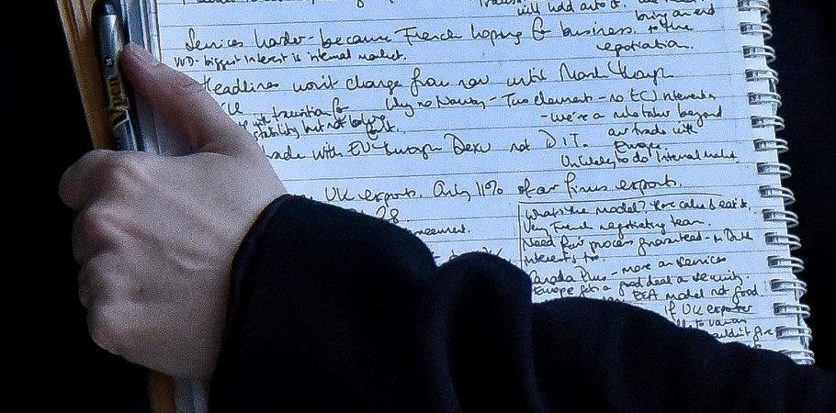
The options available to the UK and EU

Slide 11
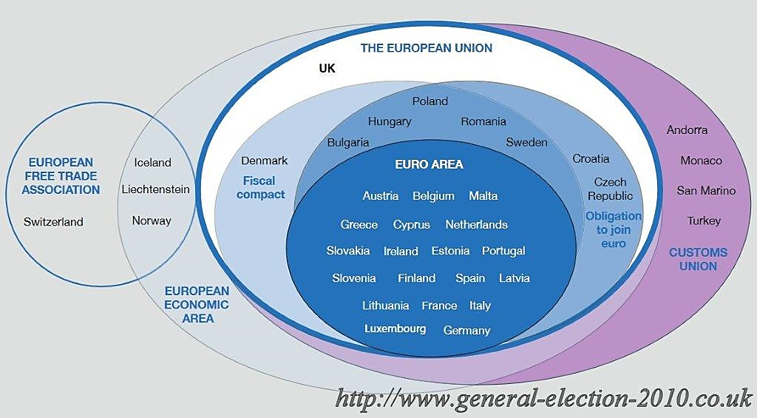
The options available to the UK and EU

Slide 12
The Norwegian EEA / EFTA Model
Sten Foyn, Advokatfirmaet Haavind
––––––

Slide 13
1. Essence of the EEA Agreement
Agreement on an European Economic Area between EU, the EU states and the EFTA states
Main content: Extending the internal market (free movement + competition rules etc) to EFTA states (- Switzerland)
Treaty obligations
Secondary legislation
Employment law: Includes free movement for workers and companies with workers + the bulk of EU employment law

Slide 14
2. Background for the Agreement
EFTA = The European Free Trade Association (1960)
Established at the initiative of UK as a reaction to the too supranational EEC (EU)
UK left EFTA and joined the EU in 1973
EEA Agreement (Agreement on the European Economic Area), 1992
1989: EEC offered the (remaining) EFTA states a more structured partnership = agreement on the internal market
EFTA = Austria, Switzerland, Finland, Norway, Sweden, Iceland and Liechtenstein
Austria, Finland and Sweden joined the EU in 1995
Switzerland declined to be a part of the EEA
The EEA Agreement therefore only comprises EU (states) + Norway, Iceland and Liechtenstein

Slide 15
3. Could the EEA Agreement serve as a model for UK relations to the EU?
In general?
On employment law?
As a temporary solution?

Slide 16
4. Institutional framework
In principle not a supranational agreement (i.a. not direct effect)
1. EEA Council and Commitee: adopts new EU legislation if «EEA relevant»
Several thousand regulations and directives have been adopted in the EFTA Countries
Unanimity principle (= «veto» right for each EFTA state, but not exercised in practice)
2. EFTA Court (corresponding to the ECJ):
Aim: Similar interpretation of the EEA Agreement in EU and in the EFTA Countries
If not, options = A) suspension of relevant parts of agreement, B) protective measures
3. EFTA Surveillance Agency (corresponding to the Commission)

Slide 17
5. Consequences of the EEA Agreement for national employment law (1/2)
EU principles of free movement are at the core of the EEA Agreement
Employees
Companies with employees, temporary cross board activities = freedom of service
Companies with employees, permanent cross boarder activities = right of establishment
Not permitted to limit EU immigration related to these freedoms
Protective measures can be implemented, but only in case of serious (and durable) economic, societal or environmental problems

Slide 18
5. Consequences of the EEA Agreement for national employment law (2/2)
EU labour legislation applies in Norway, Iceland and Liechtenstein
Legislation is interpreted in line with jurisprudence from ECJ (EFTA Court practice is sparse)
Parts of the EU employment legislation/principles are not part of the EEA Agreement, e.g.
EU Framework Directive on Discrimination
EU Charter of Fundamental Rights

Slide 19
6. EEA Agreement: is it an option for the UK?
PROS:
Secures being part of (most of) the internal market, without being a EU member, and whilst formally keeping national sovereignty
CONS (areas where the EEA Agreement clashes with the main aims of the UK Government, ref Theresa May’s speech 17 January 2017)
No voting rights on new EU (employment) legislation. Veto right in EEA can in practice only be invoked exceptionally. A significant part of Norwegian legislation is made in Brussels, not in Oslo (″Leaving the European Union will mean that our laws will be made in Westminster, Edinburgh, Cardiff and Belfast″)
A duty to seek uniform interpretation with EU (ECJ) and be subject to the EFTA Court (″So we will….bring an end to the jurisdiction of the European Court of Justice in Britain.. ″)
Not possible to limit immigration from EU countries (″And that is why we will ensure we can control immigation to Britain from Europe″)
Financial contributions to the EU (for Norway appr. 400 million Euro yearly) (″The days of Britain making vast contributions to the European Union every year will end″)

Slide 20
7. Final comments / questions
EEA agreement has, despite its inherent democratic deficiencies, large support in Norway due to a lot of factors which are specific to Norway
How can the UK...
keep a sovereign Parliament;
ensure freedom of interpretation for national courts;
control immigration; and
stop payments to Brussels,
whilst at the same time obtain a satisfactory access to the internal market?

Slide 21
The Swiss EFTA Model and how it is derailed
Balz Gross, Homburger
––––––

Slide 22
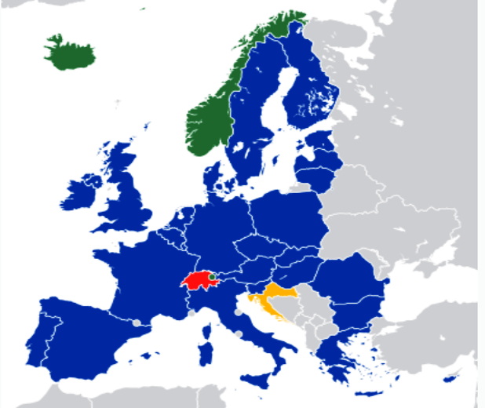
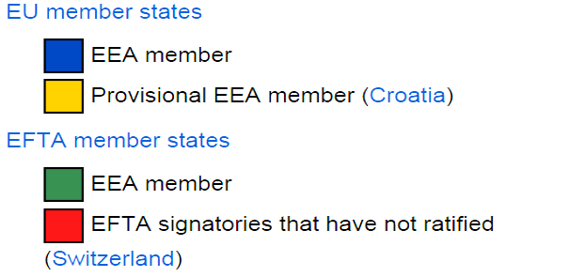
1. EEA and the Swiss model today

Slide 23
2. Bilateral agreements Switzerland – EU
Free Trade Agreements EFTA – EU EEA (Norway, Iceland, LI)
1992
Bilateral Bilateral Agreements I Agreements II
1972 CH
1999 2004 ...

Slide 24
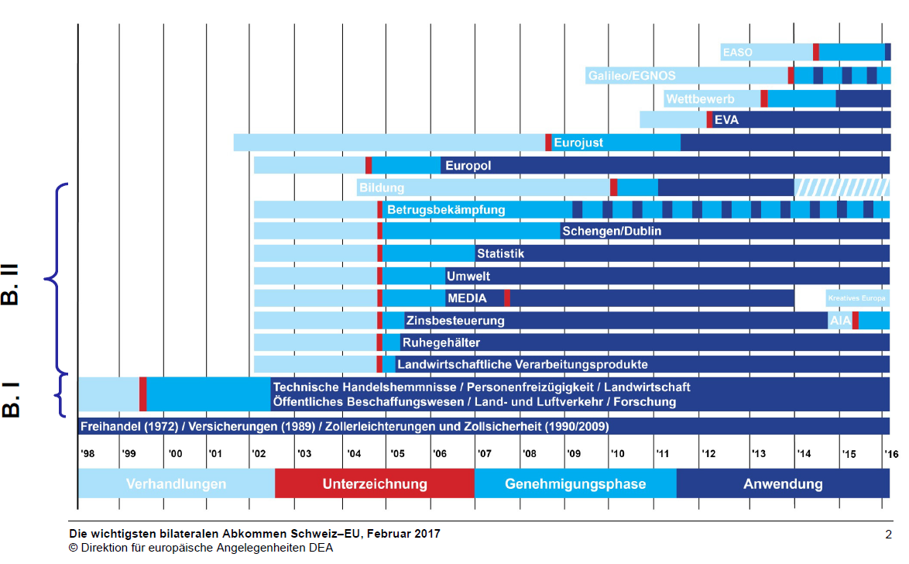
3. Overview over bilateral agreements

Slide 25
3. Overview over bilateral agreements
European employment and bilateral agreements
1999: Bilateral Agreements I (Free Movement of Persons, etc.)
2004: Bilateral Agreements II (Schengen, etc.)
2010: Agreements on Education, etc.
2011: Agreements Designations of Origin, etc.
Etc.
no supranational court, no decision making body
joint committees; consensus required
But: No European Employment Law (but free movement of persons, social security coordination)

Slide 26
4. Status today
No European Employment Law shall be taken over
EU requests institutional framework for additional cooperation
dynamic acceptance of new EU regulation
EU court decides interpretation of EU law and on interpretation of agreements
Swiss vote against mass immigration

Slide 27
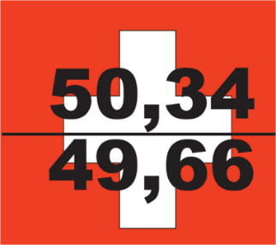
5. Swiss vote against mass immigration
Referendum against "Light National Preference" launched by a private citizen does not reach the required number of signatures
April 7, 2017
Entry into force of "Light National Preference"
Date unknown
(ca. January 2018)
Cancellation of CH-EU|EFTA Treaty on Free Movement would trigger lapse of all EU-CH bilateral treaties
Majority of Swiss electorate accepts the initiative
February 9, 2014
July 25, 2011
Swiss People's Party launches initiative
"Against Mass Immigration"
December 22, 2016
Swiss parliament adopts the "Light National Preference" (amendment to Immigration Act) to implement the initiative: preference of Swiss residents on domestic job market
Art. 121a Swiss Constitution:
"The number of residence permits for foreign nationals in Switzerland shall be restricted by annual quantitative limits and quotas. [...]."

Slide 28
5. Swiss vote against mass immigration
Protracted implementation negotiations
Initiative would limit the free movement of EU|EFTA workers to Switzerland
This would be a violation of the Treaty of Free Movement → potential cancellation of all bilateral treaties (Guillotine)
On February 26, 2014, in retaliation, the European Commission suspended Switzerland's participation in the EU research and student programs, Horizon 2020 and Erasmus+

Slide 29
5. Swiss vote against mass immigration
"Light National Preference"
Rather than imposing strict limits on EU immigration (quotas), Parliament agreed new rules that will see unemployed domestic workers given preference over EU nationals for jobs in Switzerland:
Employers will be obliged to advertise vacant positions to regional job centres and invite selected Swiss Residents (Swiss nationals or EU nationals already residing in Switzerland) for interview
Employers will not be obliged to justify why they refuse a Swiss candidate
The obligation will only apply in professions, job sectors or regions where unemployment is above average
If these measures do not work, affected regions may propose further measures to Parliament.
Europeans losing their job within the first year of their stay in Switzerland will have six months to leave Switzerland

Slide 30
Customs Union Only Model or No Deal
Joan Cradden, Brodies LLP
––––––

Slide 31
1. The cliff edge....
The Great Repeal Bill:
Repeals the European Communities Act 1972
Converts all other existing EU derived legislation into UK law as it stands (the Acqui)
Powers to amend where necessary to make the legislation ″work″
What will happen to existing case law?
UK courts will be bound by existing ECJ rulings
Future ECJ rulings will not be binding
Divergence over time as both UK law and ECJ rulings change

Slide 32
2. Political/economic influences
Unlikely to see significant change in the short term?
The current Conservative Government has made a move to the centre ground
High levels of political rhetoric around protection of workers rights
Labour law rights are not centre stage in FTAs but they are a feature
Businesses are on the whole not calling for a release from European red tape
Continued uncertainty over the future of the relationship with the EU will mean that there is no wish to talk about divergant schemes of employment protection

Slide 33
3. The European derived rights which might come under attack..
The legislation considered to be unpopular with employers:
The Working Time Regulations (esp holiday pay calculations)
The Agency Worker regulations (seen as a restriction on freedom to contract with workers and flexible employment requirements)
TUPE (esp the question of the ability to change terms and conditions of employment after a regulated transfer)
Potential limit on compensation for discrimination
Collective consultation on redundancy
Government have, however, said that they will follow ECJ principles on holiday pay
GDPR will have to be complied with before Brexit

Slide 34
3. ISSUES TO CONSIDER IN THE NEGOTIATIONS
––––––

Slide 35
The view from France
Katell Deniel-Allioux, Dentons
––––––

Slide 36
Issues to consider in the negotiations
Key negotiating issues:
How will judgments be enforced if Brussels 1 Recast Regulation no longer applies in the UK? – Balz Gross
What happens to EEA nationals in the UK and vice versa? – Joan Cradden
What happens to EU-dervived legislation in the UK? What status will ECJ judgments have? – Sten Foyn
What are the implications for cross-border transfers? – Katell Deniel-Allioux

Slide 37
How will judgments be enforced?
Judgments
Brussels I Recast Regulation no longer applies.
Transitory arrangements to be negotiated between UK and EU.
UK options:
continued application of Brussels I Recast Regulation regime (unlikely)
accession to Lugano Convention; lengthy ratification process (?!)
In addition: Accession to the Choice of Court Agreements Convention
Other Issues
No change re Arbitral Awards: 1958 New York Convention applies post-Brexit
UK already a member of the Hague Conventions (replace service of documents and evidence taking EU law)

Slide 38
4. QUESTIONS & DISCUSSION
––––––

