Slide 3
MODERN TECHNOLOGY AT THE WORKPLACE - from „Swiss Army Knife“ to technology stress
––––––

Slide 4
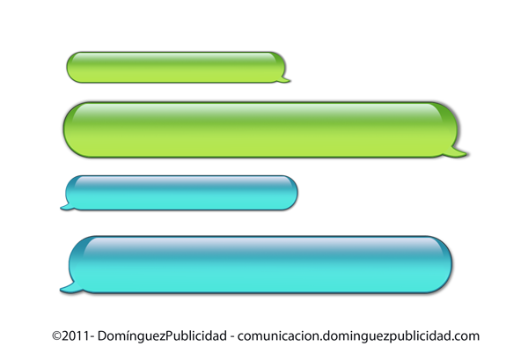



SPEAKERS
Åsa, please call John on +44 974 323 401.
Urgent. Relates to hearing.
Session Leader
Åsa Erlandsson Setterwalls, Sweden
Session Speakers
Eva Knipschild Kennedy Van der Laan, the Netherlands
Anne Morel Bonn Steichen, Luxembourg
Dr. Med. Samuel Iff State Secretariat for Economic Affairs SECO, Occupational Health Section, Switzerland
Mamma, när kommer du hem?
Deliviery for Åsa – please pick up as quicky as you can. We have loads of your stuff down here.
/Conference team

Slide 5
THE CHALLENGE OF MODERN TECHNOLOGY
Help or hinder?
A wonderful possibility for employers and employees, helping us in the work life?
But also a cause of stress?
How can we ensure that modern technology is not a danger gouds but a good and useful tool in work life?

Slide 6

DO WE HAVE A PROBLEM?

Slide 7



NEW WAYS OF WORKING („NWW“)
Work flexibility
  When to work (time, schedule flexibility)
  Where to work (place, telecommuting)
  How to work (extensive use of information and communication technology: new media, smartphone, e-mail, video conference)
  Performance based management
    Emphasis on output (as opposed to face time)

Slide 8
DOES YOUR WORK INVOLVE WORKING WITH ICT?
DO YOU GET INTERRUPTED FREQUENTLY AT WORK?
https://www.eurofound.europa.eu/surveys/data-visualisation/sixth-european-working-conditions-survey-2015

Slide 9
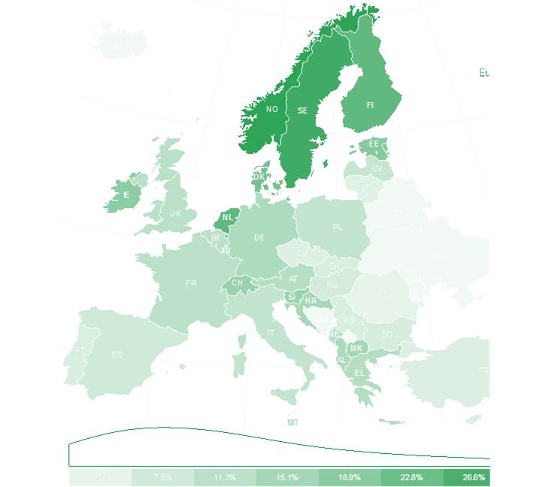
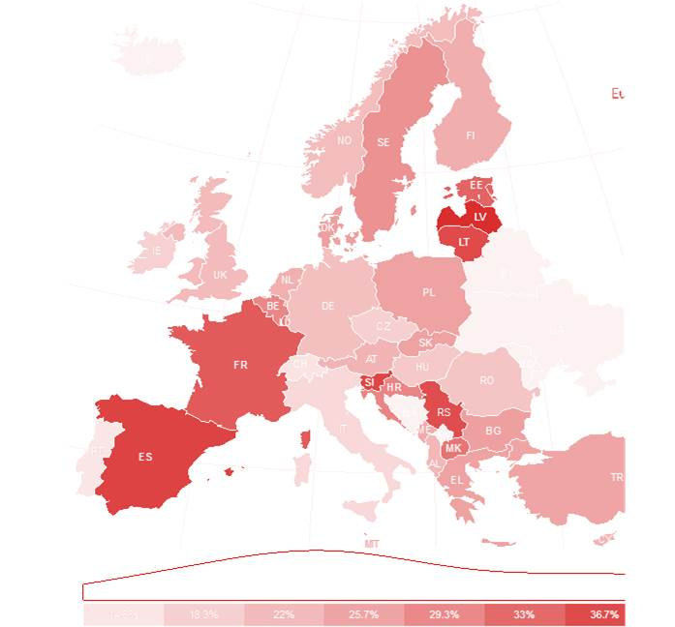
DOES YOUR WORK AFFECT YOUR HEALTH?
https://www.eurofound.europa.eu/surveys/data-visualisation/sixth-european-working-conditions-survey-2015

Slide 10


NWW FOR INDIVIDUALS
Plus
Increased productivity
Enhanced collaboration
Improved responsiveness
Availability of real time information
Faster decision making
Flexibility with work schedules
Minus
Information overload
Pressure to respond quickly
Unanticipated tasks
Interruptions and task switching
Diverse role demands
Lack of control over incoming messages
Extension of worktimes

Slide 11

THE LEGISLATIVE ENVIRONMENT

Slide 12
Some examples (from international to local)
ILO Standards
ILO core Convention on Occupational Safety and Health, 1981 (No. 155 and Rec No. 164)
Occupational Health Services Convention, 1985 (No. 161 and Rec No. 171)
European Standards
The Framework Directive on Safety and Health at Work (89/391/EEC)
The Framework Directive on the minimum safety and health requirements for work with display screen equipent (90/270/EEC)
EU Directive on prevention from sharp injuries in the hospital and healthcare sector (2010/32/EU)
Country specific legislation, for example
The Netherlands
France (the right to disconnect, „Droit à la déconnexion“, in force on January 1, 2017)

Slide 13

WHAT CAN WE DO ABOUT IT - PRACTICALLY?

Slide 14
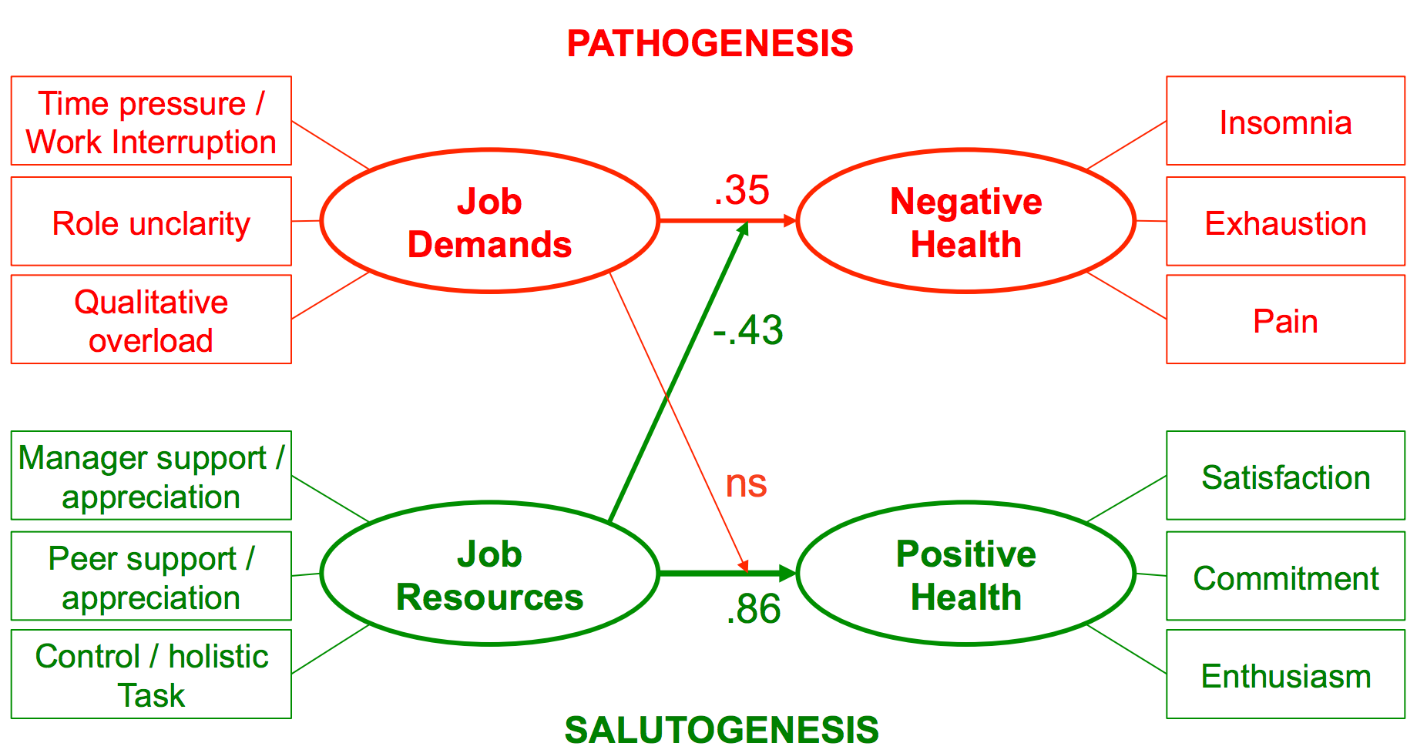
JOB DEMANDS ./. RESOURCES MODEL

Slide 15
PSYCHOLOGICHAL DEMANDS AT WORK

Slide 16
THE DOCTOR‘S PRESCRIPTION
Set clear boundaries (time/place) of work
  Create „sanctuaries“
  Stop interruptions
Communicate demands clearly
  Performance over presence
  Create „sanctuaries“
Protect employees
  Legal obligation upholds

Slide 17
THIS IS WHAT SOME COMPANIES HAVE DONE:
The „compulsory“ approach, for example:
  Volkswagen: no e-mails on nights and weekends
  Intel: four hours „quite time“ every week
  Nielsen: Disable the „reply-to-all“-function
The „softer“ approach, for example:
  La Poste: no disciplinary action when employee does not respond to e-mail outside office hours
  Orange: managers must organize physical meetings where digital tools are not used

Slide 18


SOME GENERAL ADVICE TO TAKE HOME
To the management
Spread the knowledge on why rules and policies for the use of technology is important!
Introduce mobile free meetings
Introduce silent mobiles as standard
Avoid mobile calls in open plan offices
Define expectations on availability
Encourage employees to use the technical solutions that are available at the workplace to handle and sort information
To the individual employees
Shut off the mobile and other technology during meetings
Shut off all sounds on mobiles, computers etc during working time
Block distracting pop-up-windows, push-notes etc in computer and mobile
Go away when you are making or receiving a phone call
Introduce fixed, individually designed, times for e-mail, text messages and phone calls
Step away from technology completely for a while every day. Your brain needs rest to perform!

