Slide 1
Recent cases in EU employment law

Slide 2
topics
Personal scope/status
Working time directive
  What is working time?
  Exceptions
  Discrimination law
    Religion
    Other cases
  Posted Workers

Slide 3
Personal scope

Slide 4
Who is a worker?
Extensive case law originating under Article 45 TFEU
This has been rolled out to EU social policy Directives eg Working Time Dir. 2003/88
Also note Art. 4(5) of the Enforcement Directive 2014/67
  The elements that are referred to in this Article used by the competent authorities in the overall assessment of a situation as a genuine posting may also be considered in order to determine whether a person falls within the applicable definition of a worker in accordance with Article 2(2) of Directive 96/71/EC. Member States should be guided, inter alia, by the facts relating to the performance of work, subordination and the remuneration of the worker, notwithstanding how the relationship is characterised in any arrangement, whether contractual or not, that may have been agreed between the parties
Change in burden or proof down the line: COM(2021)762

Slide 5
proposed platform work directive
Article 4
Legal presumption
1. The contractual relationship between a digital labour platform that controls, within the meaning of paragraph 2, the performance of work and a person performing platform work through that platform shall be legally presumed to be an employment relationship. To that effect, Member States shall establish a framework of measures, in accordance with their national legal and judicial systems.

Slide 6
Art. 4(2) of Proposed platform work directive
Controlling the performance of work within the meaning of paragraph 1 shall be understood as fulfilling at least two of the following:
(a) effectively determining, or setting upper limits for the level of remuneration;
(b) requiring the person performing platform work to respect specific binding rules with regard to appearance, conduct towards the recipient of the service or performance of the work;
(c) supervising the performance of work or verifying the quality of the results of the work including by electronic means;
(d) effectively restricting the freedom, including through sanctions, to organize one’s work, in particular the discretion to choose one’s working hours or periods of absence, to accept or to refuse tasks or to use subcontractors or substitutes;
(e) effectively restricting the possibility to build a client base or to perform work for any third party

Slide 7
Case C-147/17 Sindicatul
41 For the purpose of applying Directive 2003/88, the concept of ‘worker’ may not be interpreted differently according to the law of Member States but has an autonomous meaning specific to EU law. It must be defined in accordance with objective criteria which distinguish the employment relationship by reference to the rights and duties of the persons concerned. The essential feature of an employment relationship, however, is that for a certain period of time a person performs services for and under the direction of another person in return for which he receives remuneration...
42 It follows that an employment relationship implies the existence of a hierarchical relationship between the worker and his employer. Whether such a relationship exists must, in each particular case, be assessed on the basis of all the factors and circumstances characterising the relationship between the parties. ..

Slide 8
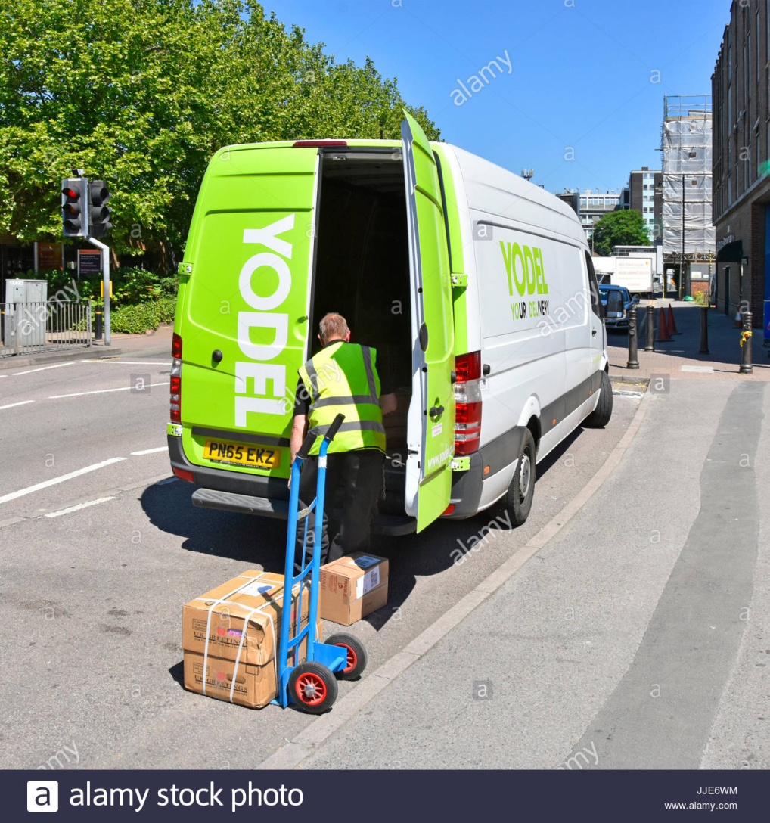
Case C-692/19 Yodel

Slide 9
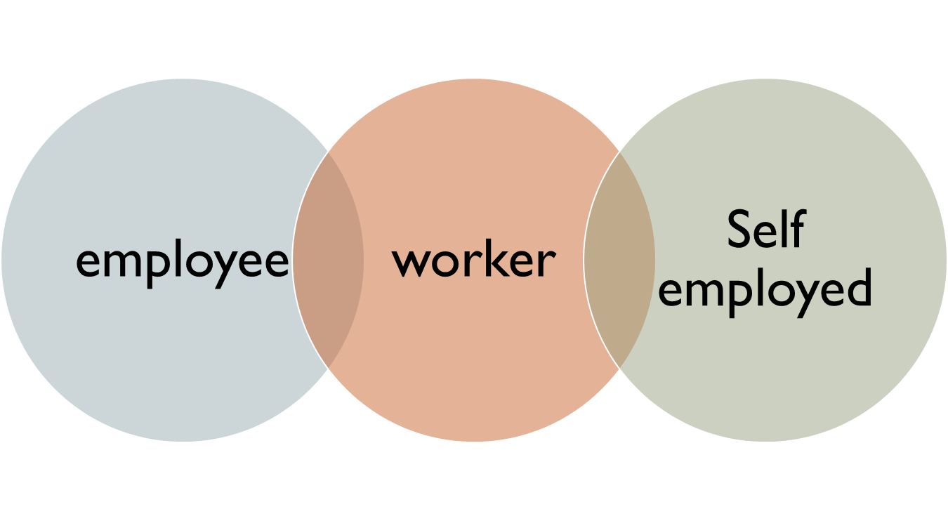
The two systems
bipartite
tripartite
Employee/
worker
Self-employed

Slide 10
Who is a worker under EU law?
concept has an autonomous meaning specific to EU law (C-147/17 Sindicatul Familia Constanţa) [41].
in order to determine to what extent a person carries on his activities under the direction of another, base that classification on objective criteria and make an overall assessment of all the circumstances of the case brought before it, having regard both to the nature of the activities concerned and the relationship of the parties involved (C-428/09 Union syndicale Solidaires Isère [29].
‘an employment relationship implies the existence of a hierarchical relationship between the worker and his employer, the issue whether such a relationship exists must, in each particular case, be assessed on the basis of all the factors and circumstances characterising the relationship between the parties’ (Sindicatul Familia Constanța [42]).
‘the essential feature of an employment relationship is that for a certain period of time a person performs services for and under the direction of another person in return for which he receives remuneration (C‑316/13 Fenoll [27]).

Slide 11
Yodel: ruling
The Working Time Directive 2003/88 precluded a person engaged by his putative employer under a services agreement which stipulated that he was a self-employed independent contractor from being classified as a ‘worker’ for the purposes of that directive, where that person was afforded discretion:
to use subcontractors or substitutes to perform the service which he has undertaken to provide;
to accept or not accept the various tasks offered by his putative employer, or unilaterally set the maximum number of those tasks;
to provide his services to any third party, including direct competitors of the putative employer, and
to fix his own hours of ‘work’ within certain parameters and to tailor his time to suit his personal convenience rather than solely the interests of the putative employer,
provided that, first, the independence of that person was not fictitious and, second, it was not possible to establish the existence of a relationship of subordination between that person and his putative employer.

Slide 12
Summary
worker
Direction
subordination
Self-employed
more leeway in terms of choice of the type of work and tasks to be executed
of the time, place, quantity of work, and more freedom in the recruitment of his own staff (incl. ability to delegate)
Provided this is not a sham
of the manner in which that work or those tasks are to be performed,
Freedom to work for third parties
control/ hierarchy

Slide 13
Case C-413/13 FNV Kunsten Informatie en Media (KIEM)
if the self-employed do not determine independently their own conduct on the market, but are entirely dependent on their principal, because they do not bear any of the financial or commercial risks arising out of the latter’s activity and operated as an auxiliary within the principal’s undertaking, they may be considered as ‘false self-employed’ and thus workers within the meaning of EU law. [41]

Slide 14
Working time Directive 2003/88

Slide 15
Relevant provisions
Arts. 1 and 2 WTD 2003/88
Art. 2 OSHFD 89/391 especially Art. 2(2) first and second subparagraphs (Art. 1(4) WTD refers)
Art 4(2) TEU
Arts 31 and 52 Charter

Slide 16
What is working time (1)?
Case C-344/19 D. J. v Radiotelevizija Slovenija
Article 2(1) means that a period of stand-by time according to a stand-by system, during which the worker is required only to be contactable by telephone and able to return to his or her workplace, if necessary, within a time limit of one hour, while being able to stay in service accommodation made available to him or her by his or her employer at that workplace, without being required to remain there, does not constitute, in its entirety, working time within the meaning of that provision,
unless an overall assessment of all the facts of the case, including the consequences of that time limit and, if appropriate, the average frequency of activity during that period, establishes that the constraints imposed on that worker during that period are such as to affect, objectively and very significantly, the latter’s ability freely to manage, during the same period, the time during which his or her professional services are not required and to devote that time to his or her own interests.
The limited nature of the opportunities to pursue leisure activities within the immediate vicinity of the place concerned is irrelevant for the purposes of that assessment.

Slide 17
What is working time (2)?
Case C‑214/20 MG v Dublin City Council (retained firefighters)
  Article 2(1) of Directive 2003/88 defines the concept of ‘working time’ as ‘any period during which the worker is working, at the employer’s disposal and carrying out his activity or duties’. In Article 2(2) of that directive, the concept of ‘rest period’ is defined negatively as any period which is not working time. Those two concepts being mutually exclusive
  a period of stand-by time according to a stand-by system served by a retained firefighter, during which that worker, with the permission of his or her employer, carries out a professional activity on his or her own account but must, in the event of an emergency call, reach his or her assigned fire station within 10 minutes, does not constitute ‘working time’ within the meaning of that provision if it follows from an overall assessment of all the facts of the case … that the constraints imposed on the said worker during that period are not of such a nature as to constrain objectively and very significantly the ability that he or she has freely to manage, during the said period, the time during which his or her services as a retained firefighter are not required

Slide 18
Art. 2(2), first sub para Exceptions: summary
Total exception
Seafarers (Art. 1(3) WTD)
Qualified exception: in such a case the safety and health of the workers must be ensured as far as possible in the light of the objectives of that directive (Art 2(2), second para OSHD
where characteristics peculiar to:
certain specific public service activities, inter alia the armed forces or the police,
or to certain specific activities in the civil protection services,
inevitably conflict with the application of the WTD
Slovene Army case (Case C-742/19 BK)
that all military personnel called upon to assist in operations involving a military commitment by the armed forces of a Member State, whether they are deployed, permanently or on a temporary basis + trainees
Art 2(2), first para OSHD

Slide 19
C‑147/17 Sindicatul: Public service
‘Public service’
EU approach
Other matters
Public service or private service contracted out to public service
Functional not institutional approach

Slide 20
General questions: Case C‑211/19 UO
1. Does the activity come within the scope of public service? If yes
2. Does the activity present certain specific features as compared with other activities coming within the scope of the public service in general or of law enforcement in particular? If yes
3. Do the characteristics peculiar to that specific public service activity inevitably conflict with the application of WTD, in view of the absolute need to guarantee effective protection of the community at large?
not possible to plan the working time [‘planning requirement’] or
must be continuous in order to ensure the effective performance of essential functions of the State [‘continuity requirement’]
Normal operations
Exceptional operations

Slide 21
Art. 2(2), first para
Art. 2(2), first para OSH
Public service activities
(eg armed forces or police) cf Sindicatul
Characteristics of activity inevitably conflict with it
Certain specific activities in civil protection services
Planning requirement
Continuity requirement
Normal operations
Exceptional operations/events
(grave natural or technological disasters, attacks or serious accidents)
WTD will usually apply (cf Sindicatul)
WTD n/a for duration of crisis

Slide 22
Continuity requirement: Case C‑211/19 UO
normal operations, even of those services requiring 24 hour a day cover such as of public health, public security and public order.
exceptional events, such as natural or technological disasters, attacks or serious accidents,
WTD will apply,
unless by the very nature of the activities it is absolutely incompatible with the planning of working time in a way that respects the requirements imposed by WTD [see Sindicatul, Slovene army case]
the gravity and scale of these events require the adoption of measures indispensable for the protection of the life, health and safety of the community at large, measures the proper implementation of which would be jeopardised if all the rules laid down in WTD had to be observed. Such circumstances justify absolute priority being given to the objective of protecting the population, to the detriment of compliance with the provisions of Directive 2003/88, which may be temporarily disregarded within those services.
Exception applies and the substance of the WTD does not apply
At issue in UO –for national court to decide on the facts

Slide 23
Case C-742/19 BK (Slovene army case) exception
77. it should be noted that all military personnel called upon to assist in operations involving a military commitment by the armed forces of a Member State, whether they are deployed, permanently or on a temporary basis, within its borders or outside of those borders, carry out an activity which, pursuant to Article 1(3) of Directive 2003/88, read in conjunction with the first subparagraph of Article 2(2) of Directive 89/391, and in the light of Article 4(2) TEU, must, by its very nature, be excluded in its entirety from the scope of Directive 2003/88.
78 Compliance with the requirements laid down by Directive 2003/88 in the course of those operations would put at considerable risk the success of those operations, that success being predicated on the total commitment, over long periods, of the members of the armed forces involved, and would consequently also put at considerable risk the proper performance of the essential functions of safeguarding national security and preserving the territorial integrity of the Member States.
79 [Exclusion applies] for the duration of those operations.
+ trainees: ‘all activities which form either part of the initial training of military personnel – and compulsory military service, which must receive the same treatment – or part of the operational training which members of the armed forces are subsequently required to perform regularly’

Slide 24
Discrimination law: Directive 2000/78

Slide 25
Overview: the principle of non-discrimination in Dir 2000/78
Measure, policy, practice
Direct discrimination
Indirect discrimination
ORs
ORs
Proportionate means of achieving a legitimate aim (Objective justification)
General OR
(Art. 4(1))
Ethos based employer OR (Art. 4(2))

Slide 26
Judgment of the Court
Issues | Case C–157/15 Achbita | Case C-188/15 Bougnaoui | C-804/18 IX and C-541/19 MJ WABE
Meaning of religion | Dir covers forum internum (the fact of having a belief) and forum externum (manifestation of belief) | Repeated [30] | Religious beliefs and philosophical or spiritual beliefs ‘On’ grounds of religion; also covers discrim between religions less favourable treatment must be ‘as a result of the R or B’
Direct discrimination | Not an issue here: no evidence that the rule was applied differently to A as compared to any other worker [28] | Question not clear | May be: MJ (large conspicuous signs)
Indirect discrimination | May be [28] | Question not clear | May be: IX (policy applied neutrally)

Slide 27
Issues | ECJ in Achbita | ECJ in Bougnaoui | ECJ in WABE
Objective justification v Art. 4(1) | Objective justification Legitimate aim – policy of neutrality must be considered legitimate (see also Art. 16 Charter. Eweida) [38-9] Proportionality: Appropriate – yes, if applied in consistent and systematic manner (for the national court) Is provision limited to what is strictly necessary? For national court to decide but… | Answered Art. 4(1) qu; only qu referred: ‘the willingness of an employer to take account of the wishes of a customer no longer to have the services of that employer provided by a worker wearing an Islamic headscarf cannot be considered a genuine and determining occupational requirement within the meaning of that provision | Objective justification - need to be interpreted strictly; Legitimate aim – policy of neutrality may be considered legitimate (see also Art. 16 Charter), provided (i) policy meets genuine need on the part of the business [64]; balancing with rights of others (eg Art. 14) and see if business would suffer and (ii) policy applied in ‘consistent and systematic’ manner (appropriate); and (iii) limited to what is strictly necessary (ii) and (iii) carried out in such a way as to balance all competing interests/FHR

Slide 28
Other cases
Case C-587/20 A:
  Article 3(1)(a) and (d) of Council Directive 2000/78/EC of 27 November 2000 means that an age limit laid down in the statutes of an organisation of workers for eligibility to stand as sector convenor of that organisation falls within the scope of that directive.
Case C-389/20 TGSS
  Spanish legislation excluding domestic workers from unemployment benefit while
  they are almost exclusively women is contrary to EU law. That exclusion constitutes indirect discrimination on grounds of sex as regards access to social security benefits which could not be justified

Slide 29
Other cases: disability
Case C-485/20 XXXX
  the concept of ‘reasonable accommodation’ for disabled persons [Art. 5 of Dir 2000/78] requires that a worker, including someone undertaking a traineeship following his or her recruitment, who, owing to his or her disability, has been declared incapable of performing the essential functions of the post that he or she occupies, be assigned to another position for which he or she has the necessary competence, capability and availability, unless that measure imposes a disproportionate burden on the employer
Case C-795/19 XX
  Arts 2(2)(a), 4(1) and 5 o must be interpreted as precluding national legislation which imposes an absolute bar to the continued employment of a prison officer whose auditory acuity does not meet the minimum standards of sound perception prescribed by that legislation, without allowing it to be ascertained whether that officer is capable of fulfilling those duties, where appropriate after the adoption of reasonable accommodation measures for the purposes of Article 5 of that directive.

Slide 30
Posted workers

Slide 31
Article 1(3): performance of work by an undertaking on its own account and under its direction
(a) post workers to the territory of a Member State on their account and under their direction, under a contract concluded between the undertaking making the posting and the party for whom the services are intended, operating in that Member State, provided there is an employment relationship between the undertaking making the posting and the worker during the period of posting;
worker
Posting company
Client company in host state
Employment
relationship
Commercial contract

Slide 32
Case C-16/18 Dobersberger
Article 1(3)(a) … does not cover the provision, under a contract concluded by an undertaking established in a Member State and an undertaking established in another Member State, which is contractually linked to a railway undertaking established in that same Member State, of on-board services, cleaning or food and drink services for passengers carried out by salaried employees of the first undertaking, or by workers hired out to it by an undertaking also established in the first Member State, on international trains crossing the second Member State, where those workers carry out a significant part of the work inherent in those services in the territory of the first Member State and where they begin or end their shifts there.

Slide 33
Transport workers? Case C-815/18 FNV
45 A worker cannot, in the light of Directive 96/71, be considered to be posted to the territory of a Member State unless the performance of his or her work has a sufficient connection with that territory (see, to that effect, judgment of 19 December 2019, Dobersberger, C‑16/18, EU:C:2019:1110, paragraph 31), which presupposes that an overall assessment of all the factors that characterise the activity of the worker concerned is carried out.
46 In that regard, it is important to note that the existence of such a connection with the territory concerned may become apparent inter alia from the characteristics of the provision of services to which the worker in question has been assigned. The nature of the activities carried out by that worker in the territory of the Member State concerned also constitutes a relevant factor for the purposes of determining whether such a connection exists.
47 As regards mobile workers such as drivers working in international road transport, the degree of connection between the activities carried out by such a worker, in the framework of the provision of the transport service to which that worker has been assigned, and the territory of each Member State concerned is also relevant for those purposes.
48 The same is true of the proportion represented by those activities in the entire service provision in question. In that regard, operations involving loading or unloading goods, maintenance or cleaning of transport vehicles are relevant provided that they are actually carried out by the driver concerned, and not by third parties.
49 By contrast, a worker who provides very limited services in the territory of the Member State to which that worker is sent cannot be regarded as ‘posted’ within the meaning of Directive 96/71 (see, to that effect, judgment of 19 December 2019, Dobersberger, C‑16/18, EU:C:2019:1110, paragraph 31). This applies to a driver who, in the course of goods transport by road, merely transits through the territory of a Member State. The same would also be true of a driver carrying out only cross-border transport operations from the Member State where the transport undertaking is established to the territory of another Member State or vice versa.
50 Moreover, the fact that a driver working in international road transport, who has been hired out by an undertaking established in one Member State to an undertaking established in another Member State, receives the instructions related to his or her tasks, starts or finishes them at the place of business of that second undertaking is not sufficient in itself to consider that that driver has been ‘posted’ to the territory of that other Member State, provided that the performance of that driver’s work does not have a sufficient connection with that territory on the basis of other factors.

Slide 34
Transport workers? Case C-815/18 FNV (cont’d)
62. .. that cabotage operations take place entirely within the territory of the host Member State, which permits the inference that the driver’s performance of his or her work in the course of such operations has a sufficient connection with that territory.
63 It follows that a driver carrying out such transport operations must, as a rule, be regarded as being posted to the territory of the host Member State for the purposes of Article 2(1) of Directive 96/71.

Slide 35
Case C‑33/21 INAIL v Ryan Air
Article 14(2)(a)(i) of Regulation (EEC) No 1408/71 means that the social security legislation applicable to the flight and cabin crew of an airline, established in a Member State, which crew is not covered by E101 certificates and which work for 45 minutes per day in premises intended to be used by staff, known as the ‘crew room’, which that airline has in the territory of another Member State in which that flight and cabin crew reside and, whichfor the remaining working time, are on board that airline’s aircraft is the legislation of the latter Member State.

