Slide 1
Employee activism and the new world of labour relations

Slide 2
Employee activism and the new world of labour relations
Jean-François Gerard, Freshfields, Belgium
Feliciano F. González Muñoz, Holcim, Switzerland
Olga Melnychenko , PwC, Ukraine
Lisa Salas, DXC, Belgium
Ruud van der Wel, Maersk, The Netherlands

Slide 3
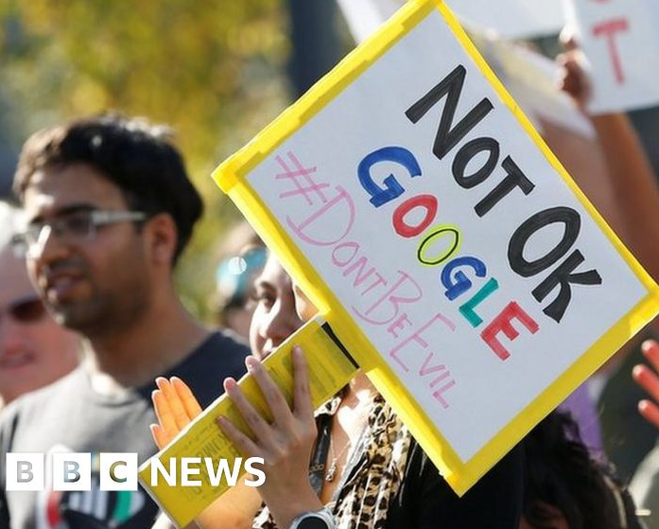
Setting the scene

Slide 4
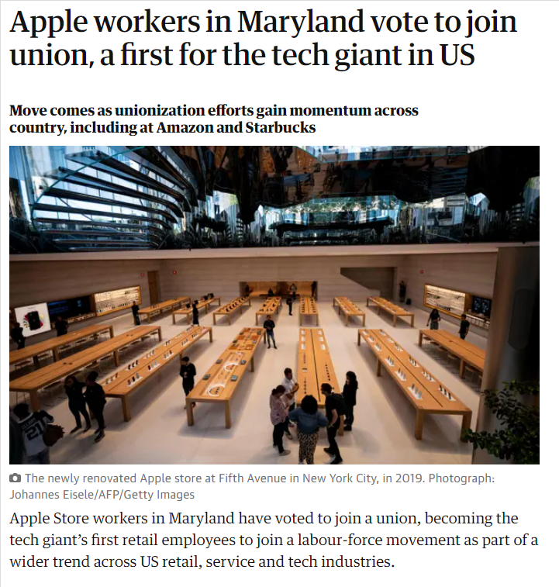
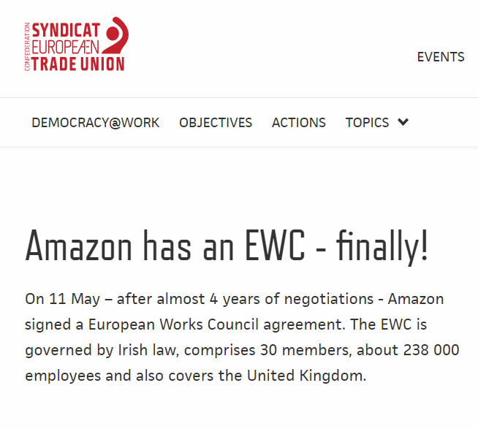
Setting the scene

Slide 5
Setting the scene - trade union density in selected countries

Slide 6
Setting the scene - decline of trade union membership

Slide 7
Employee activism and the new world of labour relations
Employee activism – as in initiatives taking place outside of the traditional trade union movement and any particular legal landscape – is often described as a trend which started in the tech industry. Could you tell us a bit more about this trend and what is happening in tech?
Some people say the emergence of new forms of employee activism is a sign of distrust towards the traditional trade unions. This might be true in countries where trade unions are indeed controlled by the government like in China, but is it true elsewhere?
How about other industries? Have you seen anything similar happening in your respective sectors in terms of different expectations and actions by the younger generations? How are the traditional trade unions reacting to these changes?
Should employers open a separate dialogue with employees on these subjects or try to confine them to more traditional forms of engagement and labour relations? What is the response of the trade union movement?

Slide 8
Employee activism and the new world of labour relations
Employee activism is another sign of the workplace dynamics that don’t feel constrained by any existing legal landscape. First we saw the emergence of GFAs. Now we see employees grouping outside of the traditional/institutional trade union framework. Is this a good sign or a bad sign for the future of labour relations?
How did the Covid pandemic impact labour relations and new trends such as employee activism? How about long-term consequences?
Back to the ESG topic, could you expand on the connections between employee activism and the wider ESG agenda?

Slide 9
Employee activism and the new world of labour relations
What should businesses do when dealing with employee activism?
Make sure you know what is going on. Keep ears to the ground. Pick up the signals and deal with things before they become issues.
Understand the legal regime
Review policies ?
Consider setting up global employee representative bodies ?
Be responsive even if it is to say no
Be consistent
Manage potential retaliation claims
Management skills and capabilities at all levels in the company!

Slide 10
Employee activism and the new world of labour relations
What about retaliation risks and protections for employee activists acting outside of the classic labour relations framework?
Do you see differences between Europe, the US and Asia when it comes to these trends and the future of labour relations?
Can we draw a parallel between this new reality and what is happening within the platform industry with new initiatives such as Commissioner Vestager wanting to open collective bargaining to the self-employed (so no cartel anymore), are labour relations entering a new age?

