Slide 1

ESG IN THE WORKPLACE.
Just a trend or a necessity?

Slide 2

ESG in the workplace.
Just a trend or a necessity?
Almudena Batista - Cuatrecasas, Spain
Emily Martin - Lloyds Banking Group, UK
Soo-Ja Schijf, Kennedy - Van der Laan, Netherlands
Simon McMenemy - Ogletree Deakins, UK
Thomas Bezani - GÖRG, Germany

Slide 3
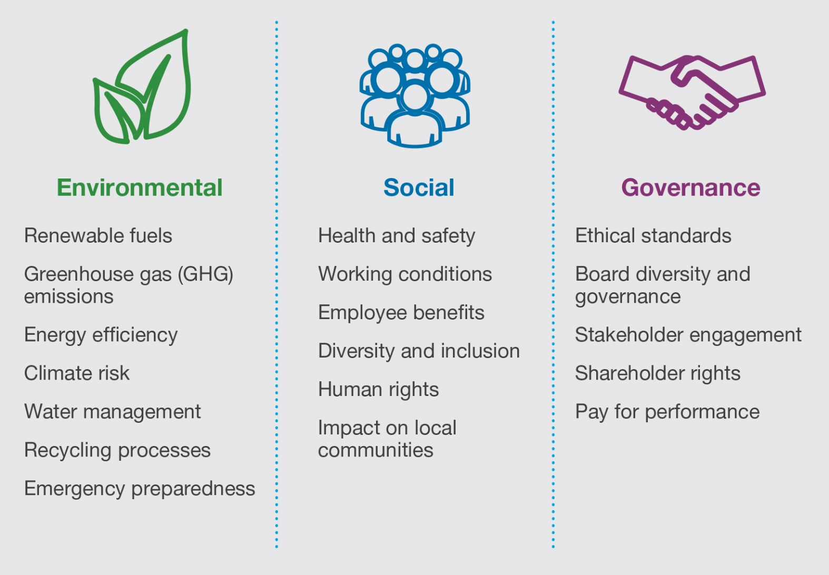
ESG: Introduction

Slide 4

Agenda 2030 and the 17 SDG

Slide 5
EU: 3 Pillars for a sustainable financial framework
Taxonomy: a common classification system to determine what qualifies as a sustainable activity.
  Regulation (EU) 2020/852 of June 18 on the establishment of a framework to facilitate sustainable investment.
  “Green taxonomy”: Taxonomy Climate Delegated Act ((EU) 2021/2139.
  “Social taxonomy”: The Platform of Sustainable Finance released its technical report in February 2020.
Disclosure: mandatory disclosure regime for non-financial and financial companies.
  Non-Financial Reporting Directive: Directive 2014/95/EU of 22 October 2014.
  Corporate Sustainability Reporting Directive (CSRD) on April 21, 2021.
Investment tools: the set of benchmarks, standards and labels that provide greater transparency and mitigate the risk of greenwashing or social washing.
  Regulation (EU) 2019/2089 of 27 November 2019.

Slide 6
Proposal for a Directive on corporate sustainability due diligence
Scope:
  EU companies:
    Group 1: 500+ employees and net EUR 150 million+ turnover worldwide.
    Group 2: 250+ employees and net EUR 40+ million turnover worldwide and operating in defined high impact sectors, e.g., textiles, agriculture, extraction of minerals.
  Non-EU companies active in the EU with turnover threshold aligned with Group 1 and 2, generated in the EU.
Obligations:
  Integrate due diligence into policies.
  Identify actual or potential adverse human rights and environmental impacts.
  Prevent or mitigate potential impacts.
  Bring to an end or minimize actual impacts.
  Establish and maintain a complaints procedure.
  Monitor the effectiveness of the due diligence policy and measures.
  Publicly communicate on due diligence.

Slide 7
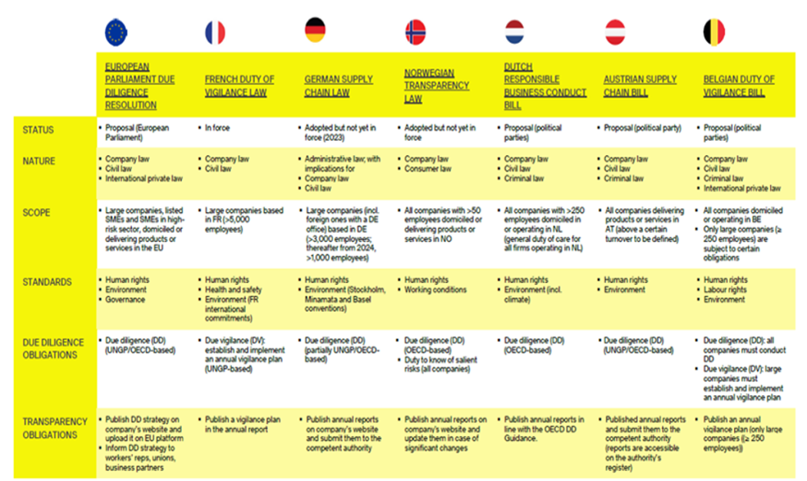
Domestic-corporate due diligence regulations

Slide 8
Other new regulations focused on the “S”
Proposal for a Directive to strengthen the application of the principle of equal pay for equal work or work of equal value between men and women through pay transparency and enforcement mechanisms (March 4, 2021).
Proposal for a Directive on adequate minimum wages in the European Union (October 28, 2020).
Directive (EU) 2019/1152 of 20 June 2019 on transparent and predictable working conditions in the European Union.

Slide 9

Environmental

Slide 10

Social

Slide 11

Governance

