Slide 1
Going Global, Staying Independent or Anything In-Between
The many routes to building a successful international employment law practice

Slide 2
Going Global, Staying Independent or Anything In-Between
Peter Susser, Littler (USA)
Ana Waaralinna, Roschier (Finland)
Pedro Pardal Goulão, MLGTS (Portugal)
Maria Benbrahim, Hogan Lovells (Netherlands)
George Theodosis, Lixouriotis – Theodosis Law Firm (Greece)

Slide 3
George Theodosis – Lixouriotis – Theodosis Law Firm (Greece)
Structural difficulties for an international legal practice in the field of employment law
Greece: a small jurisdiction – an economy based mainly on small and medium-sized companies, not an “exporter” of legal services
The employment law is mainly a “national” – local law
Small firms do not have the resources to promote international strategies or business development
How to get an international footprint?
Education / Training
High quality of work and responsiveness
International Legal Guides (e.g., Chambers, Legal 500)
Cooperation with international law firms
Cooperation with international networks and law firm alliances
Integration vs independence
Social networks/platforms

Slide 4
Peter Susser – Littler (USA)
Background
Historically, a large U.S.-based Labour & Employment Law boutique (today with 1,100 U.S.-based employment lawyers across 50+ offices in the U.S.).
Prior to 2006, greater focus on development of U.S. practice and office footprint; starting in 2006, moved towards development of a U.S.-based team of International employment lawyers
In the following years, we increased our participation in IBA & other International groups, stepped up connections with counterparts in multiple countries, and joined Ius Laboris as the U.S. member for 4+ years
Then focused on development of current International practice, focusing first on the Americas and then – following adoption of a Swiss Verein structure – across Europe, further Latin America development and into Asia.
Current Outlook
As a more mature International practice, we now focus on integrating our team of approximately 500 lawyers in 25 countries outside the U.S., developing work from current and prospective Firm clients, and coordinating our delivery of services and support to a large number of clients – based in the U.S. and around the globe – regarding their International employment law needs.
There is more work to do (always!), but the platform has been producing substantial results, expanding the scope and scale of our International legal work for clients, including those based in Europe, Latin America, Asia & other parts of the world.

Slide 5
Anna Waaralinna, Roschier (Finland)

Slide 6
Pedro Pardal Goulão, MLGTS (Portugal)

Slide 7
Maria Benbrahim, Hogan Lovells (based in The Netherlands)
Hogan Lovells is an American-British law firm co-headquartered in London and Washington, D.C.
Hogan Lovells was formed in 2010 by the merger of the American law firm Hogan & Hartson and the British law firm Lovells
HL employs 2,600 lawyers across 46 offices in the United States, Europe, Latin America, the Middle East, Africa and Asia.
Our full services covers 4 large practices:
Employment, Litigation & Arbitration
Corporate & Finance
Regulatory; and
Intellectual Property Media and Technology.

Slide 8
How Hogan Lovells compares to other global players
Very strong centrally developed business strategy
Strategic themes and partnerships:
Diversity & Inclusion
ESG academy
Advancing racial justice
Empowering women and girls and supporting youth
Supporting innovation in environmental protection and advancing our sustainability goals
In the Netherlands our office is well sized to know everyone, work alongside colleagues who are dedicated, supportive and friendly
100+ employees, 50+ legal staff, 13 partners

Slide 9
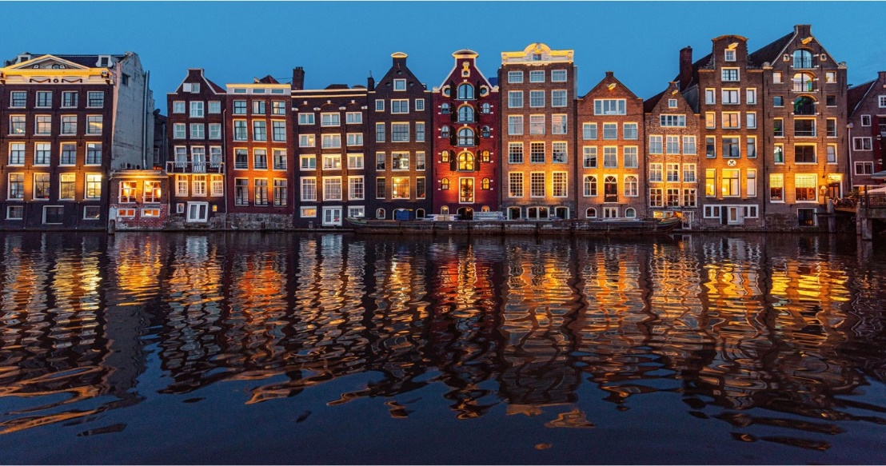
Key Facts: Hogan Lovells in The Netherlands
Amsterdam office has been an integral part of the Hogan Lovells network since 2001. The Netherlands team forms a bridge between Continental Europe and the Americas, Asia and UK.
Ranked in the Top 10 Dutch law firms with the most women partners and women lawyers.
Advising Dutch and international (Fortune 500) clients who benefit from the favourable business climate in The Netherlands by combining strong local expertise with sector knowledge and international know-how.
Multiple tier one rankings in all major legal directories such as Chambers, Legal 500.
Full service. Focus on:
Employment
Privacy and Cybersecurity
IT
M&A
Private Equity
Capital Markets
Banking and Finance
Life Sciences

Slide 10
How does the firm work internationally?
The firm has defined principles to which all associates adhere worldwide:
Clients come first
Excellence in all we do
One team worldwide
Commitment to our firm’s success
Good citizenship
There is one central – international – infrastructure for business services, compliance, conflict checks, matter administration, marketing, knowledge management etc.
Central pitches, international client events.
We really work as one team across the borders
Close connection
We really work as one team across the borders

Slide 11
Take away
Know your client’s business (sector knowledge)
Build relationships of trust with all members of your network; initiate contacts pro-actively
Connect with your clients and colleagues as your family members or friends
Availability
Responsiveness
Clear speech

Slide 12
Going Global, Staying Independent or Anything In-Between
Discussion

Slide 13
QUESTIONS?

