Slide 1
Mobility of workers and remote working: the “new" Directive on Posted worker is already an old one? Hot topics and struggles after two pandemic years

Slide 2
Mobility of workers and remote working: the “new" Directive on Posted worker is already an old one? Hot topics and struggles after two pandemic years
Lea Rossi, David Remedios, Anouk Dirix, Foteini Bampali

Slide 3
LEA ROSSI
Studio Legale Toffoletto De Luca Tamajo
DAVID REMEDIOS
Head of Consultancy at ECA International
ANOUK DIRIX
Regional Labor & Employment Counsel , ExxonMobil Petroleum & Chemical BV
FOTEINI BAMPALI
National Liason officer at ELA - European Labour Authority

Slide 4
The agenda
EU Directives on posted workers
The effect of the pandemic on posted workers
Today’s global mobility
Advantages for companies on posted workers and digital nomads
In-house counsel views
The role of the European Labour Authority
Questions

Slide 5
EU Directives on posted workers – Directive 96/71/EC
SCOPE OF APPLICATION
undertaking established in a Member State that:
Posts a worker, on its account and under its direction, to another undertaking established in another member state;
Posts a worker to another undertaking of the same group based in another member state
Is a temporary employment undertaking or placement agency and hires out a worker to a user undertaking established or operating in the territory of a Member State, provided there is an employment relationship between the temporary employment undertaking or placement agency and the worker during the period of posting.
A worker who, for a limited period, carries out his/her work in the territory of a Member State other than the State in which he normally works.
POSTED WORKERS

Slide 6
EU Directives on posted workers: recent developments
Enforcement Difficulties
DIRECTIVE 2014/67/EU
list of factual elements that identify an authentic posting
administrative cooperation between national authorities
national control measures
Social Dumping
DIRECTIVE 2018/957
ensuring equal pay between posting companies and local companies
mandatory provisions on working conditions and health and safety protection for posted workers

Slide 7
EU Directives on posted workers: the key amendments made by the directive 2018/957
More transparency of Member States, and reinforced cooperation between them, in order to achieve equal treatment
Complete application of the labour discipline of the Member State where the posted worker is working if the posting lasts more than 12 months (for a maximum of 18 months)
Remuneration: the same rules apply to posted workers as apply to local workers in the host country: Remuneration instead of minimum wage
Enlargement of the scope of application: inclusion of the temporary employment undertaking or placement agency

Slide 8
The effects of the pandemic on Global Mobility: the spread of remote working
Spread of remote working
Workers seek more flexibility
Workers wish to have the possibility to travel and work remotely from different countries (not only from home)
The attractiveness of remote working is leading to the development of a new type of worker

Slide 9
Today’s global mobility
VIRTUAL ASSIGNMENT
SECONDMENT
REMOTE WORKER
DIGITAL NOMAD
SATELLITE EMPLOYEE

Slide 10
Today’s global mobility
Secondment: worker hired in an EU country working temporarily for another entity in a different EU country
Digital nomad: worker hired in an EU country which moves and works in several countries (EU or non-EU) remotely, moving frequently
Satellite employee: worker hired in an EU country, habitually working from a country different from the one of the employer
Remote worker: worker hired in an EU country working partially in the hiring country and partially from one or more different countries remotely
Virtual assignment: worker hired in an EU country temporarily seconded to another country without physically moving to it

Slide 11
Today’s global mobility – advantages for the workers
Freedom to move and to choose where to work from
Possibility to live in a country with lower living costs
Possibility to avoid having to request a work visa to work in the country of the employer

Slide 12
Today’s global mobility – advantages for the employers
Much broader territorial target to select employees
Possibility of reducing costs
Diversity

Slide 13
Today’s global mobility - implications for the employers
?
SOCIAL SECURITY
PERMANENT ESTABLISHMENT
RIGHT TO LIVE IN THAT COUNTRY
TAX ISSUES
REMOTE WORKING COMPATIBILITY
A1 MODEL
REDUCTION OF INTERNAL COSTS

Slide 14
Today’s global mobility – challenges for the employers
Employment law rules
Is the employee a posted worker?
Application of the directives on posted workers
Yes
No
Regulation 593/2008 (Rome I)
Right to choose the applicable law but …
Habitual place of work
Not Habitual place of work
Mandatory provisions
Overriding mandatory provisions

Slide 15
Today’s global mobility – challenges for the employers
2. Social Security and administrative obligations
Is the employee a posted worker?
Administrative A1
Application of Article 12 of Regulation 883/2004
Yes
Application of Article 13 of Regulation 883/2004
No
Multi-state worker
?
Remote worker
Digital nomad
lack of uniformity among Member States

Slide 16
Today’s global mobility – challenges for the employers
3. Employee’s personal income taxes
4. Corporate taxes
Where is the employee considered tax resident?
Risk of permanent establishment
!
is the calculation made on the basis of the conventional wage?

Slide 17
Today’s global mobility – challenges for the employers
5. Immigration
The biggest problem for a non-EU digital nomad who decides to carry out her/his job from within the EU is to access it.
Tourist visa/business trip
Digital nomad visa
generally limited to 90 days
usually does not allow work activity
lack of uniformity among Member States
!
not yet widespread and differs from one country to another
Estonia
Italy

Slide 18
Today’s global mobility – challenges for the employers
5. Immigration
ITALY
A digital nomad is defined as follow:
a non-EU national carrying out highly qualified/skilled work through the use of technological tools that enable him/her to work remotely;
Can be both self-employed and employee of a company not based in Italy.
The digital nomad can obtain a specific visa, which lasts a year at most, only if
He/she holds a health insurance, covering all risks in the national territory, and compliance with the tax and social security contribution provisions in force in Italy;
He respects all the requirements provided by the government decree to be published in the near future.

Slide 19
Today’s global mobility – challenges for the employers
5. Immigration
ESTONIA
In order to apply for the digital nomads visa, which lasts a year at most, it is necessary to meet the following requirements:
Ability to work independent of location
Ability to perform the work duties remotely using telecommunications technology
Have an active employment contract with a company registered outside of Estonia, conduct business through his/her own company registered abroad, or work as a freelancer for clients mostly outside of Estonia.
Have an income that met the minimum threshold during the six months preceding the application. Currently, the monthly income threshold is €3504 (gross of tax).
It is available for both self-employed and employees

Slide 20
DAVID REMEDIOS

Slide 21
Posted workers’ directive – challenges faced by companies
Posted workers’ directive – challenges faced by companies
Directive
Challenges
A maximum posting period of 18 months - If the posting continues after the end of this period, the Labour law of the host country will apply in full. All mandatory elements of remuneration as per host country legislation shall be considered when determining the remuneration package of the assignee instead of the previously applicable “minimum rates of pay”.
The posted worker should enjoy the more beneficial treatment - under host or home country legislation
13 month bonus, holiday pay in both locations? The more beneficial treatment? Does this apply to remote workers?
Salary equivalent to a local national – different across the EU, not easy to locate peer salary data. Does this apply to remote workers?
However, how do you see your clients work this out in practice? For example, sick leave & disability, maternity & paternity leave etc.

Slide 22
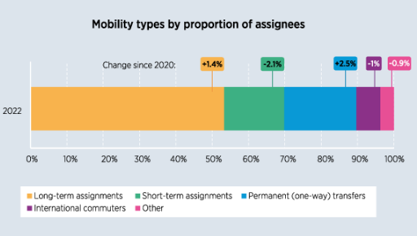
How have the numbers of assignments changed?
Long-term international assignments still dominate mobility, making up more than half of all assignments on average.
Remote workers only comprise a small proportion of the overall population
Source: ECA’s Mobility Now Survey 2022

Slide 23
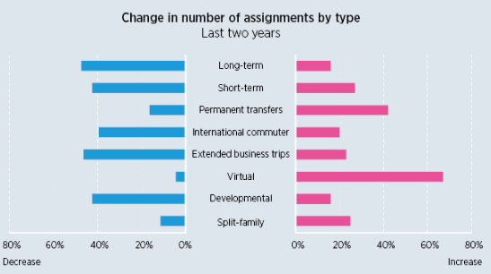
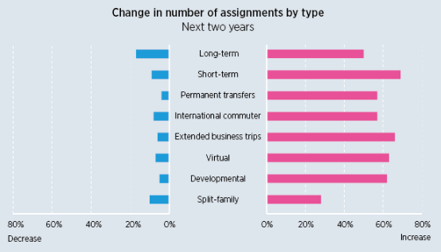
How have the numbers of assignments changed?
Source: ECA’s Mobility Now Survey 2022

Slide 24
Advantages and disadvantages of remote working
Employee advantages
Employer advantages
Freedom & flexibility
Cost saving
Work from anywhere
Work/life balance
Wider talent pool
Loyalty
Employer of choice
Source: ECA’s Mobility Now Survey 2022

Slide 25
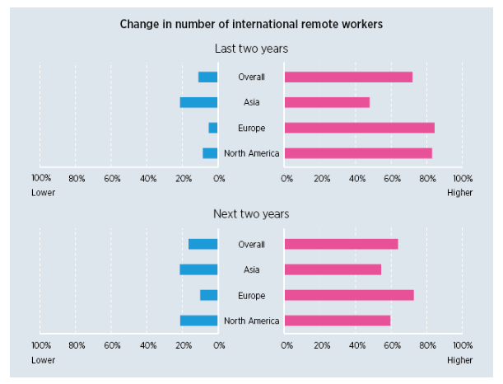
How have the numbers of international remote workers changed?
Most organisations have seen increases in the number of international remote workers in the past two years, albeit from very low levels. However, this growth is not uniform everywhere. While more than four-fifths of European and North American companies have seen numbers rise, for Asian organisations this is true for only 48%. Growth is set to continue, with the majority of organisations anticipating further increases in the next two years.
Source: ECA’s Mobility Now Survey 2022

Slide 26
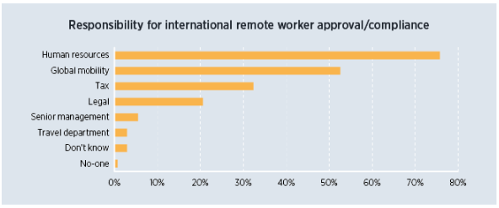
Who in the organisation is responsible for international remote worker approval/compliance?
When it comes to international remote worker approval and compliance, human resources and GM functions are most commonly involved, although small minorities reported either not knowing who has responsibility, or that no-one does. Just over half of respondents indicated that responsibility is shared between two or more departments.
Source: ECA’s Mobility Now Survey 2022

Slide 27
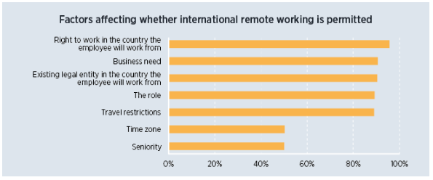
What factors affect whether companies allow international remote working?
It is rare for organisations to allow international remote working regardless of the situation. In fact, certain conditions must be in place for it to happen. The legal implications of proposed international remote work - such as the employee having the right to work and the organisation having an existing legal entity in the country they will work from - are factors for the majority, as are other considerations such as business need and the employee’s role itself.
Source: ECA’s Mobility Now Survey 2022

Slide 28
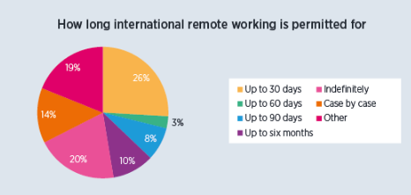
For how long do organisations permit international remote working?
The most common response was up to 30 days.
There are significant regional differences in approach, with 46% of North American organisations limiting international remote work to 30 days compared to 27% of European and just 6% of Asian ones. 39% of Asian organisations allow international remote working to continue indefinitely.
Source: ECA’s Mobility Now Survey 2022

Slide 29
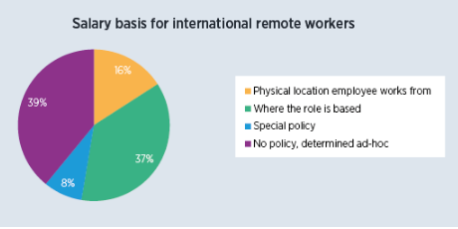
What is the basis for salaries of international remote workers?
39% of organisations have no policy for determining the salaries for these employees.
For those that do have a policy, it is most common to use the location where the role itself is based rather than the physical location the employee is working from. Only a minority have implemented a special policy for this type of employee.
Source: ECA’s Mobility Now Survey 2022

Slide 30
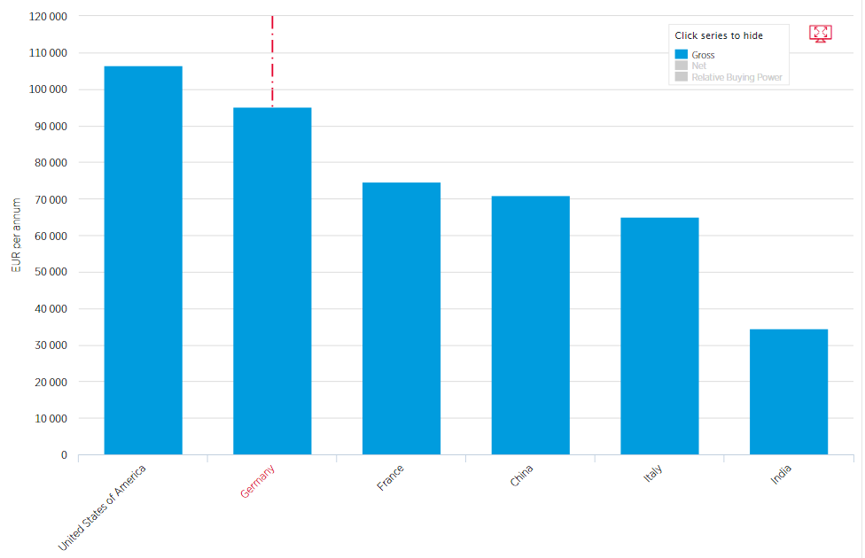
What salary should you pay international remote workers?
Place of employment
Place of residence
Headquarter rate
International market value
Mandatory minimum
Immigration salary threshold
Local benefit entitlement e.g. 13th month salary or holiday allowance
What is the impact of the Posted Workers’ Directive
Source: Willis Towers Watson / ECA International

Slide 31
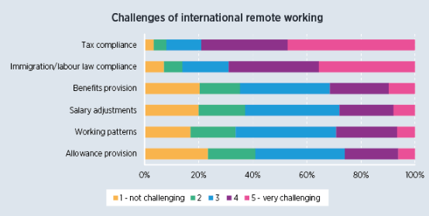
How challenging are the following aspects of international remote working?
Compliance issues are by far the most challenging aspects of international remote working.
Almost 80% of respondents ranked tax compliance in the top two most challenging categories, and almost 70% did so for immigration/labour law compliance.
Source: ECA’s Mobility Now Survey 2022

Slide 32
Challenges associated with international remote workers?
Insurances: If an employee is working overseas will the employer will need to ensure that group insurances are not impacted (or invalidated). It will be important to speak to insurers or benefits brokers in relation to benefits such as group income protection, death in service, travel insurance and private medical cover
Healthcare: If the employee is not physically living or working in the country in which they are legally employed how will they access healthcare. Does the employee qualify for free local healthcare? What supplemental healthcare is required?
Privacy and security - Homeworking creates a whole host of data protection issues and the move away from a home office increases the risks around data security. Regarding the transfer of personal data which trigger the rules about cross-border data transfer.
Health and safety – Employers need to assess the suitability of the working environment at home by (at the minimum) conducting a workplace risk assessment and ensuring that employer’s liability insurance extends coverage to home working. What about working hours?

Slide 33
ANOUK DIRIXX

Slide 34
In-house counsel views
Different forms of employee mobility, assignments & challenges
What is the scenario to be assessed?
Terminology e.g. expat, rotators, secondment, business trip, short visit, remote work, salary split
Concrete circumstance to be examined
2. Scope of application of legislation?
Does it fall within the scope of the Posted Workers Directive?
Any formalities to be respected?
DISCLAIMER: Opinions expressed are solely my own and do not express the views or opinions of my employer

Slide 35
In-house counsel views
3. Relevant, up-to-date information?
How to manage the information?
4. Increasing compliance obligations
Languages issues
Different country processes e.g. notifications
Timing / length of the processes
Different set of rules e.g. construction workers
Equal pay for equal work – complex assessments to be made
Centralized approach?
DISCLAIMER: Opinions expressed are solely my own and do not express the views or opinions of my employer

Slide 36
In-house counsel views
Opportunities?
Enhanced flexibility for working in a multi country environment
Recruitment & retention tool
Importance to have accessible, clear and up-to-date centralized information
Importance to streamline approaches amongst Member States (home/ host Country) wrt legislation framework and applications
DISCLAIMER: Opinions expressed are solely my own and do not express the views or opinions of my employer

Slide 37
FOTEINI BAMPALI

Slide 38
The activity of the European Labour Authority

Slide 39
ELA: Timeline

Slide 40
ELA‘s mandate

Slide 41
Role of ELA

Slide 42
ELA‘s objectives

Slide 43
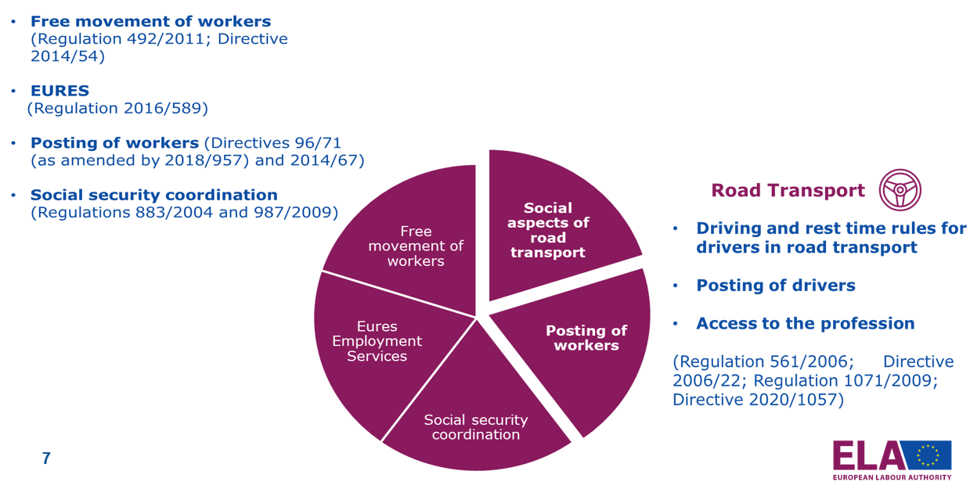
ELA‘s Scope: Work Mobility & Social Security Coordination

Slide 44
ELA‘s activities

Slide 45
How does ELA work?

Slide 46
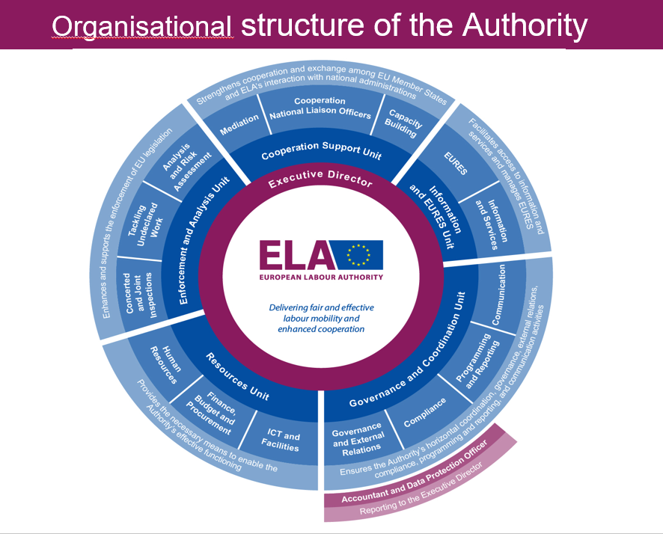
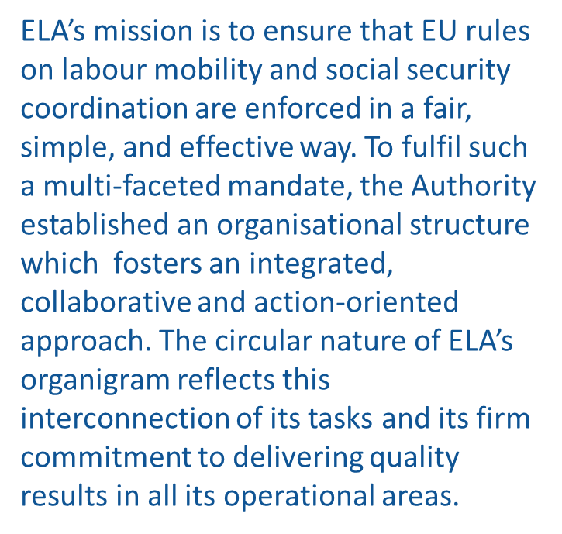
Organisational structure of the Authority

Slide 47
National Liason Officers in ELA

Slide 48
Cross border inspections (CJIs) in enforcing Union law in the area of labour mobility

Slide 49
CJIs Legal Definitions

Slide 50
CJIs in practice

Slide 51
Support for CJIs

Slide 52
Key initiatives in 2021

Slide 53
Priorities in 2022

Slide 54
ELA‘s Framework for Action 2022: key pillars

Slide 55
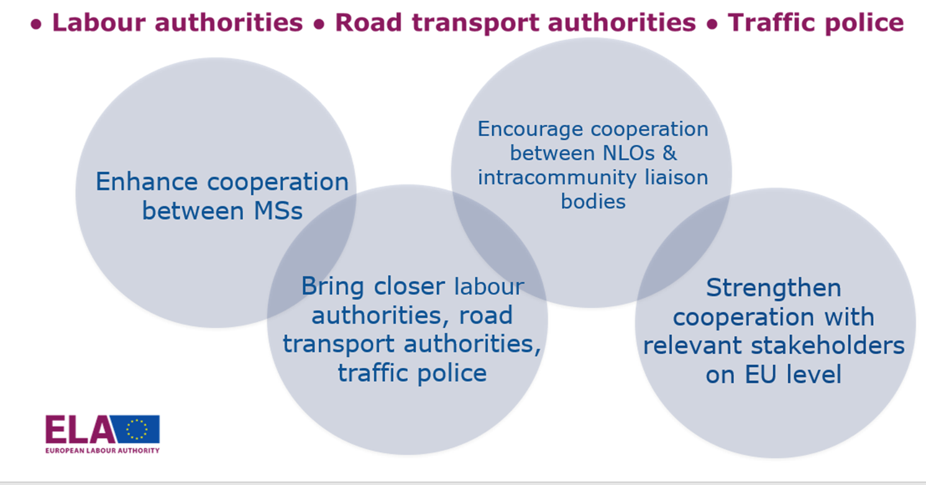
Inspections in road transport field

Slide 56
Inspections in road transport field

Slide 57
Truck & Bus days action inspection week

Slide 58
Inspections in road transport field: Roadside demo joint inspection

Slide 59
Road transport sector activities

Slide 60
Plans for 2022 - Framework for action on road transport

Slide 61
Target audience of the campaign

Slide 62
ELA‘s report: The impact of Teleworking during the COVID-19 pandemic on the applicable social security, July 2021
July 2021

Slide 64
QUESTIONS?

Slide 65
THANK YOU!

