Slide 1
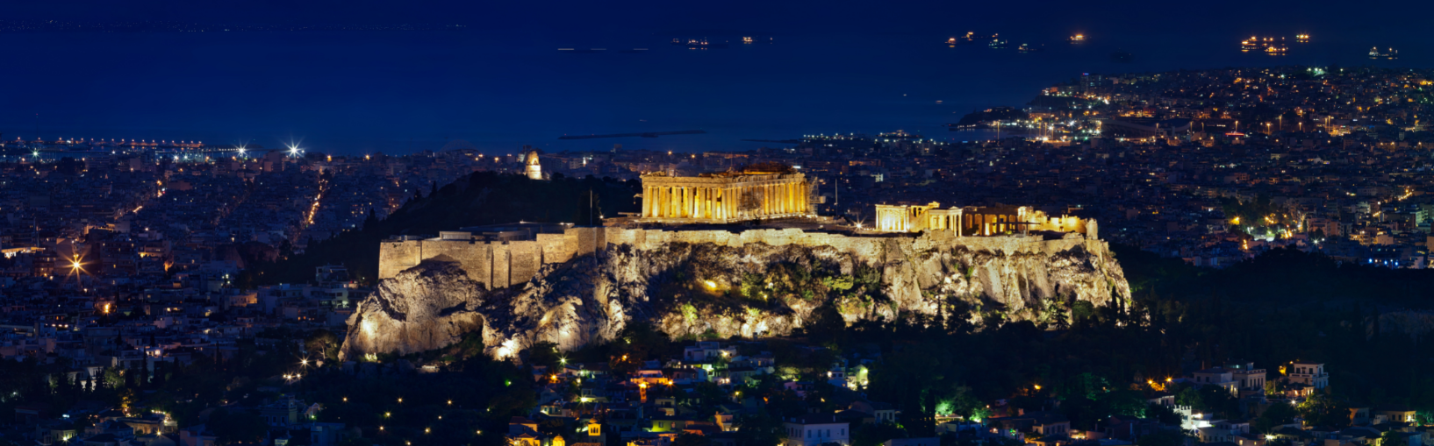

EELA General Assembly 2022
Copyright @ Alex Morozov

Slide 2
I. Welcome & Opening
Facts & Figures:
EELA Members as of 1 January 2022: 1,297
European Countries represented: 34

Slide 3
II. EELA Board Elections 2022
Board member elections for the following countries:
  Austria
  Denmark
  France
  Germany
  Greece
  Ireland
  Malta
  Poland
  Portugal
  The Netherlands

Slide 4

Presentation of the Candidates

Slide 5
COUNTRY | CANDIDATES
Austria | Ralf Peschek, Markus Löscher
Denmark | Anders Etgen Reitz, Tommy Angermair
France | Karine Audouze, Olivier Kress, Etienne Pujol
Germany | Klaus-Stefan Hohenstatt
Greece | Constantin Bakopoulos
Ireland | Breda O'Malley
Malta | Matthew Brincat
Poland | Agnieszka Lisiecka, Lukasz Chrusciel
Portugal | Pedro Pardal Goulão
The Netherlands | Christiaan Oberman

Slide 6
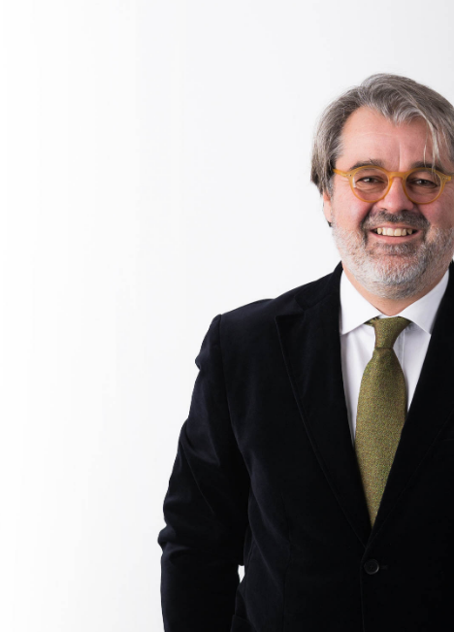
Austria
Ralf Peschek
Wolf Theiss Vienna

Slide 7

Austria
Markus Löscher
Gerlach Löscher | Littler

Slide 8
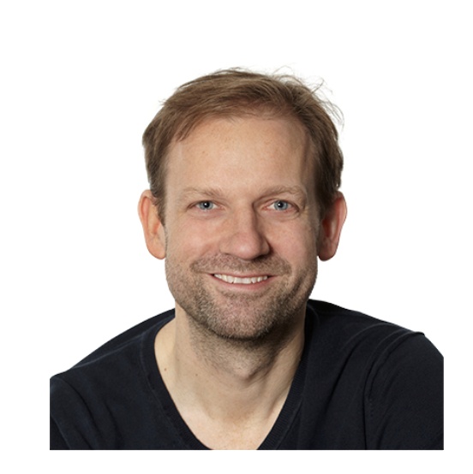
Denmark
Anders Etgen Reitz
IUNO

Slide 9
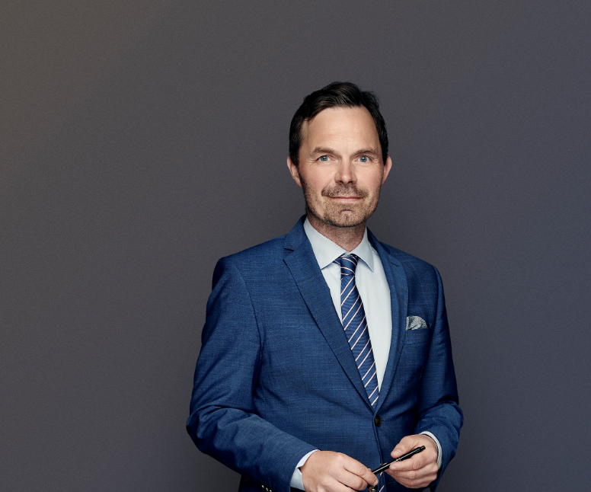
Denmark
Tommy Angermair
CLEMENS Advokatpartnerselskab

Slide 10
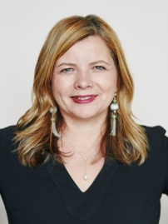
France
Karine Audouze
UGGC Avocats

Slide 11
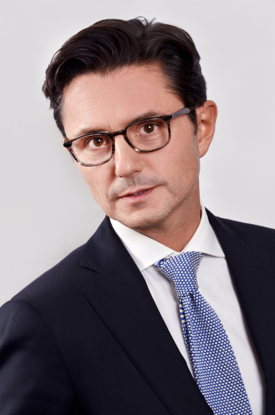
France
Olivier Kress
Flichy Grangé Avocats

Slide 12
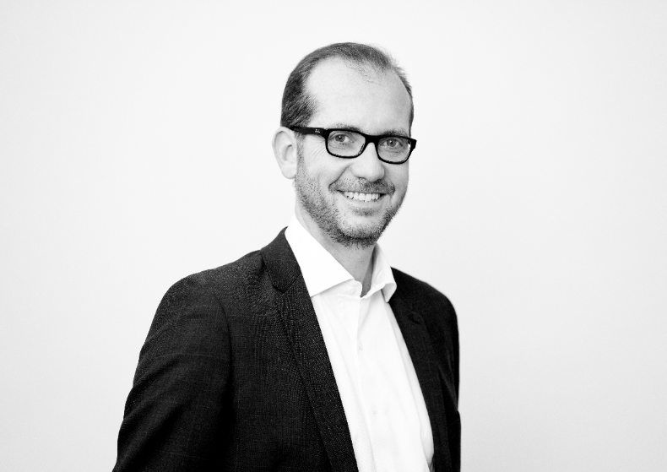
France
Etienne Pujol
BERRYLAW

Slide 13

Germany
Klaus-Stefan Hohenstatt
Freshfields Bruckhaus Deringer

Slide 14
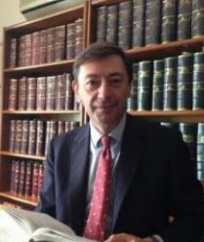
Greece
Constantin Bakopoulos
Bakopoulos Katharios
Law Firm

Slide 15
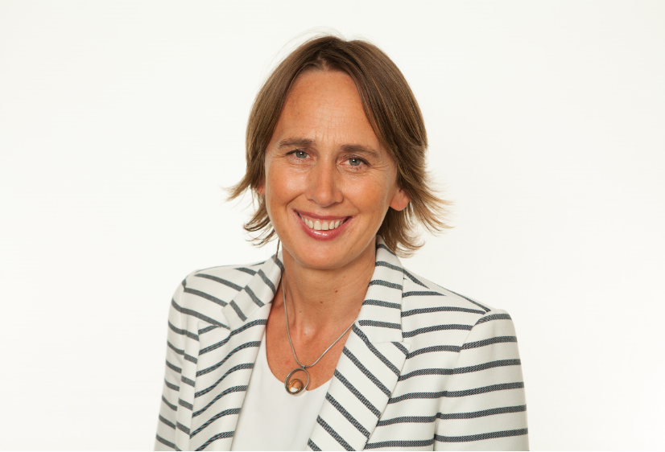
Ireland
Breda O'Malley
Hayes solicitors

Slide 16
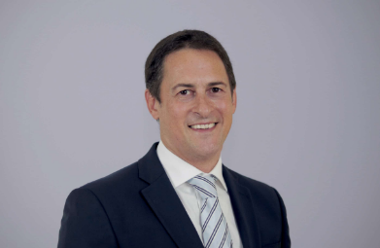
Malta
Matthew Brincat
Ganado Advocates

Slide 17
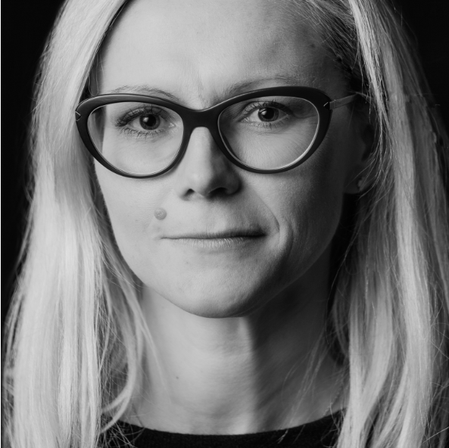
Poland
Agnieszka Lisiecka
Wardyński and Partners

Slide 18
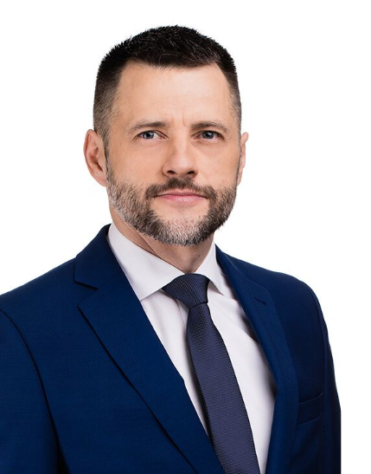
Poland
Łukasz Chruściel
PCS Paruch Chruściel Schiffter Stępień | Littler Global

Slide 19
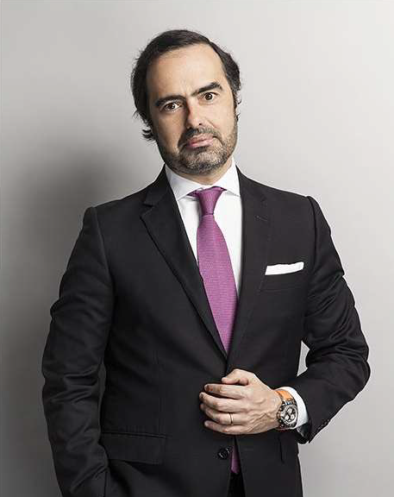
Portugal
Pedro Pardal Goulão
Morais Leitão, Galvão Teles, Soares da Silva & Associados

Slide 20

The Netherlands
Christiaan Oberman
Palthe Oberman Advocaten

Slide 21
III. Report of the Board 2019-2022
  Board Meetings
9 September 2019 Hamburg
3 February 2020 (virtual)
29 April 2020 (virtual)
28 May 2020 (virtual)
10 September 2020 (virtual)
15 December 2020 (virtual)
24 March 2021 (virtual)
15 October 2021 Athens
31 January 2022 (virtual)
14 June 2022 (virtual)

Slide 22
IV. Partnership with EELC
V. EELA/ERA Annual Seminar on European Labour Law
  Save the date: Brussels, 25 November 2022

Slide 23

VI. Approval of the EELA Accounts

Slide 24
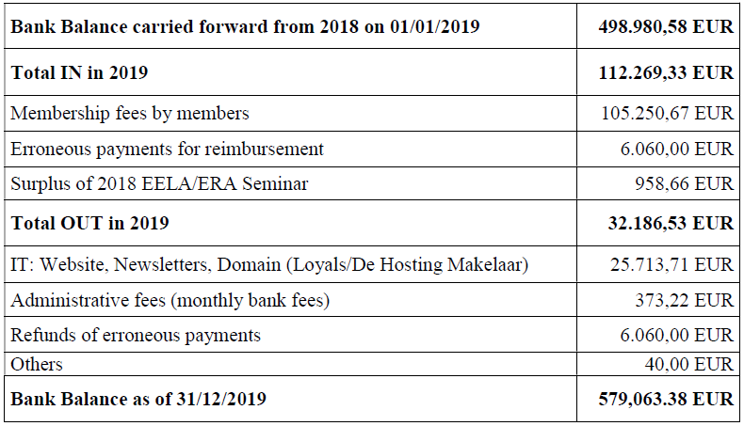
  EELA ACCOUNTS 2019

Slide 25
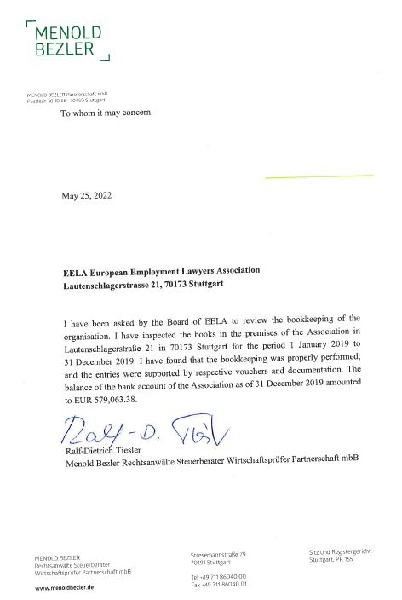
Inspection Statement
1 January 2019 - 31 December 2019

Slide 26
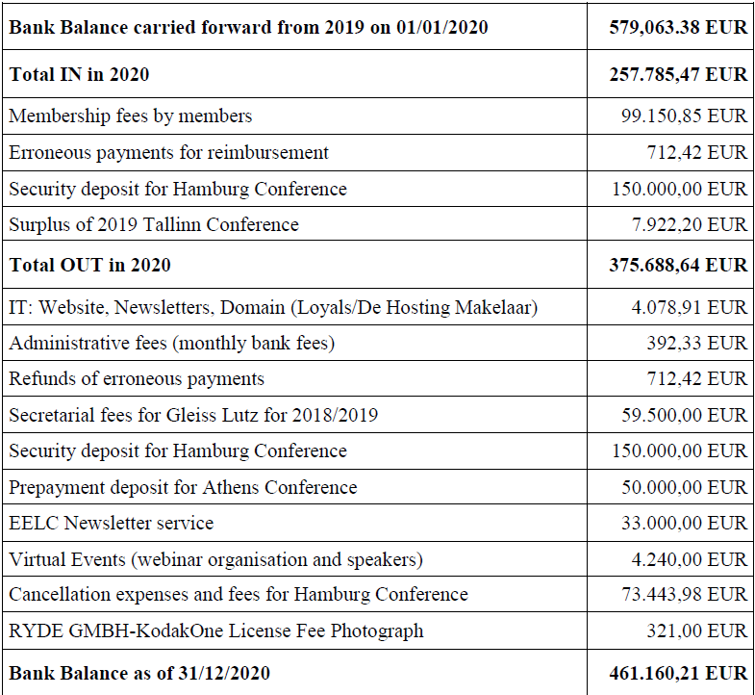
  EELA ACCOUNTS 2020

Slide 27
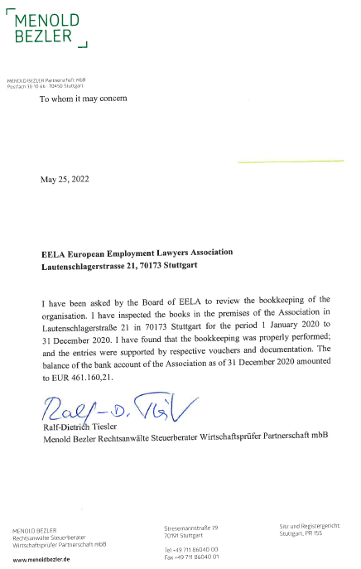
Inspection Statement
1 January 2020 - 31 December 2020

Slide 28
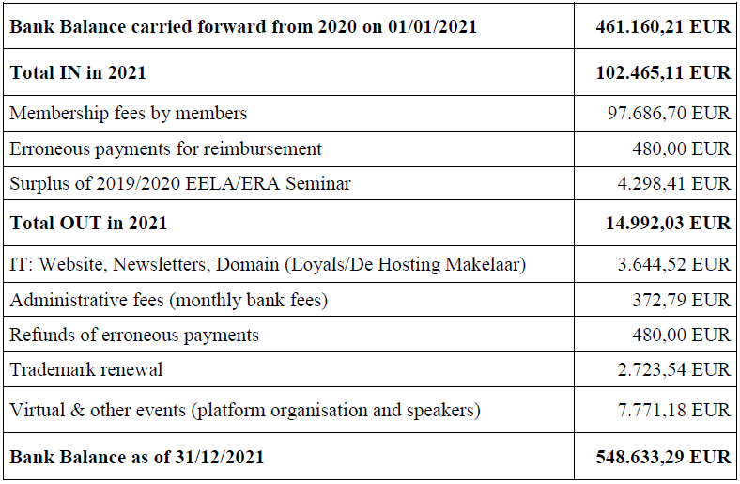
  EELA ACCOUNTS 2021

Slide 29
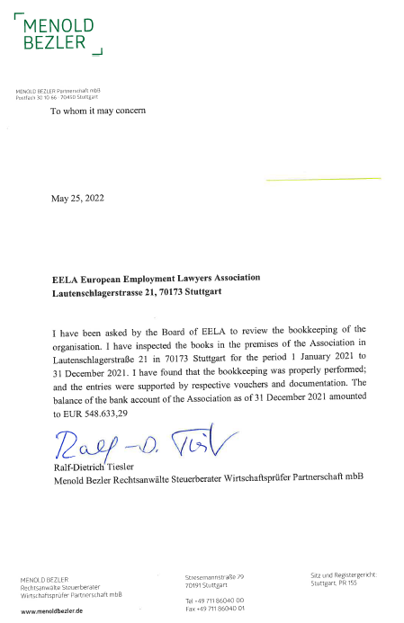
Inspection Statement
1 January 2021 - 31 December 2021

Slide 30

VII. Other Issues?

Slide 31
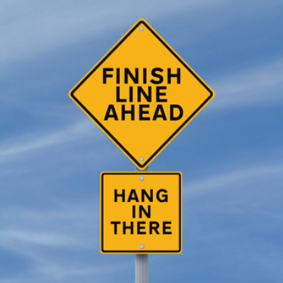
VIII. Closing

Slide 32
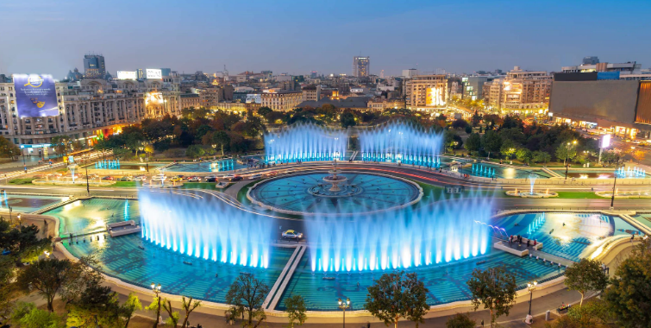
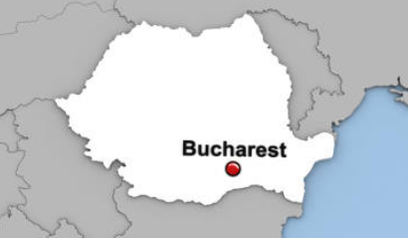
IX. 2023 Bucharest Conference (Intro)
Save the Date: 8 - 10 June 2023

Slide 33


Thank you for the attention and see you again in Bucharest!

