Slide 1
Mental health in the workplace

Slide 2
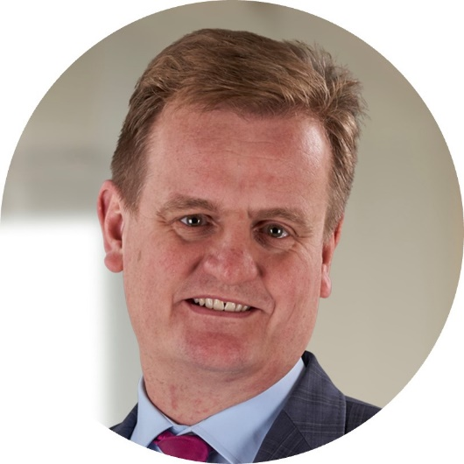
Introduction
Adam Lambert
Partner, Employment
Bryan Cave Leighton Paisner LLP, United Kingdom
adam.lambert@bclplaw.com

Slide 3
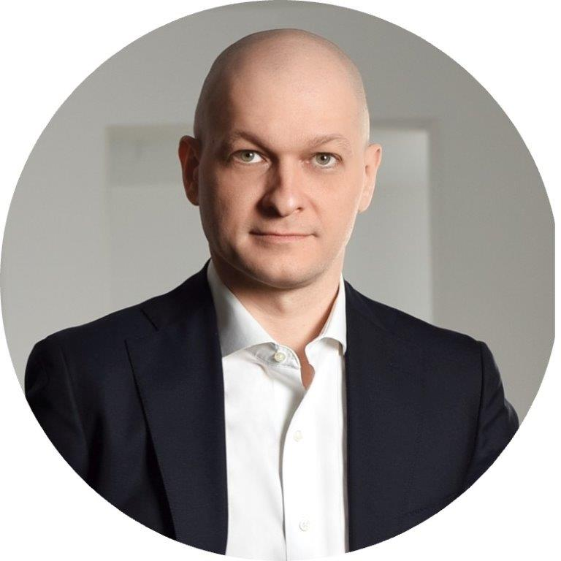
The size and scope of the problem
Prof. Dr. Dragos Iliescu
University of Bucharest
dragos.iliescu@fpse.unibuc.ro

Slide 4
Mental Health Problems - some facts:
Extremely common: 1 in 4 (while being widely under-reported)
point-prevalence: 10.7%
yearly prevalence: ~25
life-time prevalence: ~70-90%
These kinds of illnesses therefore rank alongside cardiovascular disorders and cancer as among humanity's biggest health problems.
More stunning info on: https://ourworldindata.org/mental-health

Slide 5
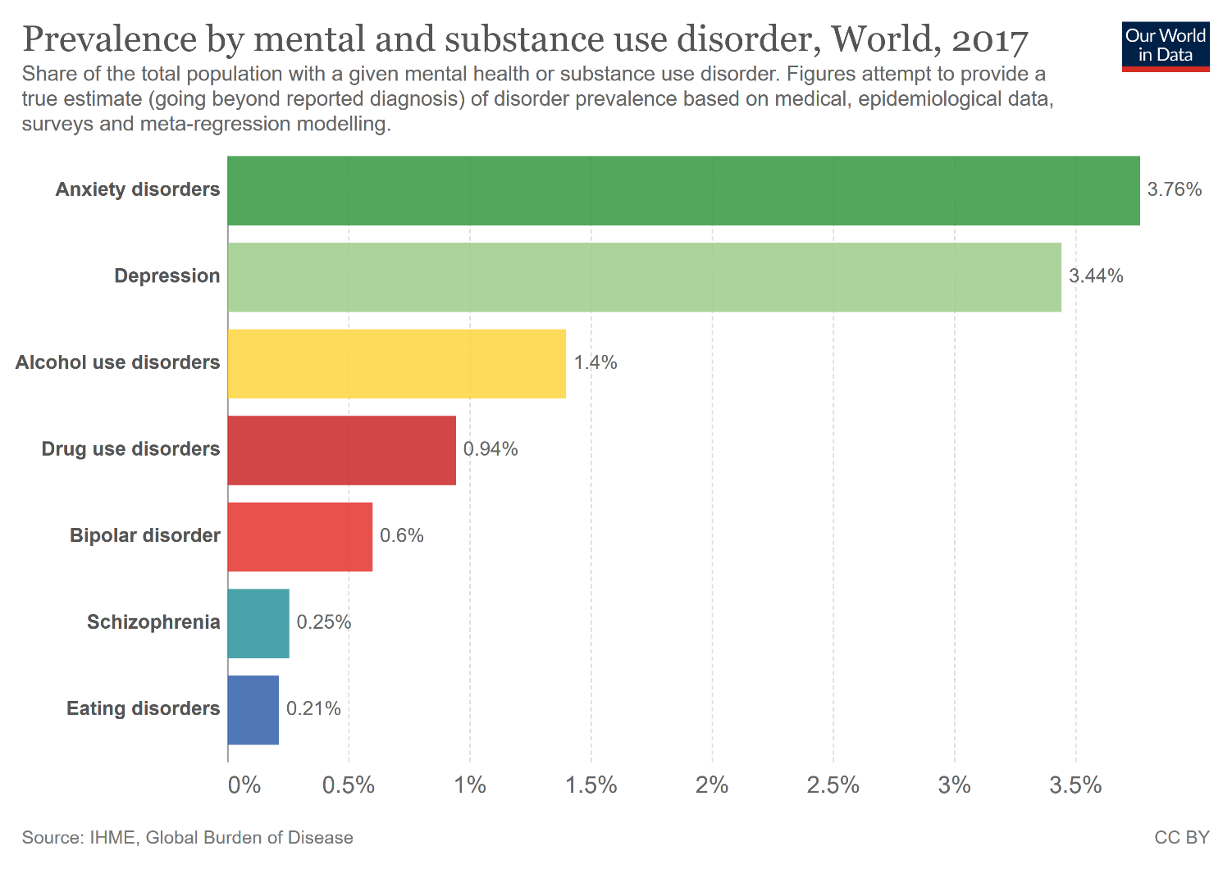

Slide 6
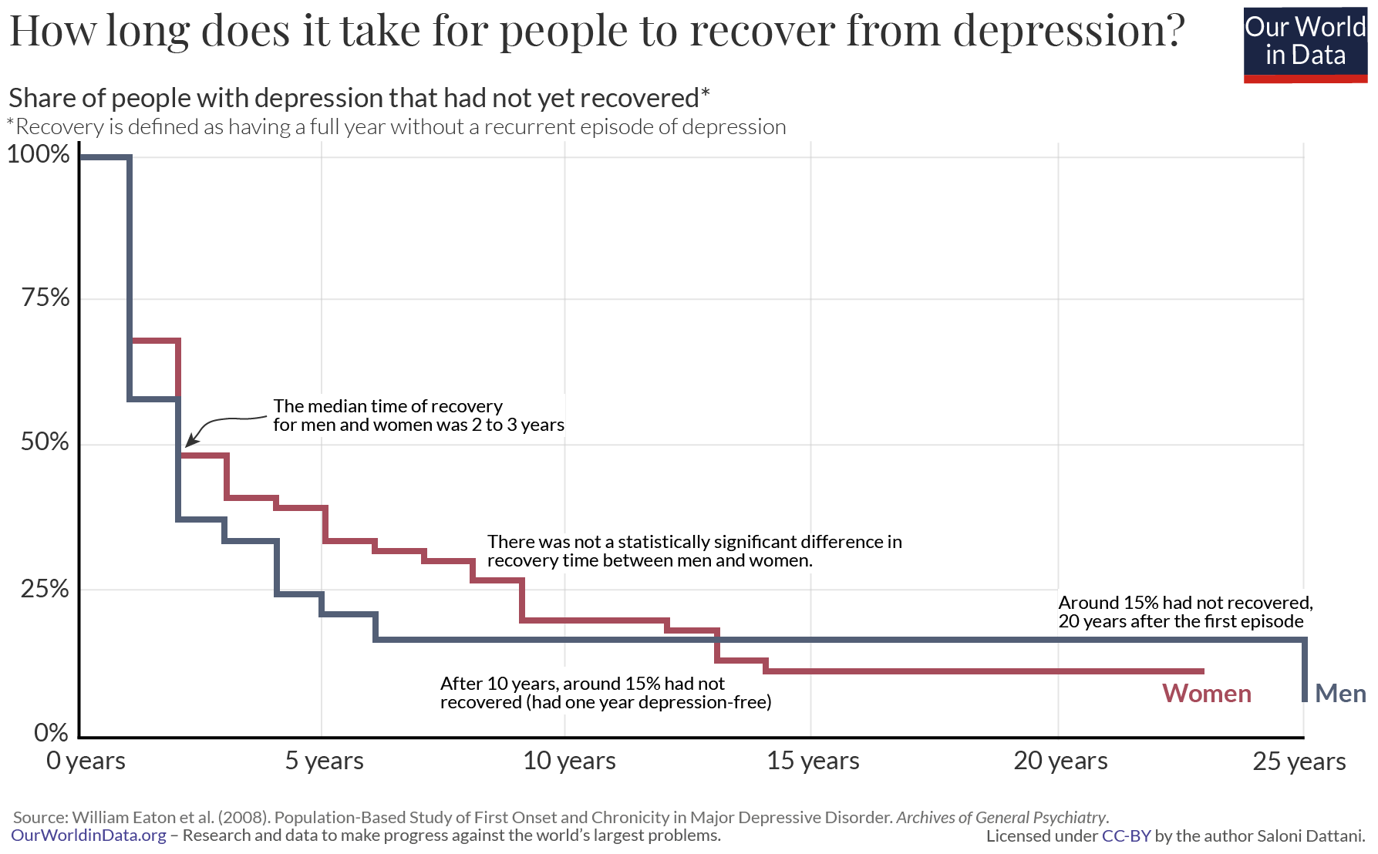

Slide 7
Can take many forms:
... severe stress, depression, mood disorders, bipolar affective disorder, schizophrenia, eating disorders, anxieties, phobias, obsessive compulsive disorder, drug and alcohol abuse, post-traumatic stress disorder, complex bereavement and dementia
These are issues which could affect any one of us (and will likely do so at one point of time or another).
Still, they are clinical issues.
What about sub-clinical illbeing?

Slide 8
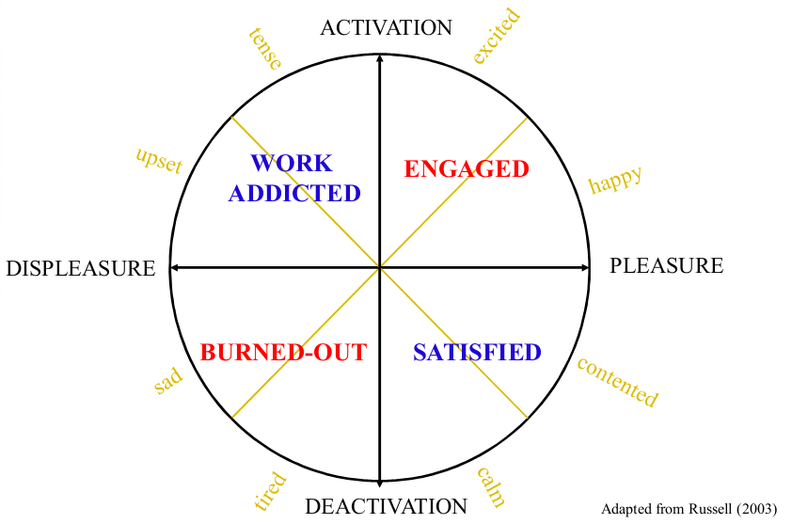
The "psychological wellbeing" territory

Slide 9
A case study: Burnout
Exhaustion
Mental distance
Impaired cognitive control
Impaired emotional control
Psychological distress/symptoms
Psychosomatic complaints

Slide 10
A case study: Burnout
EXHAUSTION
At work, I feel mentally exhausted
Everything I do at work requires a great deal of effort
After a day at work, I find it hard to recover my energy
At work, I feel physically exhausted
When I get up in the morning, I lack the energy to start a new day at work
I want to be active at work, but somehow I am unable to manage
When I exert myself at work, I get tired quicker than normal
At the end of my working day, I feel mentally exhausted and drained
MENTAL DISTANCE
I struggle to find any enthusiasm for my work
At work, I do not think what I am doing and I function on autopilot
I feel a strong aversion towards my job
I feel indifferent about my job
I am cynical about what my work means to others

Slide 11
A case study: Burnout
IMPAIRED COGNITIVE CONTROL
At work, I have trouble staying focused
At work I struggle to think clearly
I am forgetful and distracted at work
When I’m working, I have trouble concentrating
I make mistakes in my work because I have my mind on other things
IMPAIRED EMOTIONAL CONTROL
At work, I feel unable to control my emotions
I do not recognize myself in the way I react emotionally at work
During my work I become irritable when things do not go the way I want
I get upset and sad at work without knowing why
At work I may overreact unintentionally

Slide 12
A case study: Burnout
PSYCHOLOGICAL DISTRESS/SYMPTOMS
My weight fluctuates even though I am not on a diet
I have trouble falling asleep or staying asleep
I tend to worry
I feel tense and stressed
I feel anxious and/or suffer from panic attacks
Noise and crowds disturb me
PSYCHOSOMATIC COMPLAINTS
I suffer from palpitations or chest pain
I suffer from stomach and/or intestinal complaints
I suffer from headaches
I suffer from muscle pain, for example in the neck, shoulder or back
I often get sick

Slide 13
Prof. Dr. Dragos Iliescu Chair of the Doctoral School in Psychology and Educational Sciences Department of Psychology and Cognitive Science, University of Bucharest Sos. Panduri Nr. 90, 050657 Bucharest, Romania Tel: +40723627077 | Email: dragos.iliescu@fpse.unibuc.ro Extraordinary Professor of Psychology, Stellenbosch University Editor, The European Journal of Psychological Assessment (EJPA) President, International Association of Applied Psychology (IAAP), Division 2 (Psychological Assessment and Evaluation) Treasurer, The European Association for Work and Organizational Psychology (EAWOP) Secretary-General, The Romanian Association of Psychology (APR) Past-President, The International Test Commission (ITC) Chief Scientist, BRIO Educational Testing

Slide 14
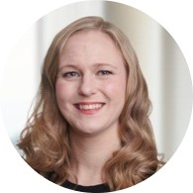
What can we do to help?
Mari Mohsen
Principal Associate, Employment
Roschier, Attorneys Ltd, Finland
mari.mohsen@roschier.com

Slide 15
What can we do?
What do we see?
What can the employer do?
What can the employees do?
What can we do as lawyers?

Slide 16
1. What do we see?
Leadership challenges
Workplace conflicts
Sick-leaves
Termination of employment
Underperformance
Occupational health care procedures
Reasonable adjustments

Slide 17
2. What can the employer do? Promoting a thriving, supportive, open, diverse, caring, safe and equal workplace
Strategy → Values → Goals
HR expertise!
Leadership – training and support from HR
Flexibility – but clear framework
Clarity – clear job descriptions, division of duties, procedures
Building trust
Continuous dialogue in the workplace
Preventing and resolving workplace conflicts
Taking note on generational differences

Slide 18
2. What can the employer do? Supportive measures for ensuring physical and mental recovery and resilience
Wellbeing strategy, react early program, policies
On-boarding and induction
Mentoring and tutoring
Employee engagement surveys
Continuous review of employee data, KPIs and metrics
Social activities, health related benefits
Occupational health care services
Mental health support (therapist, psychologist)
Support and flexibility to families

Slide 19
3. What can the employees do?
Building trust
Teamwork
Open communication and honesty
Proactivity and asking questions
Knowing your colleagues
Knowing yourselves and your limits
Contributing to a healthy and supportive culture
Contributing to speak-up culture

Slide 20
What can we do as lawyers?
Legal framework and compliance
Assistance and tools for managers
Learning about mental health
Partnering up with doctors and psychologists
Raising awareness, being active
Breaking taboos, providing training

Slide 21
Addiction in the Workplace
Anne Lyne
Partner, Employment
Hayes solicitors LLP, Ireland
alyne@hayes-solicitors.ie

Slide 22
What is addiction?
Medical definition focusing
on drugs / alcohol
“Addiction is a treatable, chronic medical disease involving complex interactions among brain circuits, genetics, the environment, and an individual’s life experiences.
People with addiction use substances or engage in behaviors that become compulsive and often continue despite harmful consequences.”
Countries take differing positions

Slide 23
Types of Addiction
Alcohol / substance addictions
Behavioral addictions (e.g. sex addiction, gambling, kleptomania, compulsive buying, internet / phone addiction)
Eating disorders
Work addiction
Exercise addiction
Spiritual addiction
Dual diagnosis addictions (co-occurrence of substance use disorders and mental health disorders)

Slide 24
Recognising the Warning Signs
Absenteeism / excessive sick days
Unreliability in keeping appointments and meeting deadlines
Frequent disappearances from the workplace / improbable excuses
Work performance
Mistakes / poor judgement / bad decisions
Confusion / difficulty concentrating
Problems with interpersonal relations
Progressive deterioration in personal appearance / hygiene
Signs of hangovers
Dilated pupils, slurred speech, unsteady walk

Slide 25
The legal issues that arise …
Addiction versus substance abuse
Disability / reasonable adjustments
Managing performance / disciplinary actions
Health and safety issues
Working time

Slide 26
Scenario Discussion
An employee joined the company 9 months ago.
He is a recovering addict (alcohol and drugs).
Since joining the company, the employee has relapsed. He is currently on sick leave.
The company plans on supporting the employee and wants to provide accommodations.
However, the employee is not taking any steps towards recovery …

Slide 27
Mental health issues in the workplace

