Slide 1

Parallel session III
9 June 2023, 14.00-15.15

Slide 2
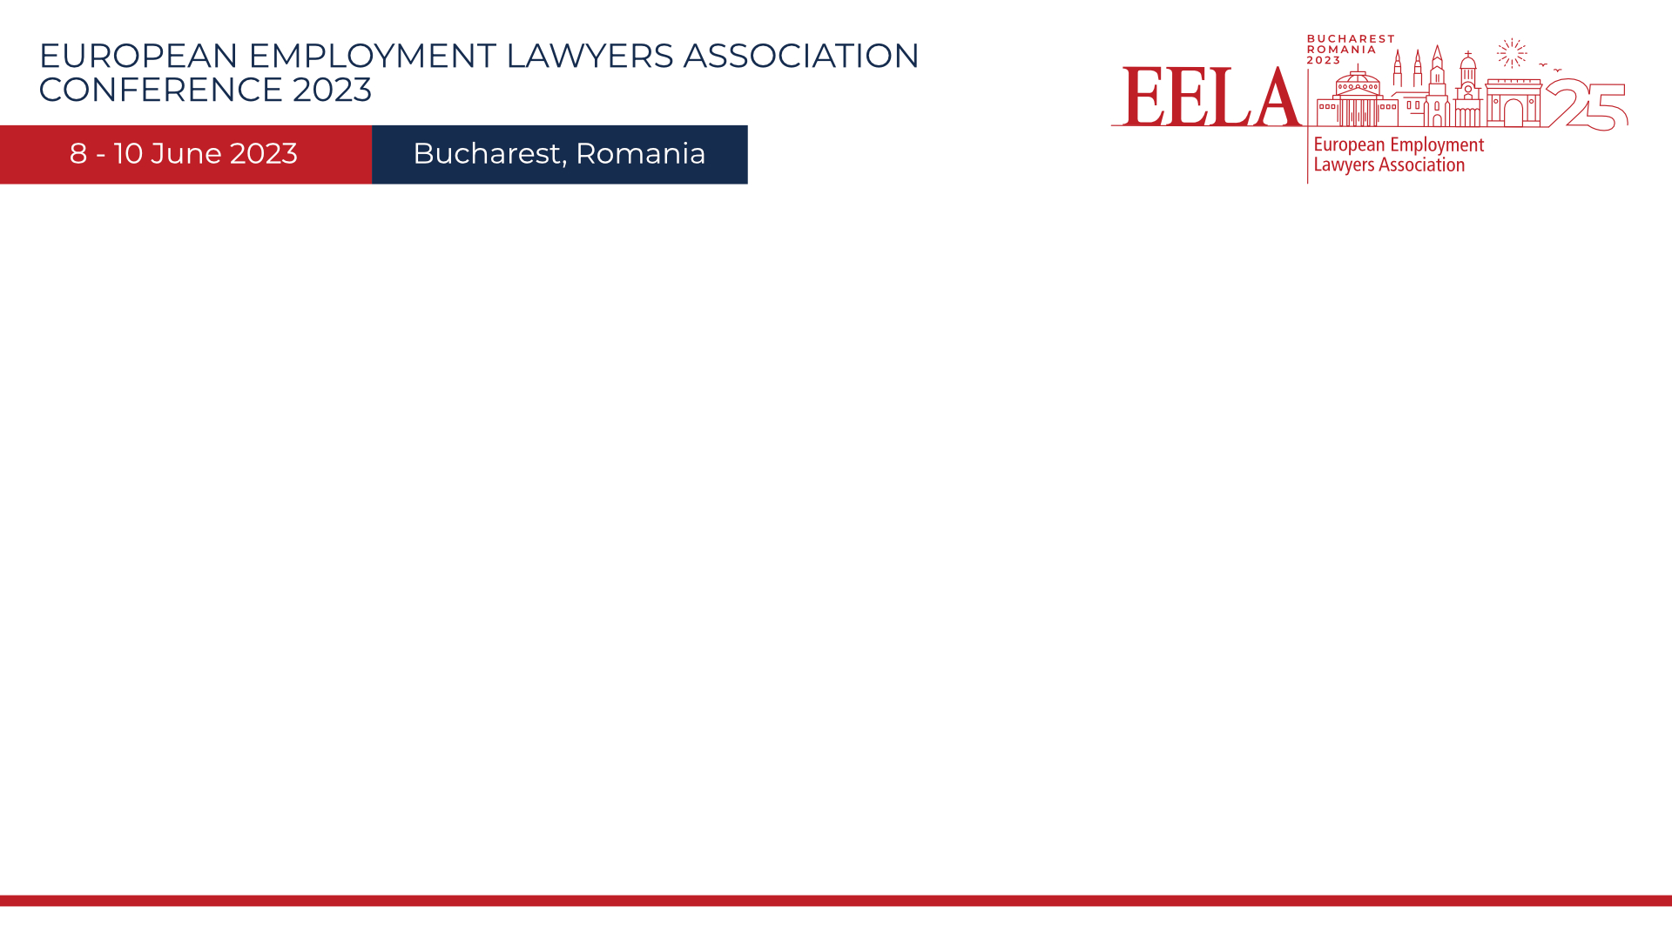
Expanding the employment Protection to the Unprotected – Minimum Wage vs Living Wage – Will the EU Directive on Supply Chain Due Diligence matter?

Slide 3
Speakers:
  Åsa Erlandsson, Setterwalls Advokatbyrå AB, Sweden
  Claudia Sowa-Frank, IG Metall, Germany
  Philippe Waechter, Ostrum AM, France
  Burkard Göpfert, KLIEMT.HR Lawyers, Germany

Slide 4
Recent case law has shown a trend to include the “Otherwise Unprotected” to the protection of employment laws. Who should be regarded as an “employee”, under EU as well as under national laws? Will the 21st Century employment laws swiftly react to a growing workforce of fragmented, individualized and non-organized parts of our population? These are also important policy questions.
Together with an economist and a representative of one of Europe’s largest union, the session will discuss potential levels of such protection, where needed. Also, as services provided by these “Otherwise Unprotected” may be regarded as a part of the “direct supply chain” of corporations, it is important to understand the impact the EU Directives on Supply Chain and Due Diligence will have on this discussion.
Topics covered:
How did the definition of an “employee” develop over the last years and where will this trend lead?
Minimum Wage vs. Living Wage – where will international soft laws lead us when it comes to develop a sound HR policy?
Gender and other discriminatory Pay Gaps – how can the fragmented “Otherwise Unprotected” world be best organized into a fair wage system?
The “Otherwise Unprotected” as a part of the “Supply Chain” – what will the legal consequences be and how should clients react to this?

