Slide 1
Multigenerational workforce

Slide 2
Rachel Easton
Associate
Vedder Price LLP
United Kingdom
Linda Nekeman-IJdema
Executive Legal Reward Consultant
ABN Amro Bank N.V.
The Netherlands
Oksana Voinarovska
Partner / Lawyer
Vasil Kisil and Partners
Ukraine
Catherine De Caluwe
Country Director Belux region
SThree
Belgium

Slide 3
Introduction on differences four generations
1.8 Billion
 | % of BE population
Baby Boomers (born 1946-1964) / 59 – 77 years | 19%
Generation X (born 1965-1980) / 43 – 58 years | 25%
Millennials (born 1981-1996) / 27 – 42 years | 26%
Generation Z (born 1997-2012) / 11 – 26 years | 18%
There are almost 2 billion Millennials on earth, making them the largest living adult generation.
Source: statista
Source: weforum

Slide 4
What Millennials value most?
Meaningful work
Work–life balance
Flexibility
Good relationship with management
Authenticity & transparency
Environment and social causes (ESG)
Work culture
Willing to learn and grow

Slide 5
Arrangements for older generations

Slide 6
Unconscious bias / discrimination older generations
60%
One of the most common unconscious bias is Ageism: the tendency to have negative feelings toward someone based on their age.
That’s the number of older employees who have experienced workplace age discrimination, with 90-95% of those saying it is common (according to a study by AARP in 2023).

Slide 7
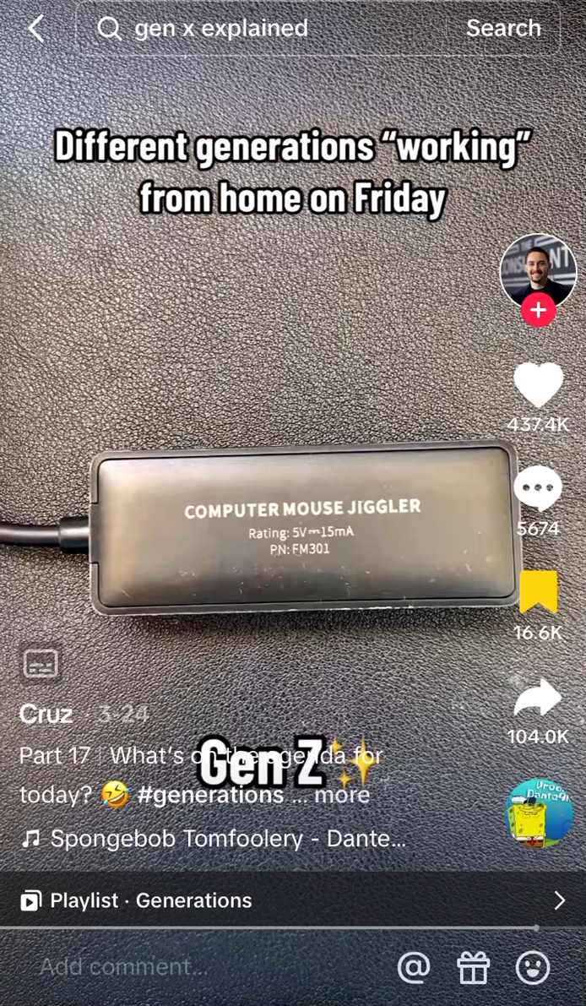
Generation Z

Slide 8
How do I see quite quitting in my organisation?
Between 13% and 20%
HOW TO ENGAGE PEOPLE ?
Bucketlist initiative
Hybrid working
Right to disconnect
eNPS survey
Since 2000, Americans have reported being disengaged at work
Source: Gallup
Wellbeing initiative
Employee assistance program

Slide 9
Gen Z and "slashing" or "moonlighting"
67%
10%
At SThree France, 10% of total employee are slash workers
In the world, 67% of the Gen Z are freelance or are planning to
Source: FIVERR

Slide 10
Climate quitting
Percentage of employees stating they are willing to quit their role if they felt their employer was taking insufficient or inadequate steps to reduce its environmental impact.
Source: Supercritical and KPMG study.
35%

Slide 11
Bringing the different generations together

