Slide 1
Business Development for
Employment Lawyers
David O’Neill
RAIN Group

Slide 2
When will you get this sales nonsense out of your head and go back to doing something respectable with your life?
My Mother

Slide 3
When will you get this sales nonsense out of your head and go back to doing something respectable with your life?
- But Mum, I was a lawyer.
My Mother & Me

Slide 4
What is Business Development?

Slide 5
Consultative Business Development
An approach where we redefine reality and maximize client value by:
Understanding, shaping, and redefining need; crafting compelling solutions to address the need; and communicating maximum impact for the client (core)
Inspiring clients and driving change with ideas that matter (advanced)

Slide 6
Look around the room
Pick 3 lawyers
Which of them disappoints their clients?

Slide 7
If it isn’t one of them,
It is you.

Slide 8
Top Client Decision Factors and Our Effectiveness
Source: “Virtual Selling Skills & Challenges,” RAIN Group Center for Sales Research

Slide 9
You can get away with it, but should you?
2.5X
Clients awarded business 2.5 times more often to those who demonstrated understanding of need versus those who didn’t.
Source: “What Sales Winners Do Differently,” RAIN Group Center for Sales Research

Slide 10
The single most important influence is the quality of the discovery conversation

Slide 11
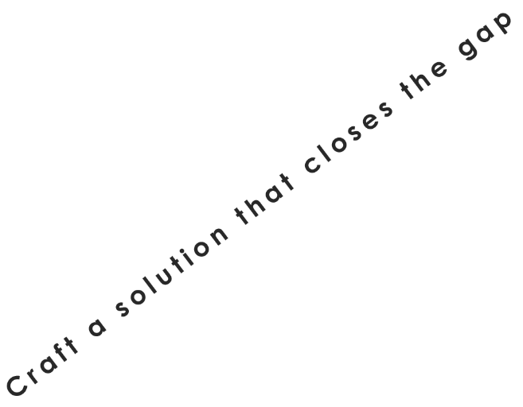
RAIN Selling: From Rapport to Commitment
TRUST
INFLUENCE

Slide 12
Top 10 Needs Discovery Tips
1
Prepare questions
in advance
6
Attend to both rational and emotional needs
2
7
Use broad open-ended, specific open-ended, and specific closed-ended questions
Ask why (multiple times) to get to the root cause
3
8
Uncover both afflictions (challenges, pain) and aspirations (hopes, desires)
Ask questions in advance of meetings
4
9
Transcribe and summarize
needs live
Keep the 30 + 3 rule in mind
5
10
Summarize needs in post-meeting follow up email
Use a checklist

Slide 13
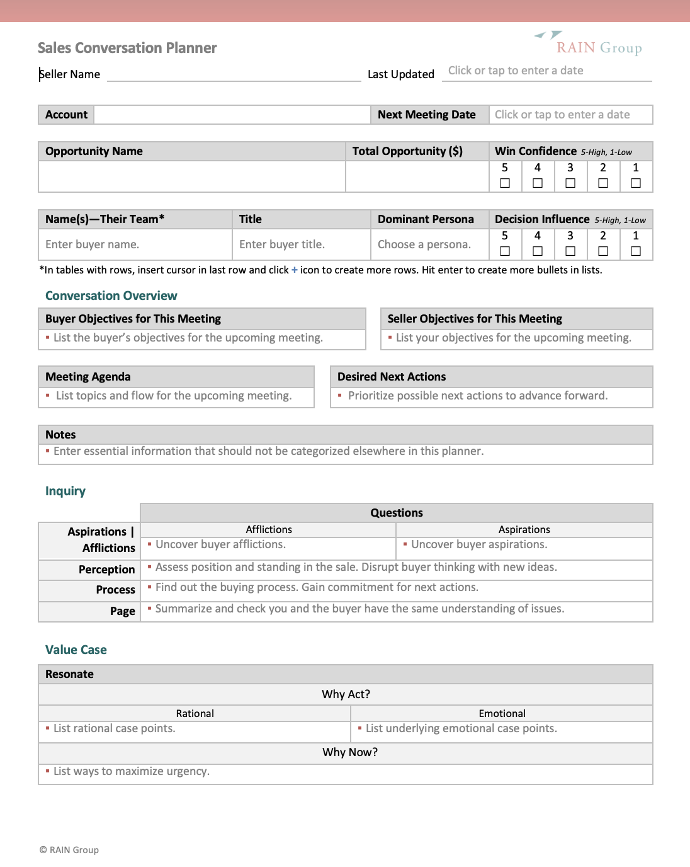
RAIN Conversation Planner

Slide 14
You can get away with it, but should you?
2.5X
Clients awarded business 2.5 times more often to those who demonstrated understanding of need versus those who didn’t.
Source: “What Sales Winners Do Differently,” RAIN Group Center for Sales Research

Slide 15
RAIN Group Change Blueprint
6. Advantages of Our Approach
1. Current State
2. New Reality
5. Your Solution
3. Overall Success Metrics
4. Mission

Slide 16
Working in groups, select one opportunity to build a Change Blueprint.
Work together to build the Blueprint using the template sent to you via chat.
The person whose opportunity was chosen will lead the group and present.

Slide 17
Present and Discuss Change Blueprints

Slide 18
It is the first time in 30 years that I thought you cared about what I think
GC at a major client (and a close friend)

Slide 19
What will you do differently next week?

Slide 20
Thank you!

Slide 21
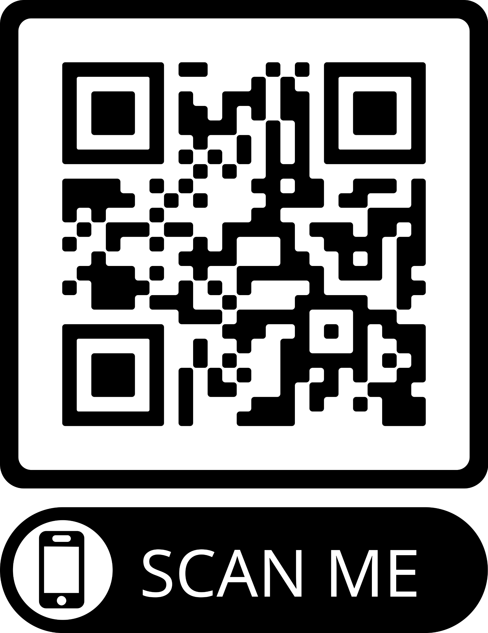
30 minutes
free consultation on any client opportunity

