Slide 1
Call My Agent:
Social Media Strategy for Law firms

Slide 2
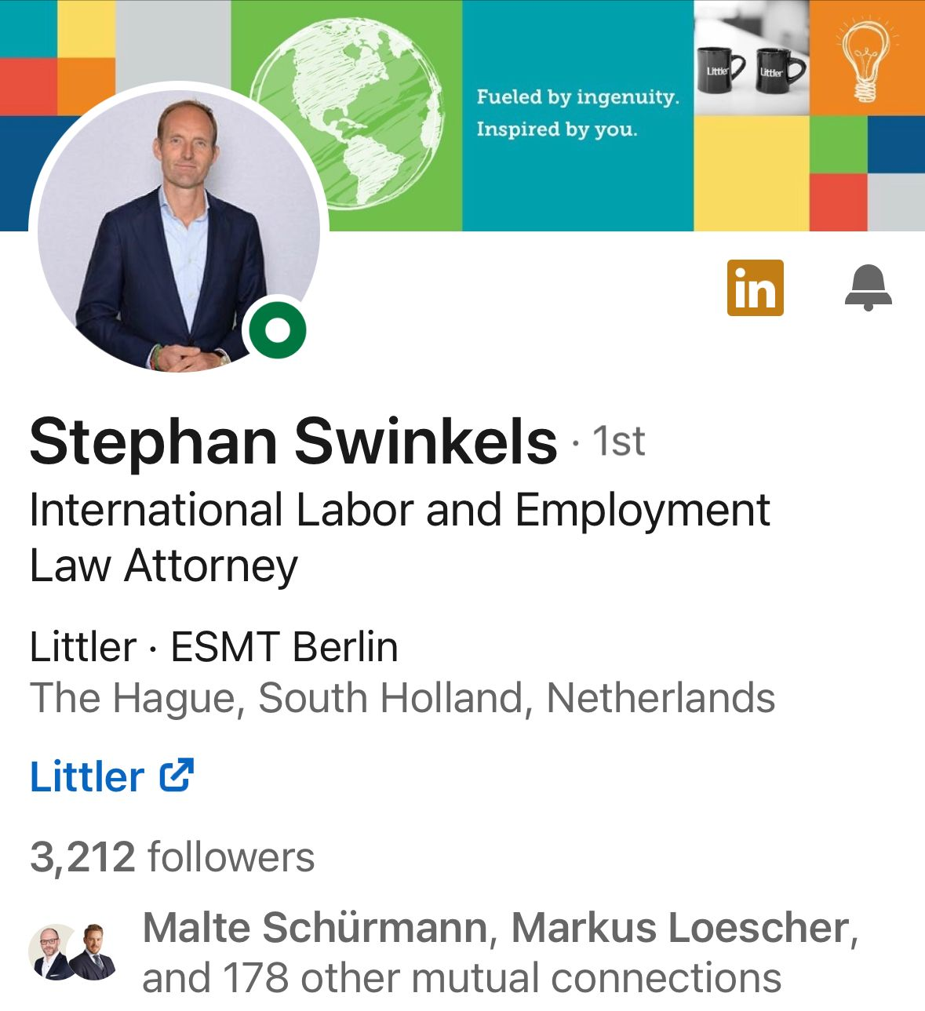
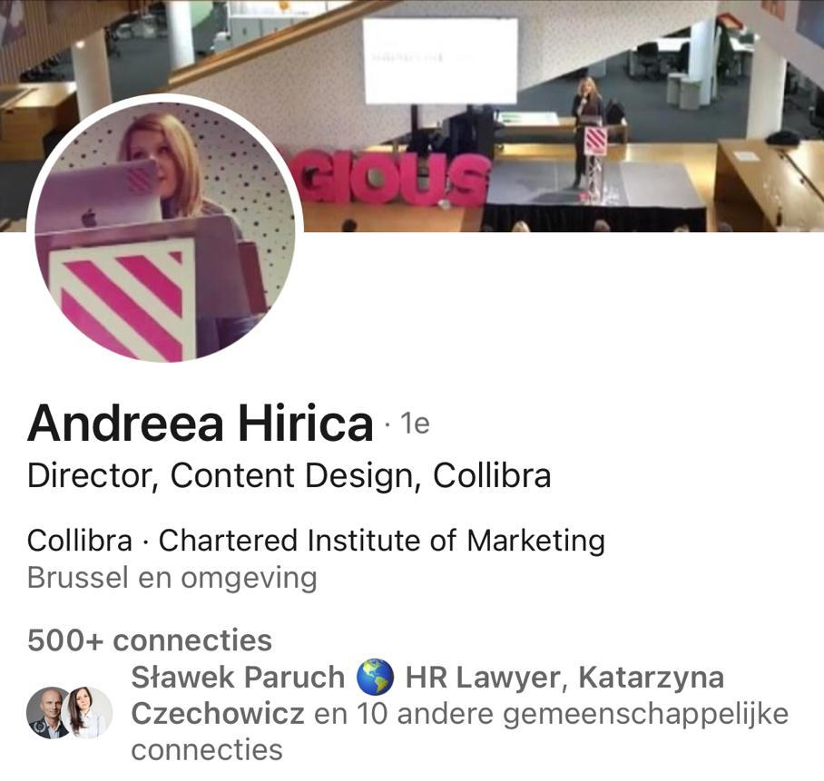
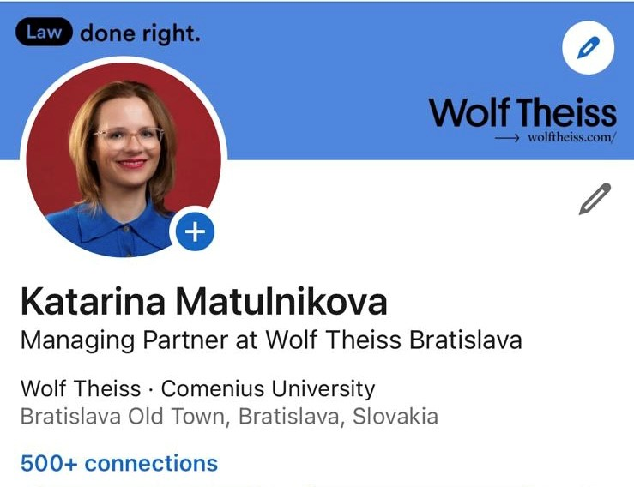
Presented by
Stephan Swinkels
ANDREEA HIRICA
SLAWEK PARUCH
KATARINA MATULNIKOVA
Shareholder
Littler
Netherlands
Director Content Design
Collibra
Brussels
Partner
Littler | Poland
Poland
Managing Partner
Wolf Theiss
Bratislava

Slide 4
Agenda
Key Findings
The Social Media Landscape
When to use which content and how?!
Social Media Strategy
Personal Brand or Company Brand in Social Media … or both?
So… what are the hot topics clients want to hear about?
KPI’s, ROI’s, when is my Social Media activity successful?
Exercise: My Social Media Profile

Slide 5
In-house counsel and C-suite members increasingly perceive LinkedIn as a valuable platform for the delivery of information tailored to their requirements and interests
In uncertain times, executive decision-makers turn to reputable editors and publications for advice. Traditional media rank No. 1 for in-house counsel and C-suite members, respectively, and No. 2 for the latter group, behind periodicals and websites covering their field.
Articles are preferred over all other content formats by C-level executives. For each category, conferences/webinars and research papers made it into the top three, with decision-makers selecting information that is instructive, pertinent, and simple to read and access.
When looking at hiring prospective outside law and professional services businesses, legal and executive decision-makers place a growing amount of value on thought leadership and credentialing activities.
The fact that utility is still the most prized quality highlights the enduring significance of material that informs busy executives of what they must know and what to do with it.
Cybersecurity and DEI are both top issues on which both C-suite members and in-house counsel would like further direction from their external advisors.
Summary of the
Social Media Landscape for Law Firms

Slide 6
Do you consider yourself an active Social Media User?
Yes
I have my moments
No

Slide 7
Which social media platforms do you think are the most valuable?
You can click more than one answer
LinkedIn
Instagram
Twitter
Facebook
TikTok
Other

Slide 8
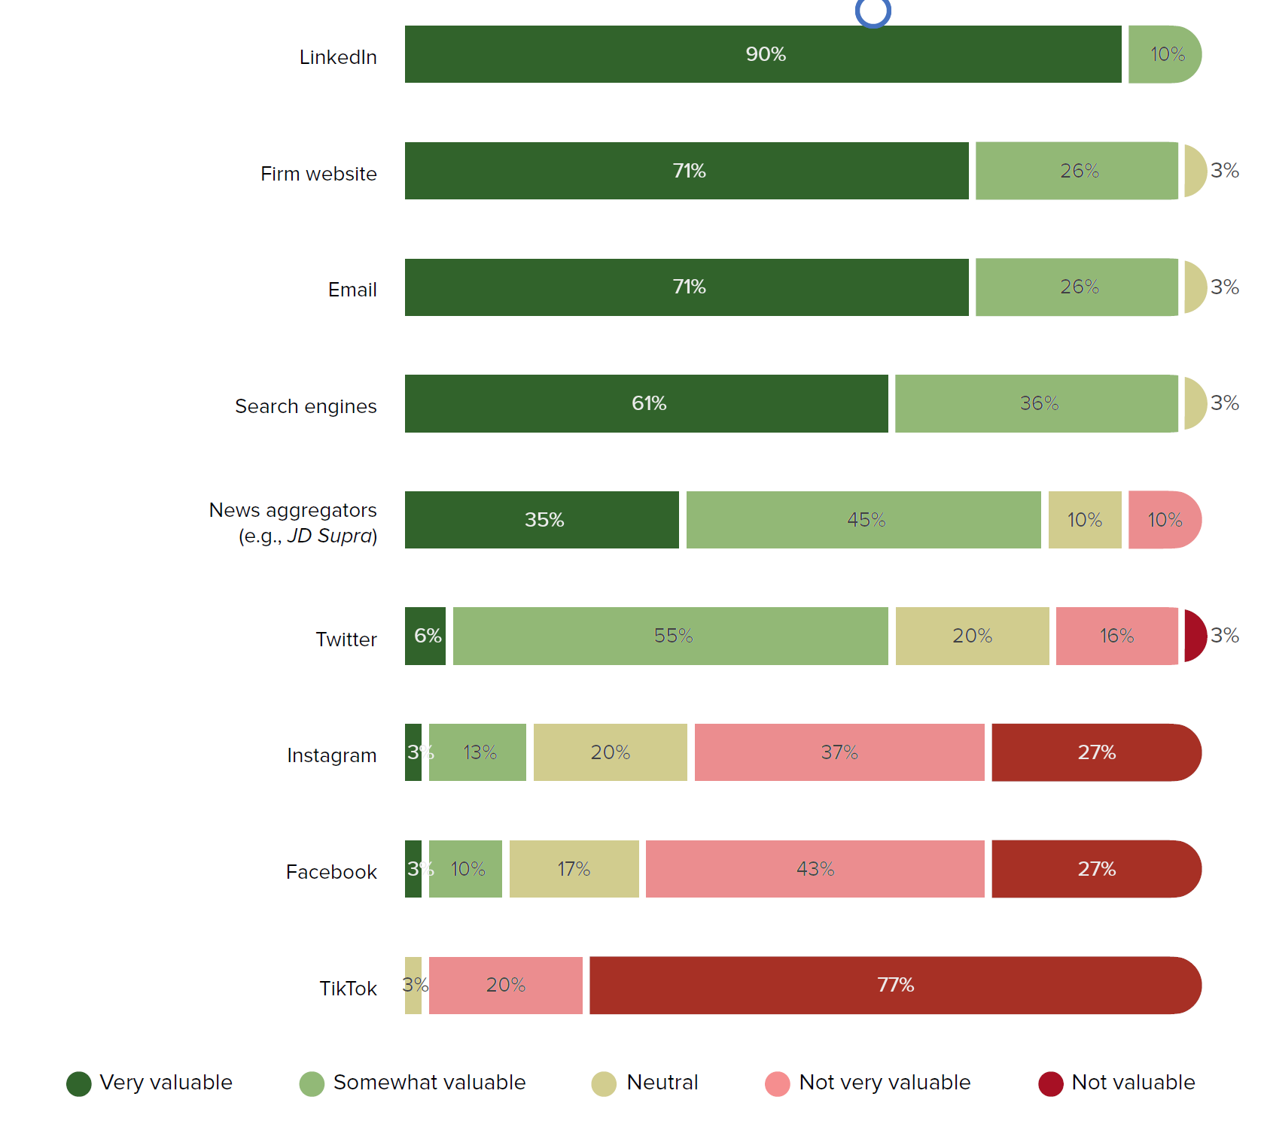
Platforms for content distribution purposes
How valuable are the following platforms for content distribution purposes?

Slide 9
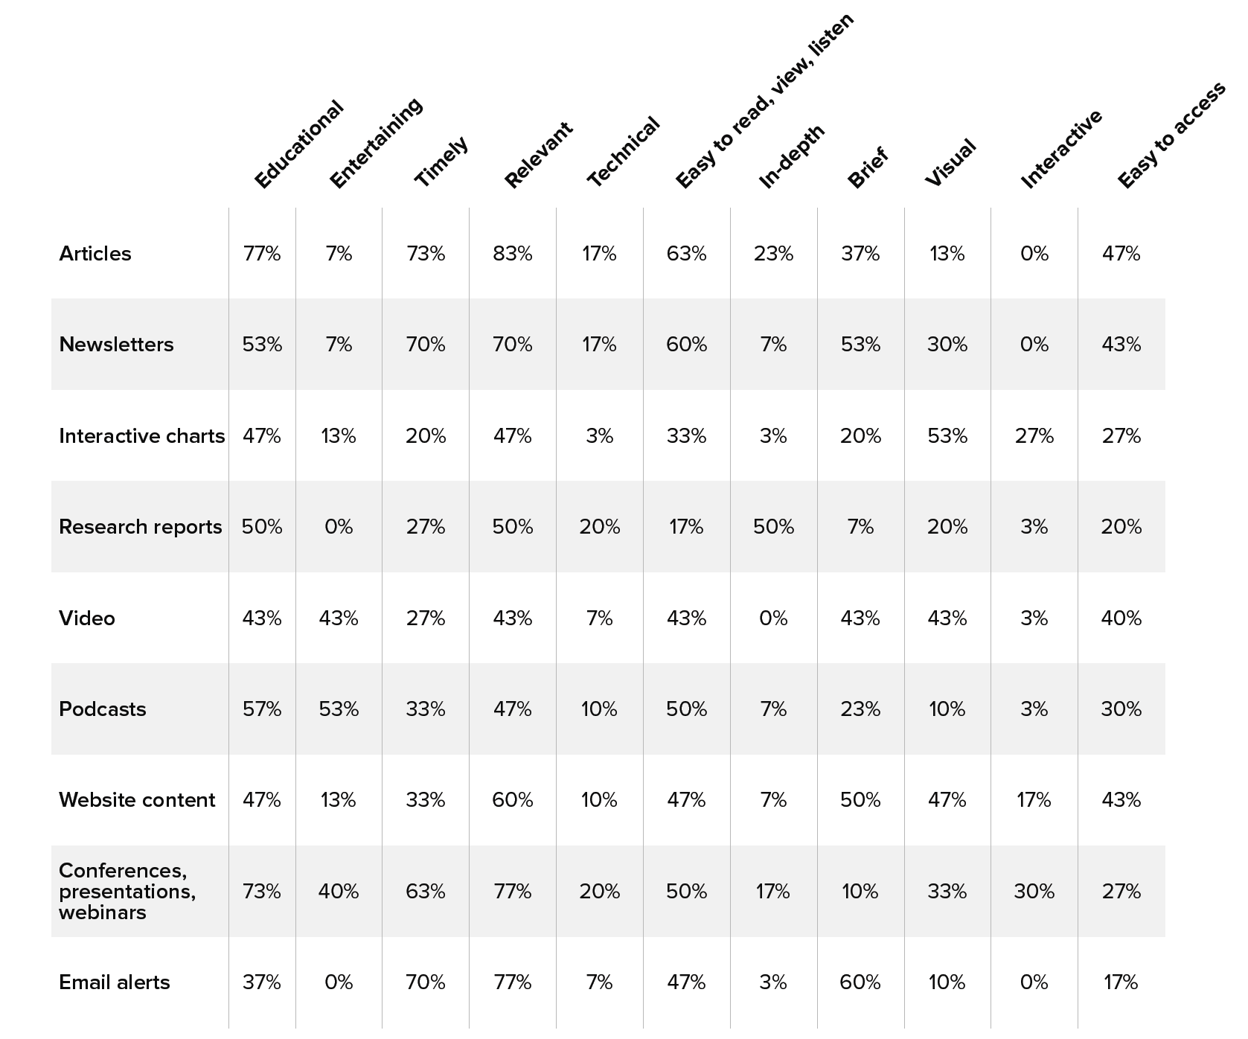
When to use which content and how?!
Which attributes do you believe readers/audiences appreciate most when it comes to each of the following types of content your firm produces?

Slide 10
Does your law firm have a overarching social media strategy in place?
Yes, we have a documented strategy
Yes, but not documented
No, but we are planning to have one
No

Slide 11
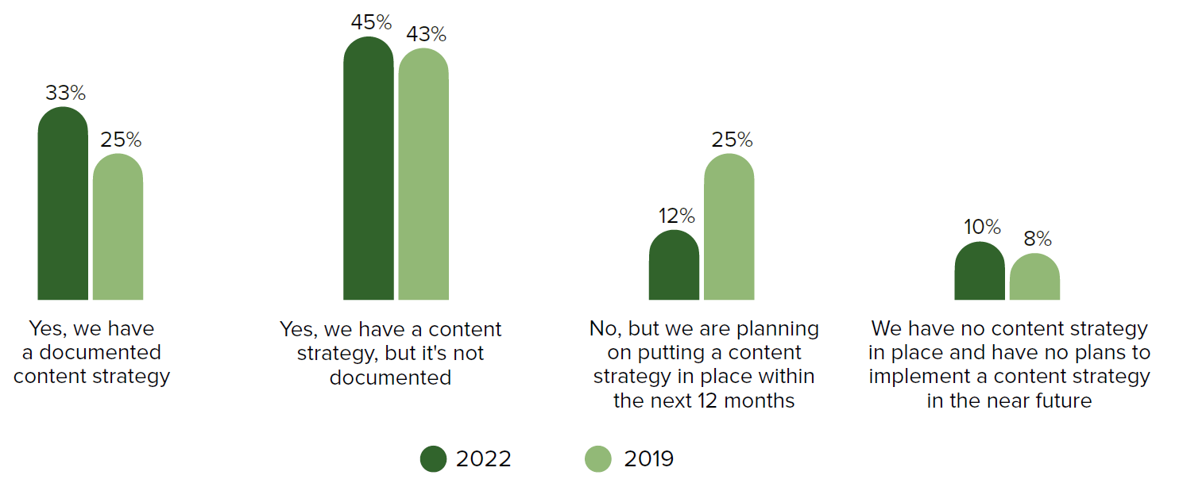
Social Media Strategy in Law Firms
Does your law firm have an overarching strategy in place?

Slide 12
Personal Brand or Company Brand in Social Media … or both?

Slide 13
Which topics do you post about the most?
(Word cloud)

Slide 14
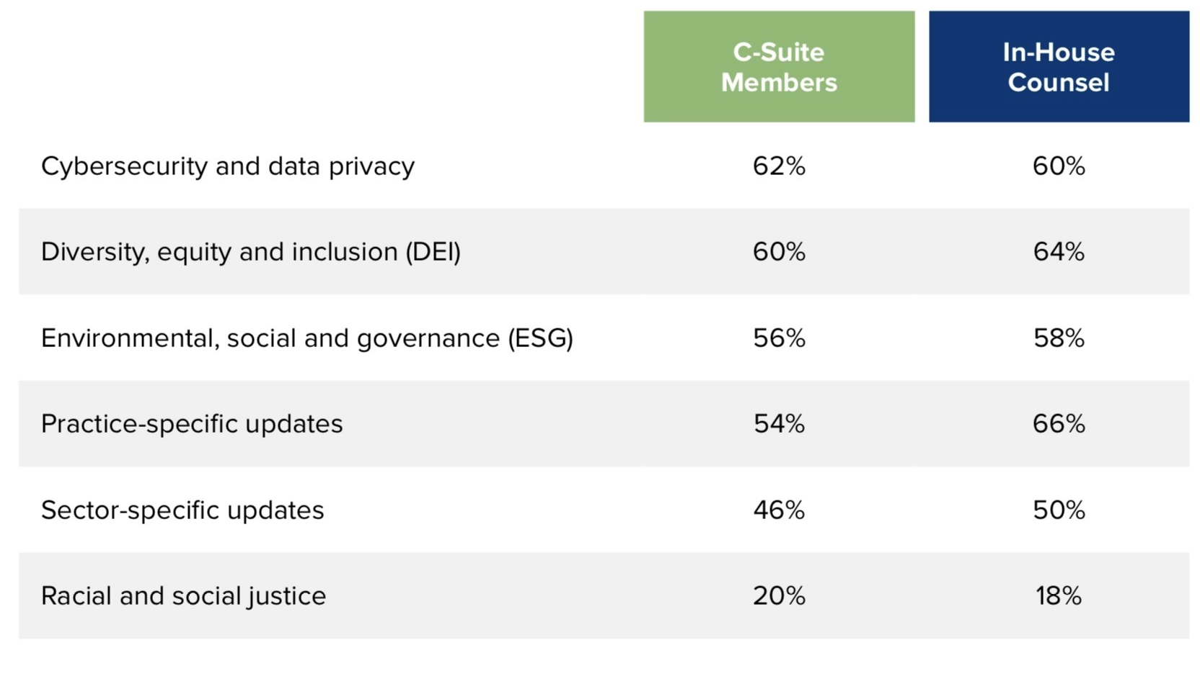
So… what are the hot topics clients want to hear about?

Slide 15
KPI’s, ROI’s, when is my Social Media activity successful?
Profile impressions
Profile reach
Followers
Audience growth rate
Engagement rate
Video plays
Posting frequency
Clicks
Shares

Slide 16
KPI’s, ROI’s, when is my Social Media activity successful?
Specific: Be as clear as possible. For example, do you hope to increase your firm’s LinkedIn follower count by 500 in the next month? Do you want to increase your click-through rates by 20% by the end of the year?
Measurable: Will you be able to track and quantify your progress? For example, during a monthly check-in, you should be able to determine how close you are to meeting the goal.
Attainable: Keep it real. Set KPIs that are within an achievable scope.
Relevant: Make sure each social media KPI connects to the firm’s larger goals.
Timely: What’s the timeframe for achieving this goal and determining whether success has been met? One month, six months, one year?

Slide 17
Key Takeaways:
The use of social networks is inevitable, but beneficial
Have a social media strategy that balances between individual and corporate brand promotion.
Have social media guidelines
Monitor social media use and be flexible – there are no rules set in stone and algorithmus changes.

Slide 18
Based on what you've learned so far, how would you design your Social Media personality?
Exercise

Slide 19
Contact Us!
Stephan Swinkels
Littler Shareholder | Netherlands | sswinkels@littler.com
ANDREEA HIRICA
Director Content Design Collibra | Brussels | andreea.hirica@gmail.com
SLAWEK PARUCH
Littler Poland Partner | Poland | sparuch@littler.com
KATARINA MATULNIKOVA
Managing Partner Wolf Theiss | Bratislava | katarina.matulnikova@wolftheiss.com

