Slide 1
Responding to workplace climate challenges in the 'global boiling' era

Slide 2
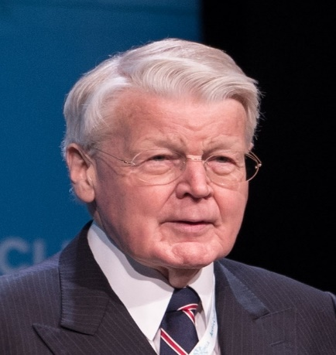
Halldór Þorgeirsson
Ólafur Ragnar Grímsson
Adriano Gomez
Feliciano F. González Muñoz
Prof. Dr. Björn Gaul

Slide 3
The status quo of climate change

Slide 4
Temperature
2023 was the warmest year on record. 10 warmest years in Europe occurred since 2007.
Since 1850-1900: Global: +1,3°C, Europe: +2,3°C, Arctic: +3,3°C.
2023: Record number of days with "extreme heat stress" (= feels like temperature of > 46°), especially in southern Europe with impacts for certain groups like construction workers, transport drivers, farmers, fishermen etc.
Atmospheric concentration of the greenhouse gases carbon dioxide and methane continued to increase on record level – highest level in at least hundreds of thousands of years.
(Source: https://climate.copernicus.eu/esotc/2023/temperature-and-thermal-stress)

Slide 5
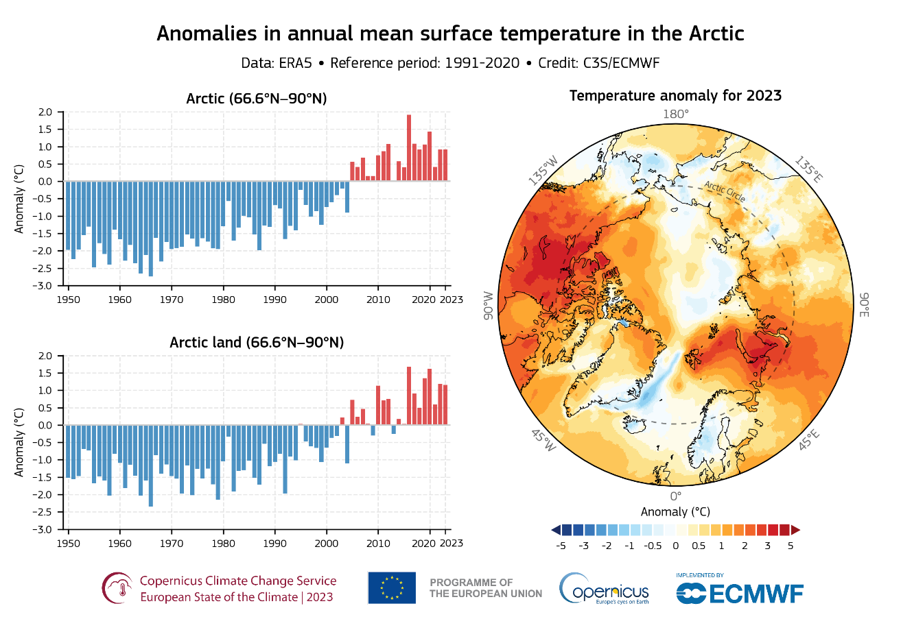
Arctic temperature
The Arctic has been one of the fastest-warming places on Earth (three times faster). 5 warmest years on record have occurred since 2016.
The warming of the Arctic has implications for ecosystems, indigenous populations, economic activities, and geopolitics.
(Source: https://climate.copernicus.eu/esotc/2023/arctic-temperature; https://climate.copernicus.eu/sites/default/files/custom-uploads/ESOTC%202023/Summary_ESOTC2023.pdf; page 17)

Slide 6
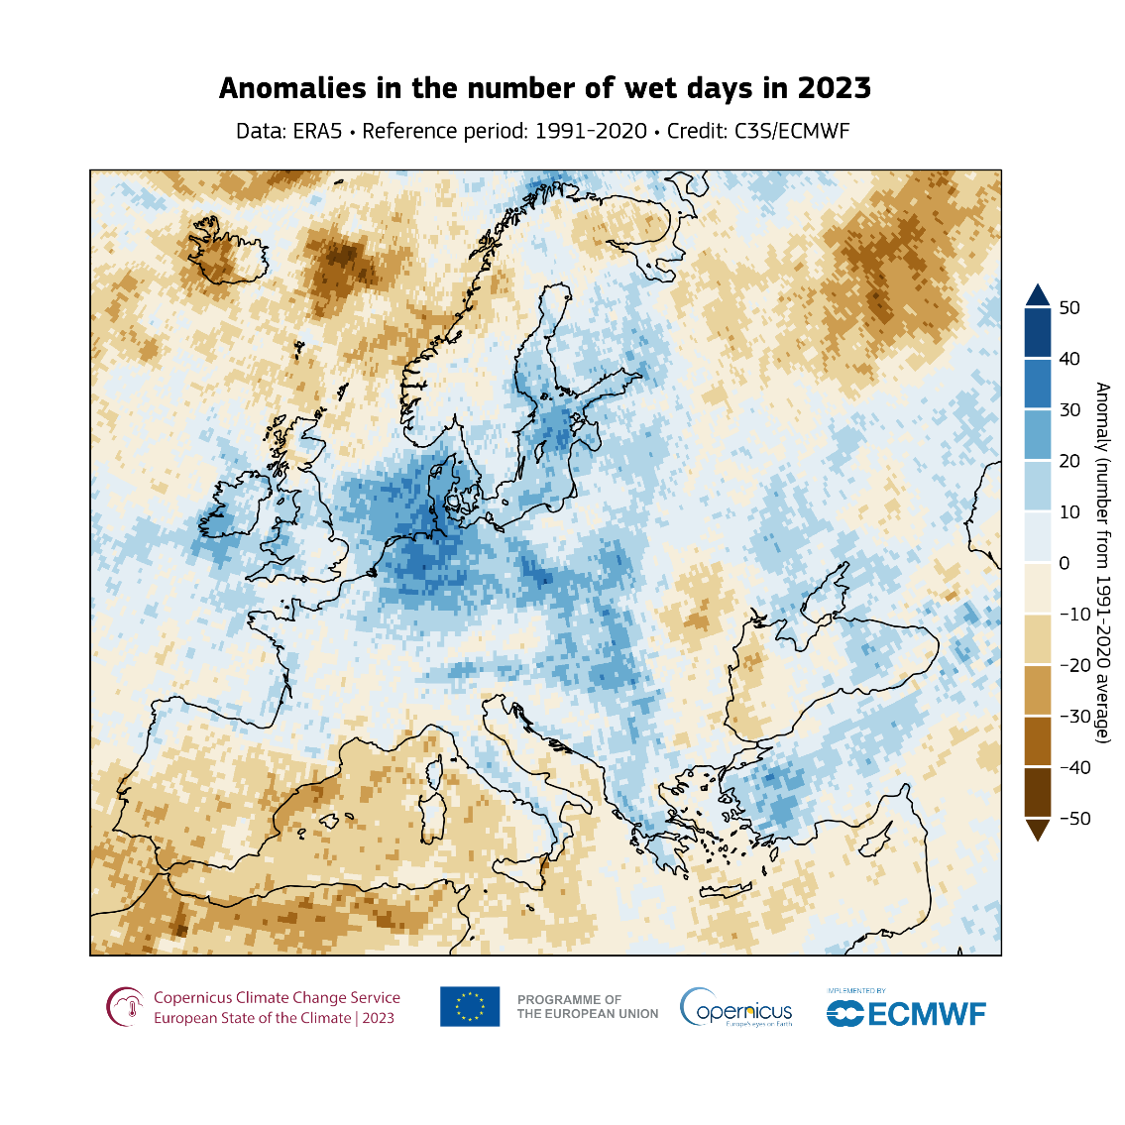
Precipitation
Precipitation is a key component for water cycle and essential for life. It is important for sectors such as food production and transport.
During 2023, Europe as a whole, was around 7 % wetter than average.
At the same time: Countries west of the Black Sea, southern France and the southern Iberian Peninsula experienced above-average drought especially from Februar to April.
(Source: https://climate.copernicus.eu/esotc/2023/precipitation)

Slide 7
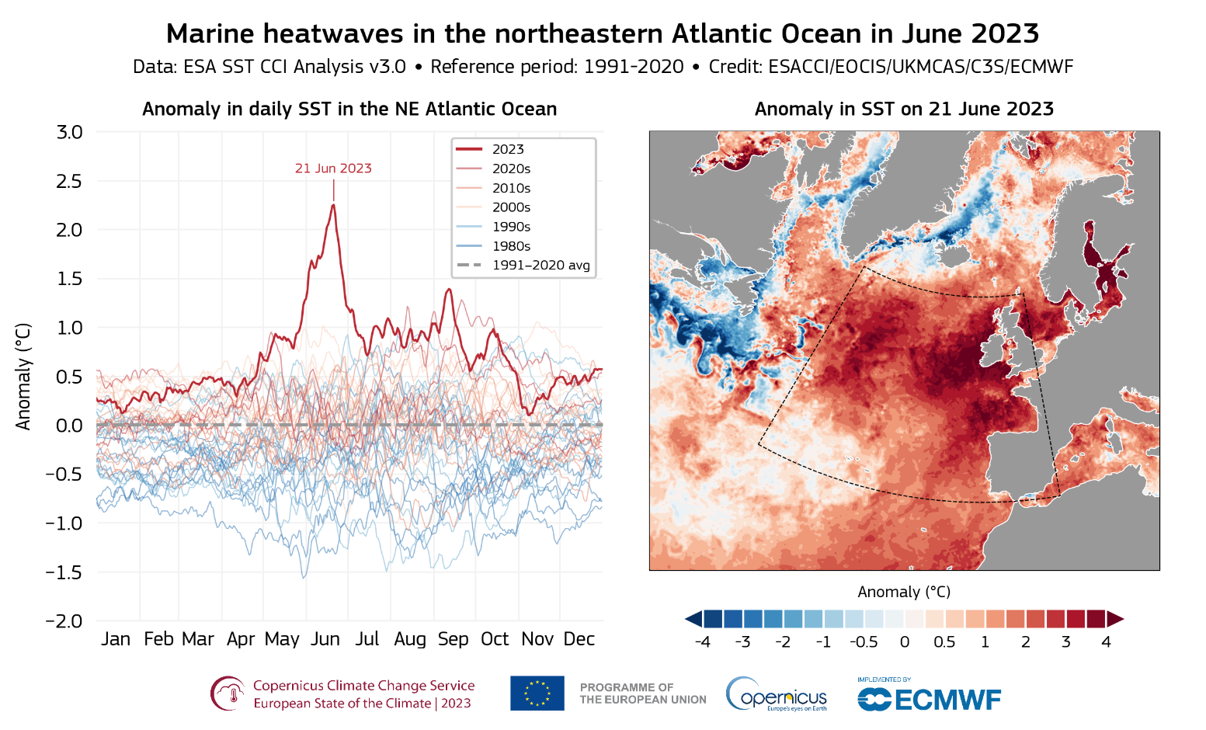
Marine heatwaves / sea level
Sea surface temperatures in 2023 were 5.5°C above average (UK, IRE, Mediterranean Sea). Marine heatwaves have significant / sometimes devasting impacts on ocean ecosystems and biodiversity
Pacific: Transitions from (warm) El Niño to (cold) La Niña.
Accelerating rise of global sea level (Ø 4,3mm/y)
(Source: https://climate.copernicus.eu/esotc/2023/european-ocean)

Slide 8
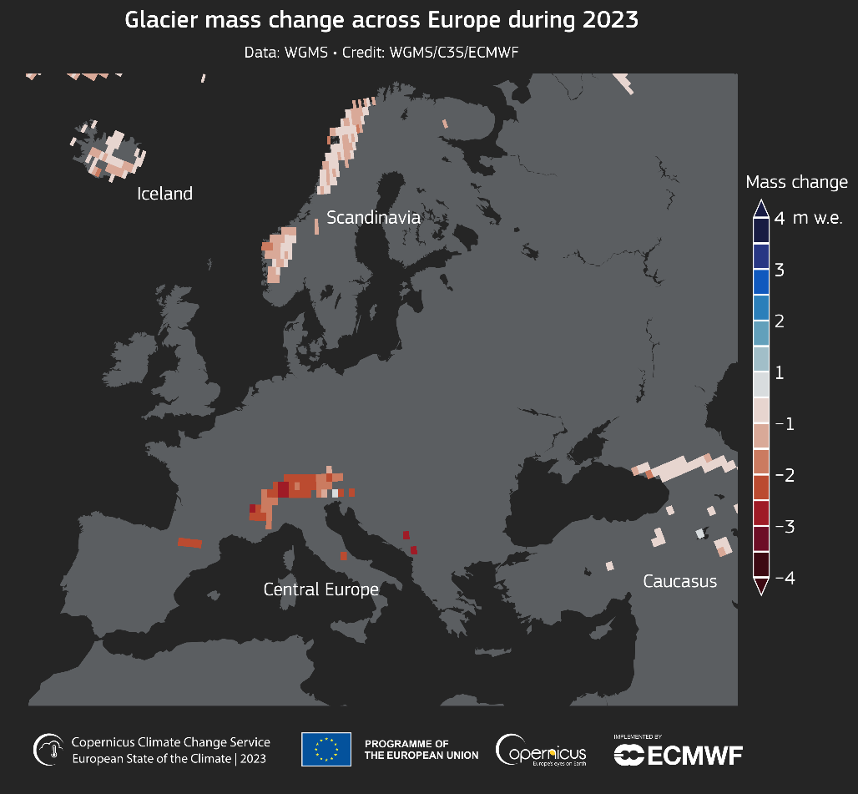
Glacier and sea ice
Between 2022 and 2023, glaciers in the Alps lost around 10% of their volume (= record loss)
Since 1976, Europe (including central Europe, Scandinavia, Iceland, the Caucasus, Svalbard and Jan Mayen, excluding peripheral glaciers in Greenland) has lost 850 km³ of glacier ice.
Arctic sea ice: Since the 1980s we can measure a loss of sea ice of around 2,6 mio. km²
(Source: https://climate.copernicus.eu/esotc/2023/snow-and-glaciers; https://climate.copernicus.eu/sites/default/files/custom-uploads/ESOTC%202023/Summary_ESOTC2023.pdf; page 15)

Slide 9
Panel Discussion

Slide 10
1
A scientist's view on the climate change

Slide 11
2
Holcim's journey to net zero

Slide 13
3
Sectors typically effected by climate change

Slide 14
Tourism: this industry is highly vulnerable to the impacts of rising temperatures
Construction: the sector must address infrastructure and sector decarbonization, as well as it is exposed to carbon taxes
Sectors particularly affected
Food and agriculture: shift towards green farming could stimulate demand for supplies and equipment, but the sector overall is expected to see reduced employment
Automotive industry: most predict major job losses in the manufacturing segment – between 275,000 and 410,000 by 2040 due to vehicles electrification
(Source: https://www2.deloitte.com/ce/en/pages/real-estate/articles/putting-the-construction-sector-at-the-core-of-the-climate-change-debate.html; https://www.mckinsey.com/capabilities/sustainability/our-insights/spotting-green-business-opportunities-in-a-surging-net-zero-world/transition-to-net-zero/food-and-agriculture; https://www.greeneuropeanjournal.eu/a-fight-for-every-job-decarbonising-europes-cars/#:~:text=Forecasts%20on%20how%20electrification%20will,European%20Association%20of%20Automotive%20Suppliers; https://www.weforum.org/agenda/2023/08/temperatures-tourism-climate-impact/)

Slide 15
4
Climate Change creating jobs?

Slide 16
Green industries and technologies are emerging to respond to this global emergency and could help in mitigation over the long term
Relocation of 5 million employees from the fossil fuel sector, but 14 million new jobs in the renewable sector, resulting in a net gain of 9 million in this pathway
More than 30 million jobs could be created in clean energy, efficiency and low-emissions technologies by 2030
(Source: https://www.ilo.org/media/535301/download; https://www.iea.org/commentaries/the-importance-of-focusing-on-jobs-and-fairness-in-clean-energy-transitions; https://www.iea.org/reports/world-energy-employment/overview)

Slide 17
Are there regional differences in Europe based
on the transformation to a sustainable Europe?
5

Slide 18
Capital cities such as Paris, Stockholm and Vilnius usually have a greater concentration of highly skilled workers, with the share of green-task jobs as high as 30%
Regions in southern Europe - in Greece, Italy, Portugal, and Spain tend to have a lower share of green-task jobs
Regions in the Baltic and Nordic countries score high on this measure
The lowest share of green-task jobs is found in Western Greece
(Source: https://www.oecd.org/newsroom/action-on-jobs-skills-and-regional-disparities-vital-for-the-green-transition.htm; https://www.oecd-ilibrary.org/sites/21db61c1-en/1/3/2/index.html?itemId=/content/publication/21db61c1-en&_csp_=f2842cfcbf9633a0ce68042bae4d00dd&itemIGO=oecd&itemContentType=book)

Slide 19
Possible measures for
an ecological transformation scenario
on a national or international level
6

Slide 20
Scope of the obligation to
protect employees' health and safety
7

Slide 21
MEASURE | COUNTRIES
Heat limits
Humidity limits
Organisation of working hours or compulsory resting
Artificial ventilation or air renewal
Mandatory prevention related to activities that involves extreme heat
Employers should provide fresh drinking water during heatwaves
(Source: https://entreprendre.service-public.fr/actualites/A16642?lang=en; https://eurogip.fr/wp-content/uploads/2023/08/EUROGIP_Working-in-extreme-heat-and-heatwaves-legislation-and-preventive-measures-at-international-level.pdf)

Slide 22
8
Legally binding standards at international level
for labor law in connection with climate change

Slide 23
9
Impact of ECHR rulings in climate change cases

Slide 24
Case Verein KlimaSeniorinnen Schweiz and Others v. Switzerland
Duarte Agostinho and others v. Portugal and 32 other states
Careme v. France
Result: Estimated
Result: Inadmissible/ Rejected
Conclusion: The respondent State exceeded its margin of appreciation and failed to comply with its positive obligations in the present context
POSSIBLE INFLUENCE IN OTHER SIX PENDING CASES IN THE ECHR AND IN DOMESTIC RULINGS
(Source: https://www.echr.coe.int/w/grand-chamber-rulings-in-the-climate-change-cases; https://www.google.com/url?sa=t&rct=j&q=&esrc=s&source=web&cd=&cad=rja&uact=8&ved=2ahUKEwjolfjbhbWGAxXH8gIHHS9eCGcQFnoECB4QAQ&url=https%3A%2F%2Fhudoc.echr.coe.int%2Fapp%2Fconversion%2Fpdf%2F%3Flibrary%3DECHR%26id%3D003-7566368-10398533%26filename%3DStatus%2520of%2520climate%2520applications%2520before%2520the%2520European%2520Court.pdf&usg=AOvVaw1rzPlI6vWbACG6z5CBDNqV&opi=89978449)

Slide 25
changing consumer behavior
due to an awareness of sustainability
on the labor market
10

Slide 26
11
Actions to fight climate change and
minimize the consequences for the workplace?

Slide 27
(More) legal regulations establishing an obligation
for companies to take measures
to achieve the climate targets of Paris and Dubai?
12

Slide 28
Financial Support for the necessary transformation
into sustainable and climate-friendly processes?
13

Slide 29
Participation of works councils and trade unions
for a more climate-friendly working environment
14

Slide 30
Proposal for a Directive on Corporate Sustainability Due Diligence: due diligence policy should be developed in prior consultation with the company’s employees and their representatives
Agreement between construction trade unions and employers' associations on workers' rights during heatwaves
Trade unions were consulted during the drafting process of the National Adaptation Plan
Clauses regarding sustainability have been established in collective bargaining agreements
Trade unions can influence European bodies and employers' associations to develop clearer guidelines and adaptation strategies related to climate change
Trade unions demand long-term objectives of climate policies with strategies on innovation, investments and qualification
(Source: ETUC-adaptation-climate-guide_DE_0.pdf, page 52; https://www.eurofound.europa.eu/en/resources/article/2018/germany-trade-unions-approach-climate-change-policies); https://data.consilium.europa.eu/doc/document/ST-6145-2024-INIT/en/pdf; https://www.europarl.europa.eu/doceo/document/TA-9-2024-0329_EN.html#title2)

Slide 31
15
Take-aways

Slide 32
Q & A

Slide 33
Thank's a lot to everyone!
Enjoy Reykjavik and the rest of Iceland!

