Slide 1
The EEA and Labour Law
Árni Páll Árnason
Vice-President

Slide 2
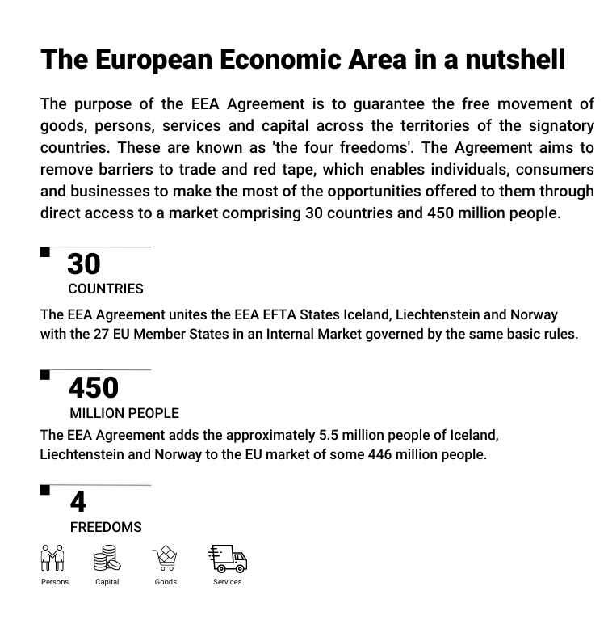
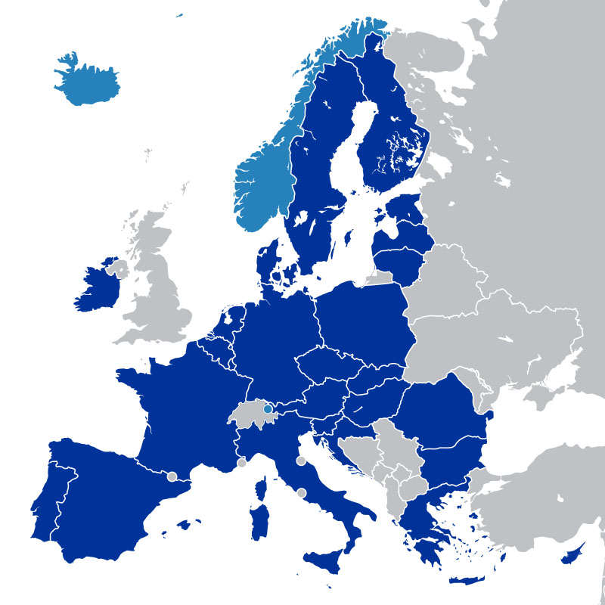
EEA-EFTA States
EU Member States

Slide 3
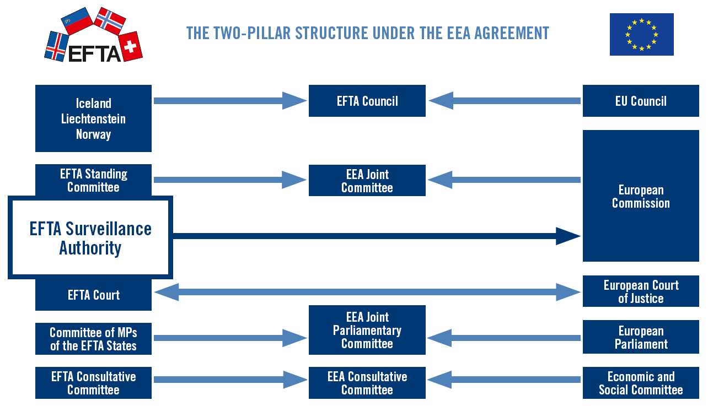
EEA Council
Notes:
Klippa til ESA/EU commission partinn

Slide 5
Within the scope of the EEA Agreement:
Four freedoms
Competition and State Aid
Environment and Energy
Food and veterinary
Transport and connectivity
Financial services
Public procurement …

Slide 6
Outside the scope of the EEA Agreement:
Agriculture, fisheries and forestry
Customs union and external trade
Taxation and tax policy
Defence and security
(…but the EEA Agreement may also affect those areas)

Slide 7
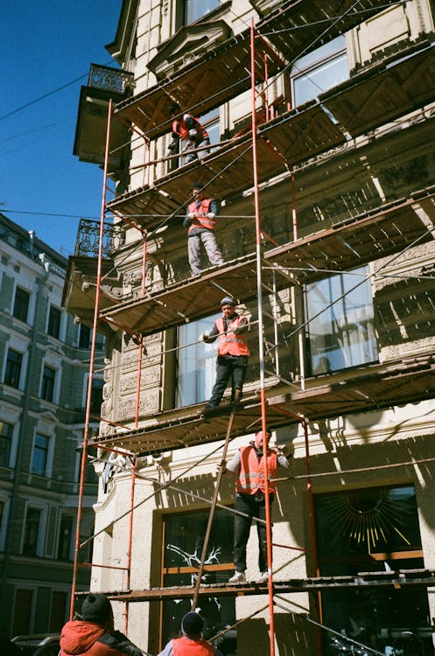
Temporary agency workers restrictions in Norway
Norwegian rules prevent the use of temporary agency workers “when the work is of a temporary nature”
Total prohibition in the construction sector in several municipalities
ESA assessment in LFN:
Unjustified and disproportionate restrictions
Advisory opinion pending from the EFTA Court

Slide 8
Paid annual leave – Norway and Iceland
Article 7 of the Working Time Directive:
All workers are entitled to at least four weeks of paid annual leave
Potential delay of up to one year or longer in allowing the exercise of accrued paid annual leave entitlements
Denmark had a similar system
Changed after Commission intervention
Norway working on changes following dialogue with ESA – continuing w Iceland

Slide 9
Advisory opinion – Working time during work travel
Reykjavik District Court asked: Does time spent by an employee travelling for work in the service of, and at the behest of their employer, when it falls outside traditional daytime work hours classify as working time?
EFTA Court: If a worker is required to undertake certain assignments away from his fixed or habitual place of attendance, travelling to and from that location must be considered an intrinsic aspect of his work. As a consequence, the necessary travel time must be considered to be “working time”

Slide 10
No policy or legislative role
Policy and legislative proposals
THE TWO-PILLAR STRUCTURE UNDER THE EEA AGREEMENT
EUROPEAN COMMISSION
EFTA SURVEILLANCE AUTHORITY
Enforcement
EFTA COURT
EU COURT OF JUSTICE

Slide 11
Thank you!

