Slide 1
Recent developments in EU Labour law
Catherine Barnard
Trinity College, Cambridge

Slide 2
Structure of talk
Agency workers
Equal Treatment Directive 2000/78
Fixed term work
Working time
Platform Work Directive

Slide 3
Agency workers

Slide 4
Case C-649/22 XXX v Randstad Empleo
Employers association
Trade unions
Agency
individual
User undertaking
CBA Eur 10,500
Equivalent worker: Eur 60,000

Slide 5
Case C-649/22 XXX v Randstad Empleo
Injured in his work as a handling operator at the user undertaking’s premises and permanently incapacitated
Article 5 of Dir 2008/104 ‘The basic working and employment conditions of temporary agency workers shall be, for the duration of their assignment at a user undertaking, at least those that would apply if they had been recruited directly by that undertaking to occupy the same job.
Art. 3(1)(f)(ii) basic working and employment conditions includes pay
44. [T]he concept of ‘pay’ is defined in Article 157(2) TFEU as ‘the ordinary basic or minimum wage or salary and any other consideration, whether in cash or in kind, which the worker receives directly or indirectly, in respect of his employment, from his employer’. As is apparent from the case-law, that concept must be interpreted broadly and it covers, in particular, any consideration, whether in cash or in kind, whether immediate or future, provided that the worker receives it, albeit indirectly, in respect of his employment from his employer, and irrespective of whether it is received under a contract of employment, by virtue of legislative provisions or on a voluntary basis (judgment of 8 May 2019, Praxair MRC, C‑486/18, EU:C:2019:379, paragraph 70).

Slide 6
Case C-649/22 XXX v Randstad Empleo
The first subparagraph of Article 5(1) of Directive 2008/104/EC, read in conjunction with Article 3(1)(f) thereof, … preclude[es] national legislation, as interpreted by national case-law, under which the compensation to which temporary agency workers are entitled in respect of a total permanent incapacity to carry out their usual occupation as a result of an accident at work sustained at the user undertaking and resulting in the termination of their temporary employment relationship, is less than the compensation to which those workers would be entitled, in the same situation and on the same basis, if they had been recruited directly by that user undertaking to occupy the same job for the same period of time.

Slide 7
Case C-631/22 Ca Na Negreta
Article 5 of Council Directive 2000/78/EC … establishing a general framework for equal treatment in employment and occupation, read in the light of Articles 21 and 26 of the Charter of Fundamental Rights of the European Union and Articles 2 and 27 of the United Nations Convention on the Rights of Persons with Disabilities,… , must be interpreted as precluding national legislation which provides that an employer may terminate the employment contract on the ground that the worker is permanently unable to perform the tasks entrusted to him or her under that contract, on account of a disability occurring during the employment relationship, without the employer first being required to make or maintain reasonable accommodation in order to enable that worker to keep his or her job, or to demonstrate, where appropriate, that such accommodation would constitute a disproportionate burden.

Slide 8
Equal treatment Directive 2000/78

Slide 9
Overview: the principle of non-discrimination in Dir 2000/78
Measure, policy, practice
Direct discrimination (Art. 2(2)(a))
Indirect discrimination Art. 2(2)(b))
ORs
ORs
Proportionate means of achieving a legitimate aim (Objective justification)
General OR
(Art. 4(1))
Ethos based employer OR (Art. 4(2))
Art. 2(5) Directive is without prejudice to measures laid down by national law which, in a democratic society, are necessary for public security, public order, prevention of criminal offences, protection of health and protection of rights and freedoms of others

Slide 10
Case C-518/22 JMP v AP Assistenprofis
AP Assistenzprofis offers disabled persons assistance and advisory services in relation to ‘the self-determined and independent management of their everyday life’
company published a job offer stating that A., a 28-year-old female student, was looking for female personal assistants, who should be ‘preferably between 18 and 30 years old’, to help her in all areas of everyday life.
J.M.P. was born in 1968, applied for that job but was rejected; claimed direct discrimination on the grounds of age
German law provides that provides that, when deciding on personal assistance services and in the performance of those services intended to promote the disabled person’s participation in the community, the legitimate wishes of the persons entitled to receive those services are to be respected, in so far as those wishes are reasonable and by taking account of those persons’ personal circumstances, age, sex, family and religious and philosophical needs.

Slide 11
Case C-518/22 JMP v AP Assistenprofis
58. the legislation under which that measure was adopted pursues an objective of protecting the self-determination of persons with disabilities, by guaranteeing those persons’ right to express their wishes and to make choices freely as regards decisions on the personal assistance services and their provision, since those services concern all areas of life and extend considerably into the private and intimate areas of the life of the person in receipt of them. That legislation thus seeks to guarantee the right of persons with disabilities to organise how they live their life in as self-determined and independent a manner as possible.
59 … that objective comes within the scope of Article 2(5) of Directive 2000/78, inasmuch as it is intended to protect the right to self-determination of persons with disabilities, in accordance with which those persons must be able to choose how, where and with whom they live.

Slide 12
Case C-518/22 JMP v AP Assistenprofis
61 it is important to point out that the right to express wishes and to choose freely referred to in paragraph 58 above gives specific expression to the right of persons with disabilities to measures aimed at ensuring their independence, social and occupational integration and participation in the life of the community, which forms part of the rights recognised by EU law, in accordance with Article 26 of the Charter.
62 In addition, respect for the self-determination of persons with disabilities is also an objective enshrined in Article 19 of the UN Convention, the provisions of which may be relied on for the purpose of interpreting Directive 2000/78, including Article 2(5) thereof. That directive must be interpreted, to the extent possible, in a manner consistent with that convention (see, to that effect, judgment of 11 September 2019, Nobel Plastiques Ibérica, C‑397/18, EU:C:2019:703, paragraph 40 and the case-law cited).

Slide 13
Case C-518/22 JMP v AP Assistenprofis
63. it is important to ascertain whether a difference of treatment on grounds of age, such as that at issue in the main proceeding, is the result of a measure that is necessary for the protection of the rights and freedoms of others, within the meaning of Article 2(5) of that directive and, in particular, the protection of the right to self-determination of the disabled person concerned in the provision of personal assistance services.
65 Accordingly, in a situation such as that in the main proceedings, taking account of the preference for a certain age range expressed by the disabled person in receipt of personal assistance services is likely to promote respect for that person’s right to self-determination in the provision of those personal assistance services, inasmuch as it appears reasonable to expect that a person within the same age range as the disabled person will fit more easily in that person’s personal, social and university circle.

Slide 14
Overview: the principle of non-discrimination in Dir 2000/78
Measure, policy, practice
Direct discrimination (Art. 2(2)(a))
Indirect discrimination Art. 2(2)(b))
ORs
ORs
Proportionate means of achieving a legitimate aim (Objective justification)
General OR
(Art. 4(1))
Ethos based employer OR (Art. 4(2))
Art. 2(5) Directive is without prejudice to measures laid down by national law which, in a democratic society, are necessary for public security, public order, prevention of criminal offences, protection of health and protection of rights and freedoms of others

Slide 15
Case C-148/22 OP v Commue d’Ans
applicant worked for the municipality since 11 April 2016 as ‘head of office’, a function she performed in the ‘back office’.
She has carried out her duties without wearing any signs which might reveal her religious beliefs until 8 February 2021, the date on which she requested that she be able to wear a ‘headscarf at work’ from 22 February 2021; this was rejected
On 29 March 2021, the municipal board of the municipality amended its terms of employment by inserting a requirement of ‘exclusive neutrality’ in the workplace, understood as prohibiting all municipal workers from wearing, in that workplace, any visible sign that might reveal their beliefs – religious or philosophical in particular – whether or not they were in contact with the public. Article 9 provides, :
  ‘Workers have freedom of expression in accordance with the principle of neutrality, their duty of discretion and their duty to act in good faith.
  Workers are required to observe the principle of neutrality, which means that they must refrain from any form of proselytising and that they are prohibited from wearing any overt sign which might reveal their ideological or philosophical affiliation or political or religious beliefs. This rule applies both to their contacts with the public and to their working relationships with hierarchical superiors and colleagues.

Slide 16
Case C-148/22 OP v Commue d’Ans
- indirect discrimination (G4S Secure Solutions, C‑157/15, EU:C:2017:203, paragraph 34, and of 15 July 2021, WABE and MH Müller Handel, C‑804/18 and C‑341/19, EU:C:2021:594, paragraph 59).
- such a difference in treatment does not, however, amount to indirect discrimination if it is objectively justified by a legitimate aim and if the means of achieving that aim are appropriate and necessary.

Slide 17
Case C-148/22 OP v Commue d’Ans
39 it should be noted that the legitimate objective of ensuring, through a policy of ‘exclusive neutrality’ as established by Article 9 of the terms of employment at issue in the main proceedings, an entirely neutral administrative environment can be effectively pursued only if no visible manifestation of beliefs – philosophical or religious in particular – is allowed when employees are in contact with users of the public service or with other employees, since the wearing of any sign, even a small-sized one, undermines the ability of that measure to achieve the aim allegedly pursued and therefore calls into question the consistency of that policy. … Such a rule is therefore necessary.
40 It will still be for the referring court, in the light of all the factors characteristic of the context in which that rule was adopted, to weigh up the interests at stake, taking into account, on the one hand, the fundamental rights and principles at issue, namely, in this case, the right to freedom of thought, conscience and religion guaranteed by Article 10 of the Charter of Fundamental Rights, the corollary of which is the prohibition of any discrimination based on religion enshrined in Article 21 thereof and, on the other hand, the principle of neutrality pursuant to which the public administration concerned seeks to guarantee, by means of the said rule limited to the workplace, the users of its services and the members of its staff an administrative environment devoid of visible manifestations of beliefs, philosophical or religious in particular.

Slide 18
C‑157/15 Achbita
43. In the present case, so far as concerns the refusal of a worker such as Ms Achbita to give up wearing an Islamic headscarf when carrying out her professional duties for G4S customers, it is for the referring court to ascertain whether, taking into account the inherent constraints to which the undertaking is subject, and without G4S being required to take on an additional burden, it would have been possible for G4S, faced with such a refusal, to offer her a post not involving any visual contact with those customers, instead of dismissing her. It is for the referring court, having regard to all the material in the file, to take into account the interests involved in the case and to limit the restrictions on the freedoms concerned to what is strictly necessary.

Slide 19
Fixed term work

Slide 20
Direct effect of unimplemented or incorrectly implemented Directives after Case C-715/20 KL
Duty of consistent interpretation: Marleasing, Pfeiffer
No HDE
3. Case C-715/20 KL (underlying provision is directly effective; need remedy; MS implementing EU law so Charter applies (Art. 51(1)) and so MS must ensure compliance with right to effective remedy enshrined in Art. 47; individuals can rely in Art. 47 (horizontally); national court disapply conflicting national law
State
Vertical
direct
Effect
Marshall I
Individual
Individual
no horizontal
direct effect

Slide 21
Working time

Slide 22

Annual leave
Joined Cases C‑271/22 to C‑275/2 XT Article 31(2) of the Charter of Fundamental Rights of the European Union and Article 7 of Directive 2003/88/EC means that a worker may rely on the right to paid annual leave, enshrined in the former provision and given concrete expression by the latter, against his or her employer and the fact that the employer is a private undertaking, holding a public service delegation, is irrelevant in that regard.
Article 7 of Directive 2003/88 must be interpreted as not precluding national legislation and/or a national practice which, in the absence of a national provision laying down an express temporal limit on the carry-over of entitlements to paid annual leave accrued and not exercised due to a long-term absence from work due to illness, allows requests for paid annual leave submitted by a worker less than 15 months after the end of the reference period in which the entitlement to that leave arose and limited to two consecutive reference periods to be granted.
Case C-218/22 BU Article 7 of Directive 2003/88/EC and Article 31(2) of the Charter of Fundamental Rights of the European Union must be interpreted as precluding national legislation which, for reasons relating to the control of public expenditure and the organisational needs of the public employer, prohibits the payment to a worker of an allowance in lieu of the days of paid annual leave acquired, during both the last year of employment and previous years, which were not taken at the date on which the employment relationship ended, where that worker voluntarily terminates that employment relationship and has not shown that he or she had not taken his or her leave during that employment relationship for reasons beyond his or her control.

Slide 23
Annual leave
Case C‑206/22 TF Article 7(1) of Directive 2003/88/EC and Article 31(2) of the Charter must be interpreted as not precluding national legislation or practice that does not permit the carry-over of days of paid annual leave which were granted to a worker who is not sick in respect of a period coinciding with a period of quarantine ordered by a public authority on account of that worker having been in contact with a person infected with a virus.
  Case C-57/11 YQ Article 7(1) of Directive 2003/88/EC must be interpreted as precluding national case-law by virtue of which a worker who was unlawfully dismissed and then reinstated in his or her employment, in accordance with national law, following the annulment of his or her dismissal by a decision of a court, is not entitled to paid annual leave for the period between the date of the dismissal and the date of his or her reinstatement in his or her employment on the ground that, during that period, that worker did not actually carry out work for the employer as the latter did not assign him or her work and as he or she is already entitled, under national law, to wage compensation during that period.

Slide 24
Platform work directive

Slide 25
The Directive
Commission: ‘over 28 million people in the EU work through digital labour platforms. In 2025, their number is expected to have reached 43 million’.
Basic presumption: platforms present world of opportunity; flourishing of business models; job creation
Regulate only address the negative consequences of platform work: balance
  Interests of platforms
  Interests of individuals
  FHR
Text pdf (europa.eu); implementation 2 years after coming into force

Slide 26

headlines
Adopted 11 Mar
Legal basis Art. 153 and Art. 16
  Significant role of GDPR
Covers ‘phygital’ (Uber situation) and online work
Legal presumption in favour of platform worker status
Directive only applies to platforms

Slide 27
Personal scope

Slide 28
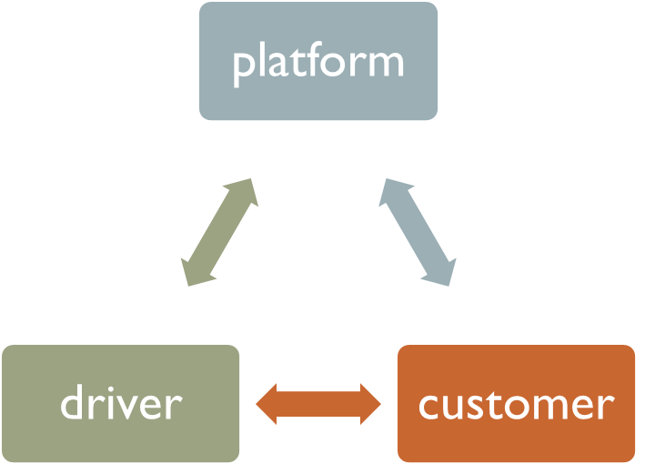
Gig economy standard operating model
Contract/ self-employed
B2C contract?
app
Contr-act??

Slide 29
Binary divide
Self-employed
(no employment protection; protection of civil/commercial law)
Worker (employment protection)
Dependent/
vulnerable
Independent
risk /reward
False self-employed?

Slide 30
Binary divide: platforms
Commission proposal
Self-employed (no employment protection; protection of civil/commercial law)
Worker (employment protection)
Including ‘false self employed’
Genuine self employed
All rights for workers in other social Directives + TAR rights in PWD
Some TAR rights in PWD
Effect of Platform Work Directive (PWD)

Slide 31
who are the beneficiaries of the Directive?
‘Platform worker’ (PW) means any person performing platform work who has an employment contract or is deemed to have an employment relationship as defined by the law, collective agreements or practice in force in the Member States with consideration to the case-law of the Court of Justice Art. 2(1)(4)
‘Person performing platform work’ (PPPW) means any individual performing platform work, irrespective of the nature of the contractual relationship or its designation by the parties involved (Art. 2(1)(3))
Also applies to PPPW via intermediaries
PPPW
PW
Some TAR rights in PWD
All TAR rights in PWD
Plus rights in all other social directives
Art. 2(1)(2): ‘platform work’ means any work organised through a digital labour platform and performed in the Union by an individual on the basis of a contractual relationship between the digital labour platform or an intermediary and the individual, irrespective of whether a contractual relationship exists between the individual or an intermediary and the recipient of the service

Slide 32
Platform work Directive
Art. 2(1)(1): ‘Digital labour platform’ means ‘any natural or legal person providing a service which meets all of the following requirements:
(a) it is provided, at least in part, at a distance through electronic means, such as a website or a mobile application;
(b) it is provided at the request of a recipient of the service;
(c) it involves, as a necessary and essential component, the organisation of work performed by individuals in return for payment, irrespective of whether that work is performed online or in a certain location;
(d) it involves the use of automated monitoring or decision-making systems
platform
customer
driver
App

Slide 33
 | Platform Workers | Persons Performing Platform Work | GDPR Inspiration
Chapter III Algorithmic management |  |  | Chapter II: Principles
Limitations on processing of personal data by means of automated decision making (Art. 7) | Yes | Yes | Art 6 (grounds) and Art 9 (special category data) – adds clear redlines
Data protection impact assessment (Art. 8) | Yes | Yes | Art 35: Impact Assessment
Transparency on automated monitoring or decision-making systems (Art. 9) | Yes | Yes | Art 12, Art 13: Transparency and Information
Human oversight of automated decision making (Art. 10) | Yes | Yes | Art 22: Ban on automated individual decision-making in particular contexts
Human review (Art. 11) | Yes | Yes | Art 16: Right to rectification
Safety and health (Art. 12) | Yes | No
Information and consultation (Art. 13) | Yes | No
Information of workers (Art. 14) | Yes | No
Specific arrangements for representatives of PPPW other than PWs’ representatives (Art. 15) | Yes | Yes | Art 35(9): controller’s duty to ‘seek views’

Slide 34
Chapter V remedies and enforcement | PW | PPPW | GDPR
Right to redress (Art. 18) | Yes | Yes | Ch VIII, esp Art 79 and Art 82
Procedures on behalf or in support of PPPWs (Art. 19) | Yes | Yes | Art 15 (individual access)
Communication channels for PPPWs (Art. 20) | Yes | Yes
Protection from adverse treatment or consequences (Art. 22) | Yes | Yes
Protection from dismissal | Yes | Yes

Slide 35
Legal presumption

Slide 36
Who is a ‘Platform worker’?
Platform worker’ means any person performing platform work who
has an employment contract or
is deemed to have an employment relationship as defined by the law, collective agreements or practice in force in the Member States with consideration to the case-law of the Court of Justice
Legal presumption

Slide 37
Presumption of worker status (commission)
1.The contractual relationship between a digital labour platform that controls, within the meaning of paragraph 2, the performance of work and a person performing platform work through that platform shall be legally presumed to be an employment relationship. To that effect, Member States shall establish a framework of measures, in accordance with their national legal and judicial systems.
The legal presumption shall apply in all relevant administrative and legal proceedings. Competent authorities verifying compliance with or enforcing relevant legislation shall be able to rely on that presumption.
2.Controlling the performance of work within the meaning of paragraph 1 shall be understood as fulfilling at least two of the following:
(a)effectively determining, or setting upper limits for the level of remuneration;
(b)requiring the person performing platform work to respect specific binding rules with regard to appearance, conduct towards the recipient of the service or performance of the work;
(c)supervising the performance of work or verifying the quality of the results of the work including by electronic means;
(d)effectively restricting the freedom, including through sanctions, to organise one’s work, in particular the discretion to choose one’s working hours or periods of absence, to accept or to refuse tasks or to use subcontractors or substitutes;
(e)effectively restricting the possibility to build a client base or to perform work for any third party.
Emphasis on control

Slide 38
The issues: presumption
Commission
initial Commission proposal said that presumption triggered if two out of five criteria;
Council
three out of seven criteria
Parliament
wanted to exclude the presumption from social security, tax and criminal proceedings.
wanted to remove criteria altogether. Any hint of subordination to platforms could have the presumption be trigger [‘No criteria’];
Oct 2023 any one out of 8 criteria
EU policymakers brace for clash in thorny debate over platform workers’ status – Euractiv; now pdf (europa.eu)

Slide 39
Final version
Article 4 Correct determination of the employment status
1. Member States shall have appropriate and effective procedures in place to verify and ensure the correct determination of the employment status of persons performing platform work, with a view to ascertaining the existence of an employment relationship as defined by the law, collective agreements or practice in force in the Member States, with consideration to the case-law of the Court of Justice, including through the application of the presumption of an employment relationship in accordance with Article 5.
2. The determination of the existence of an employment relationship shall be guided primarily by the facts relating to the actual performance of work, including the use of automated monitoring or decision-making systems in the organisation of platform work, irrespective of how the relationship is classified in any contractual arrangement that may have been agreed between the parties involved.
3. Where the existence of an employment relationship is established, the party or parties assuming the obligations of the employer shall be clearly identified in accordance with national legal systems.

Slide 40
Final version
Pres-umption
Article 5 Legal presumption
1. The contractual relationship between a digital labour platform and a person performing platform work through that platform shall be legally presumed to be an employment relationship when facts indicating control and direction, according to national law, collective agreements or practice in force in the Member States and with consideration to the case-law of the Court of Justice, are found. Where the digital labour platform seeks to rebut the legal presumption, it shall be for the digital labour platform to prove that the contractual relationship in question is not an employment relationship as defined by the law, collective agreements or practice in force in the Member States, with consideration to the case-law of the Court of Justice.
2. To that effect, Member States shall establish an effective rebuttable legal presumption of employment that constitutes a procedural facilitation to the benefit of persons performing platform work, and Member States shall ensure that that legal presumption does not have the effect of increasing the burden of requirements on persons performing platform work, or their representatives, in proceedings ascertaining their employment status.
3. The legal presumption shall apply in all relevant administrative or judicial proceedings where the correct determination of the employment status of the person performing platform work is at stake. The legal presumption shall not apply to proceedings which concern tax, criminal and social security matters. However, Member States may apply the legal presumption in those proceedings as a matter of national law
rebuttal
Recital 32

Slide 41
Final version: Article 5 cont’d
4. Persons performing platform work, and, in accordance with national law and practice, their representatives, shall have the right to initiate the proceedings referred to in paragraph 3 first subparagraph for ascertaining the correct employment status of the person performing platform work.
5. Where a competent national authority considers that a person performing platform work might be wrongly classified, it shall initiate appropriate actions or proceedings, in accordance with national law and practice, in order to ascertain the employment status of that person.
6. With regard to contractual relationships entered into before and still ongoing on the date set out in Article 29(1), the legal presumption referred to in this Article shall only apply to the period starting from that date

Slide 42
Article 6 Framework of supporting measures
Member States shall establish a framework of supporting measures in order to ensure the effective implementation of and compliance with the legal presumption. In particular, they shall:
(a) develop appropriate guidance, including in the form of concrete and practical recommendations, for digital labour platforms, persons performing platform work and the social partners to understand and implement the legal presumption including on the procedures for rebutting it;
(b) develop guidance and establish appropriate procedures in line with national law and practice for competent national authorities, including on the collaboration between different competent national authorities, to proactively identify, target and pursue digital labour platforms which do not comply with rules on correct determination of the employment status
(c) provide for effective controls and inspections conducted by national authorities, in line with national law or practice, and in particular provide, where appropriate, for controls and inspections on specific digital labour platforms where the existence of an employment status of a person performing platform work has been ascertained by a competent national authority, while ensuring that such controls and inspections are proportionate and non-discriminatory.
(d) provide for appropriate training for competent national authorities and provide for the availability of technical expertise in the field of algorithmic management, to enable those authorities to carry out the tasks referred to under point (b).

Slide 43

Pros and cons of the new approach
Advantages
  There was agreement
  Subsidiarity
  Different systems of IR
Disadvantages
  Lack of harmonisation
  Justification for EU rules?
  Uber et al have deeper pockets and can fight every case

Slide 44
Rights/obligations under the Directive

Slide 45
Algorithmic management
Art. 7 Limitations on processing of personal data by means of automated monitoring or decision-making systems
Art. 8 Data protection impact assessment
Article 9 Transparency on automated monitoring or decision-making systems
Article 10 Human oversight of automated systems
Article 11 Human review
Article 12 : Safety and health (platform workers)
Article 13 Information and consultation (platform workers’ representatives)
Article 14 Information of workers (platform workers)
Article 15 Specific arrangements for representatives of persons performing platform work other than platform workers’ representatives

Slide 46
Algorithmic management: Art. 7
1. Digital labour platforms shall not, by means of automated monitoring or decision-making systems:
(a) process any personal data on the emotional or psychological state of the person performing platform work;
(b) process any personal data in relation to private conversations, including exchanges with other persons performing platform work and their representatives;
(c) collect any personal data while the person performing platform work is not offering or performing platform work;
(d) process personal data to predict the exercise of fundamental rights, including the right of association, the right of collective bargaining and action or the right to information and consultation, as defined in the Charter;
(e) process any personal data to infer racial or ethnic origin, migration status, political opinions, religious or philosophical beliefs, disability, state of health, including chronic disease or HIV status, the emotional or psychological state, trade union membership, a person's sex life or sexual orientation;
(f) process any biometric data, as defined in Article 4, point (14), of Regulation (EU) 2016/679, of a person performing platform work to establish that person’s identity by comparing that data to stored biometric data of individuals in a database
2.The provisions of this Article shall apply to all persons performing platform work from the start of the recruitment or selection procedure.
3. In addition to automated monitoring and decision-making systems, this Article shall also apply to digital labour platforms where they use automated systems supporting or taking decisions that affect persons performing platform work in any manner.

Slide 47


Slide 48
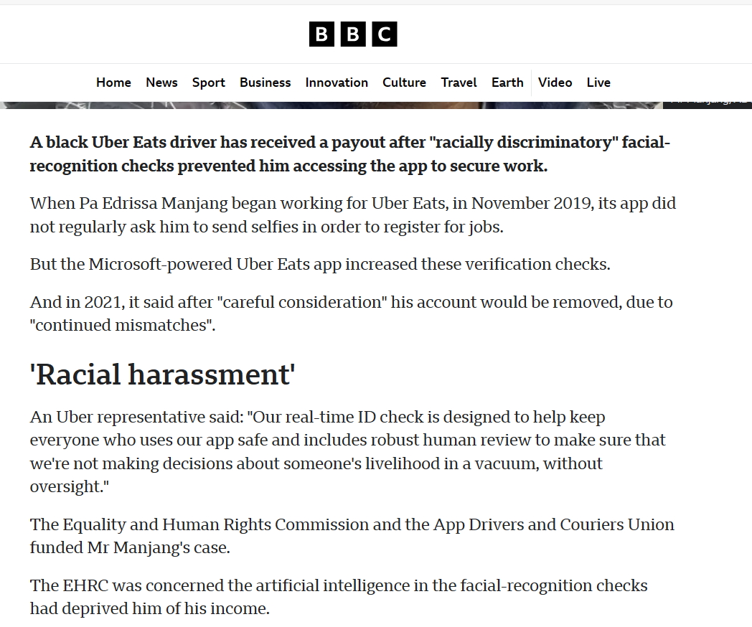
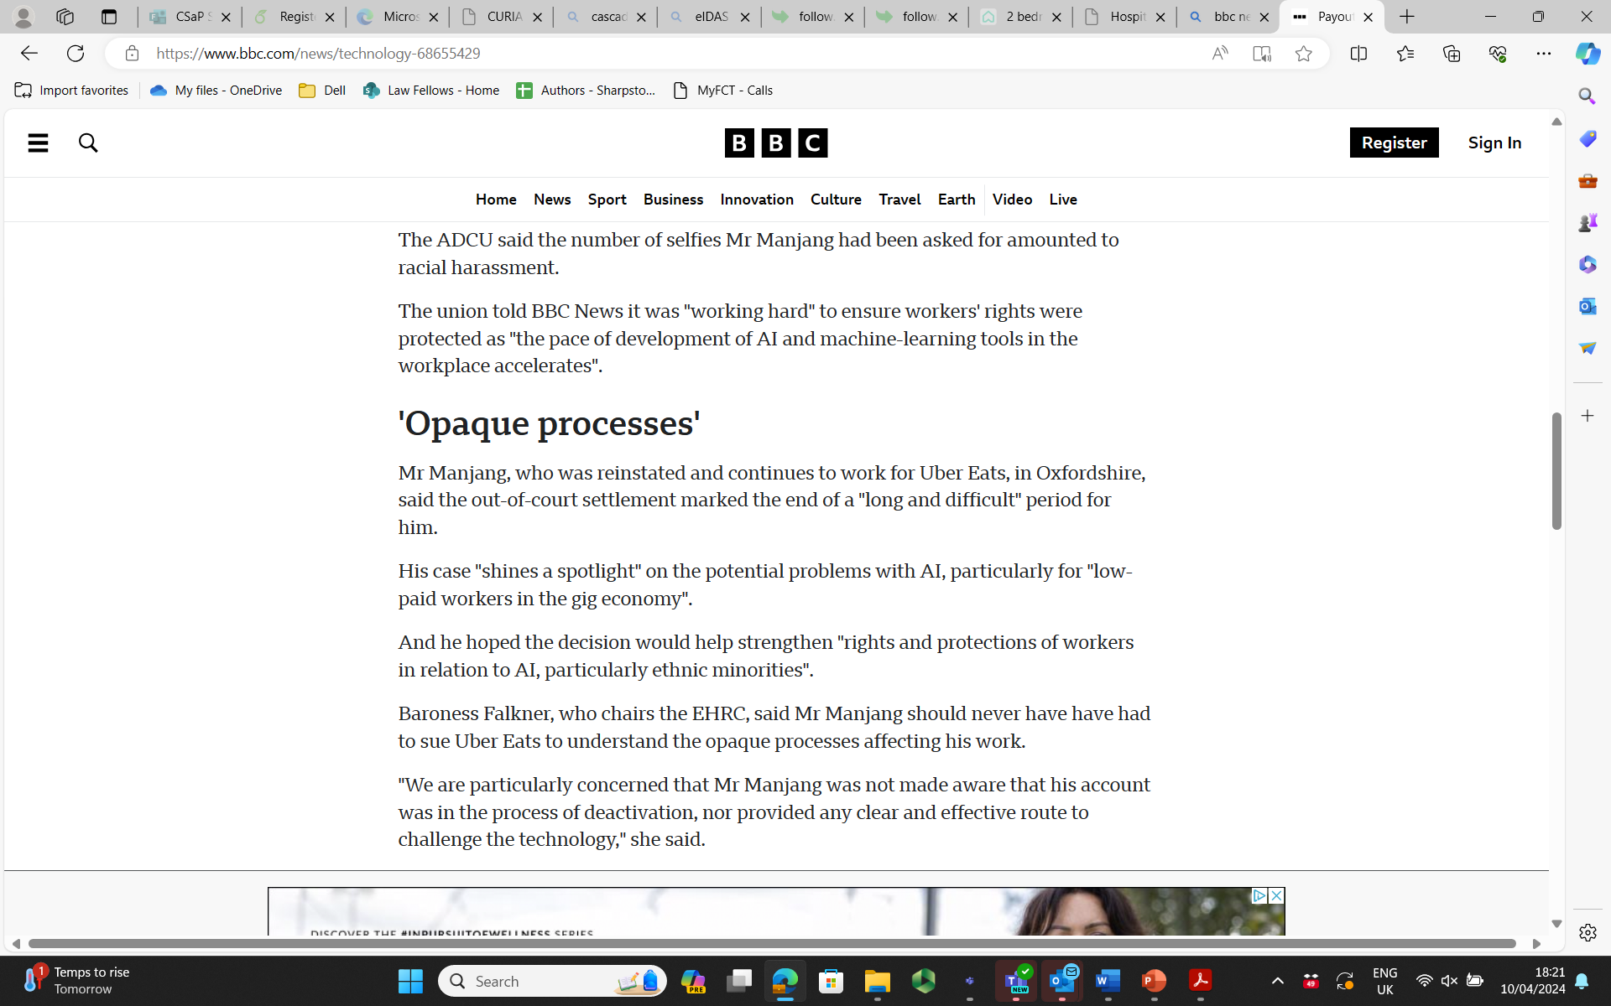

Slide 49
Other provisions
Chapter IV transparency on platform work
Article 16 Declaration of platform work
Article 17 Access to relevant information on platform work
Chapter V remedies and enforcement
Article 18 Right to redress
Article 19 Procedures on behalf or in support of persons performing platform work
Article 20 Communication channels for persons performing platform work
Article 21 Access to evidence
Article 22 Protection against adverse treatment or consequences
Article 23 Protection from dismissal
Article 24 Supervision and penalties

