Slide 1
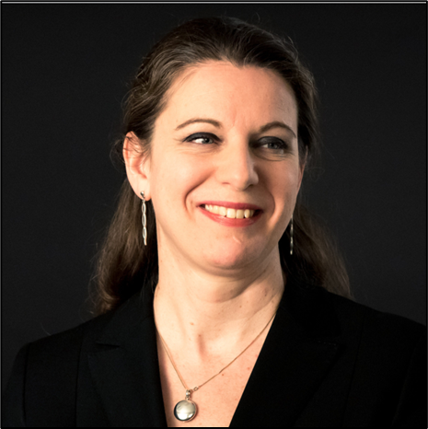
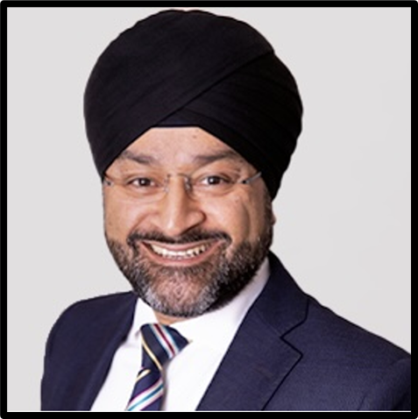
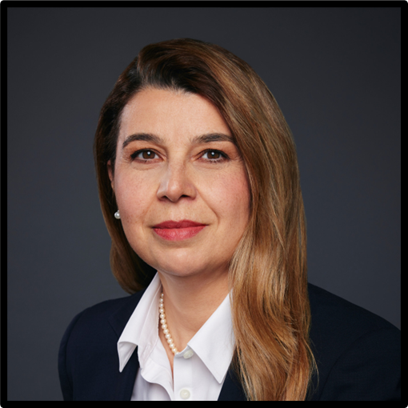
INVESTIGATIONS MASTERCLASS
7 June 2024, EELA Reykjavík
Anne Pritam, UK, Partner, Stephenson Harwood LLP, London.
Mohinderpal Sethi KC, UK, Littleton Chambers, London.
Daniela David, Romania, Senior Partner, Vernon David, Bucharest.
Bryan Black, Switzerland/Ireland, Head of European Legal Affairs at Incyte Corporation, Morges.

Slide 2
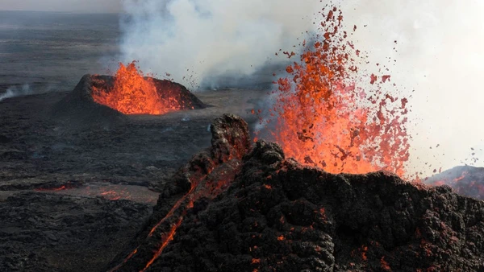
Introducing Volcano Inc.
Dramatis Personae:
An impatient CEO
Viktor
Erika
Anna
Bernard
Jenny
An independent investigator
You
3 Groups each with two paragraphs to consider
A discussion led by our speakers
Feedback from each group
Round-up from each speaker
A sting in the tail
Team Daniela: Paragraphs 1 & 2
Team Mo: Paragraphs 3 & 4
Team Bryan: Paragraphs 5 & 6
Notes:
1 harassed – meaning what. Is the association meaningful or should you ignore it.
Suspension – when is it appropriate?

Slide 3
Volcano Inc is your client. A junior employee Erika has made a complaint against Viktor, its CFO. She says he is a bully and that he’s harassed two of her colleagues. The CEO intensely dislikes Viktor. 4 years ago Viktor was disciplined for drunkenly attempting to kiss a colleague at the Christmas party. The CEO wants Viktor to be suspended immediately and instructs you to start an investigation “so that we can remove him permanently”. How do you respond?
You say you cannot carry out the investigation and an external independent investigator should do it. An investigator is identified but she says she can’t start her investigation without agreed terms of reference that define the scope of the investigation. You draft terms of reference for the CEO to review; he sends the draft document to all members of the Volcano Inc board for their comments. He calls you to ask what he should do next.
Notes:
DANA

Slide 4
1 & 2
Looking at the issues in the round
Sector specific regulatory issues
Identifying your client
Independent or internal or lawyers’ investigation?
Privilege & conflict
Exercising powers of suspension

Slide 5
In the meantime, Volcano’s HR officer Jenny has interviewed Erika. She says Viktor came back to the office after a business lunch. He was drunk and insisted on giving Anna a shoulder massage. He patted Bernard’s bottom. Anna and Bernard refuse to give witness statements to Jenny but Bernard says he is thinking of reporting Viktor to the police. Jenny interviews Viktor and puts Erika’s accusations to him, anonymously. He demands to know who is accusing him of what, and says he is totally innocent. Viktor also says the entire Board of Directors supports him, this is a plot by the CEO to remove him, and that they must all be interviewed as witnesses if this is to be a fair investigation. He says all of this is putting him under severe mental strain. Jenny calls you to ask if what she did was right and when she should interview the Directors.
With your assistance, the terms of reference are finally agreed between the external investigator and the Board. The investigator says she will take her own statements and interview witnesses, with Jenny taking notes. Viktor is called to an investigation meeting. He refuses to be in a room with Jenny. He also wants his lawyer to attend the meeting with him. The investigator refuses to allow the lawyer to attend. Viktor says that is a breach of his human rights but agrees to continue the meeting, under protest and on condition that he can record it on his phone. The investigator calls you to ask what she should do.
Notes:
MO

Slide 6
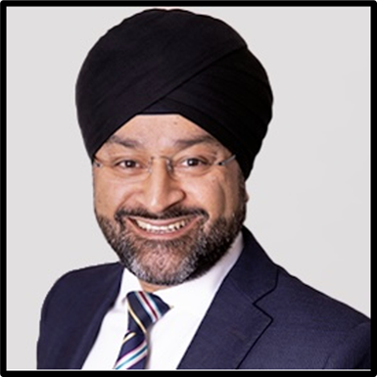
3 & 4
Impact of criminal allegations & right of non-incrimination
Boundaries and why terms of reference matter
Witnesses – who, how many & who chooses?
Disclosure of evidence including statements
Impact of refusals & sickness on process
Who is in the investigation room?
Recordings

Slide 7
The investigator meets with Erika. Erika is told her investigation interview will be recorded, just as Viktor's was. She demands to have a copy of the recording of both her and his interview, and a copy of the report when written. The investigator calls you to ask what she should say.
Following the investigation, the investigator concludes that there was poor behaviour on Viktor's part and recommends executive coaching and D&I training. Following a period of sickness absence for stress, Viktor has a disciplinary hearing and is given a warning, a coach and D&I training. Jenny calls Erika, Anna and Bernard to a meeting to tell them that Viktor will be back in the office soon, that he has suffered poor mental health, and that everyone must look forward and work together positively.

Slide 8
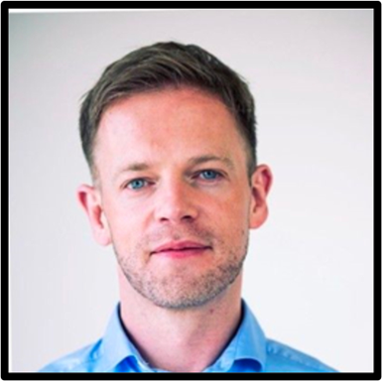
5 & 6
Sharing information about the investigation
Competing employee demands
Status of investigation outcome: decision or recommendation?
If recommendation: who will make decision?
Impartiality at hearing and appeal level
The power of “soft” outcomes
The ongoing impact of a disruptive incident in the workplace – cultural and legal
The in-house/private practice partnership

Slide 9
The day before he is due to return to work, a local news website publishes an online story "All heat but no fire - Sex-pest CFO keeps job at Volcano Inc", with a photo of Erika. The CEO calls you and asks how you are going to put things right for the company.

Slide 10
7
High risk for clients
Culture
Reputation
An expanding & rewarding area of our practice
Needs wide legal horizons
Always expect the unexpected…

